Slide 1
Key environmental challenges & the role of the Sustainable Development Goals (SDGs): water management
Carla Chiaretti – Head of Policy
European Parliament, 19 November 2019

Slide 2
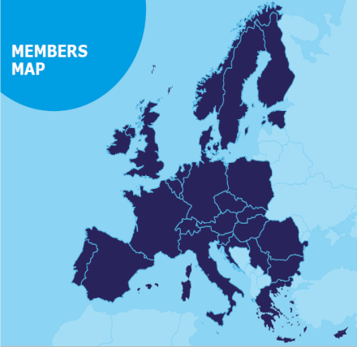
EurEau - Who we are
European Federation of Water Services
32 national associations of drinking and waste water operators from 29 European countries
Public and private sector
Provide safe and wholesome drinking water 24/7
Ensure that waste water is returned safely to the environment.

Slide 3
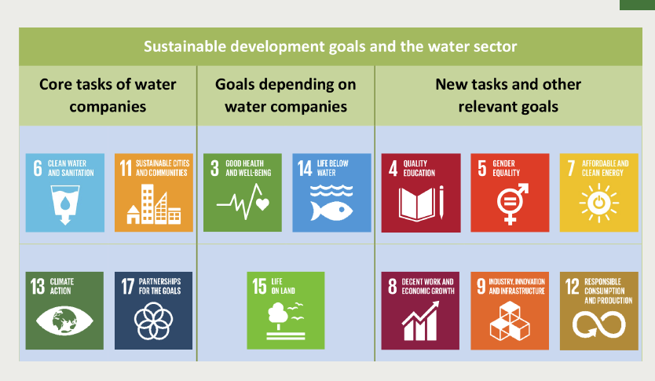
SDG6 at EU level
”Water is not a commercial product like any other, but, rather, a heritage which must be protected, defended and treated as such” – WFD, 2000
Source: DANVA
Notes:
UN GA definition of human right to water:
Availability
Accessibility
Affordability
Acceptability
Safety

Slide 4
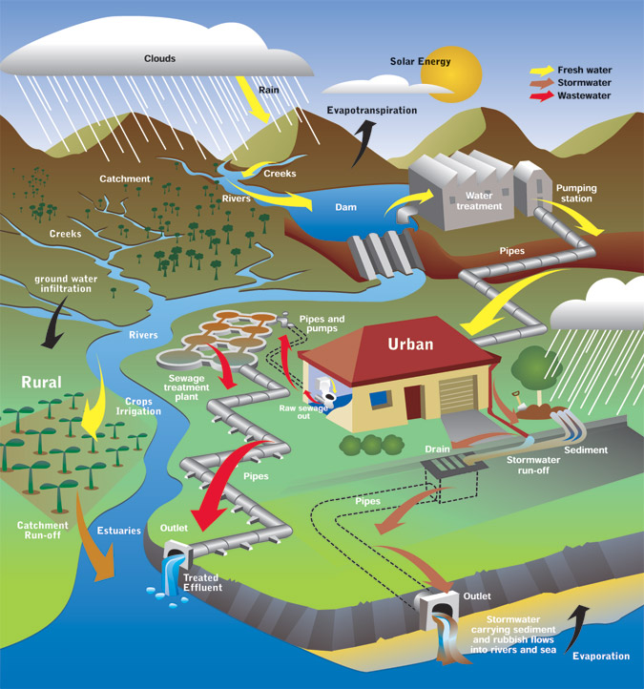
Water Framework Directive= Water Law
Drinking Water Directive
Ground Water Directive
Water Reuse Reg
Nitrates Directive
Priority Substances
Directive
Urban Waste Water Treatment
Directive
Industrial Emissions
Directive
Bathing Water
Directive
Source: EUROPEAN COMMISSION
Notes:
4

Slide 5
A compass for MEPs
UN GA definition of human right to water – SDG6:
  Availability
  Accessibility
  Affordability
  Acceptability
  Safety
Art.191.2 TFEU
    “The Union policy on the environment [..] shall be based on the precautionary principle and on the principles that preventive action should be taken, that environmental damage should as a priority be rectified at source and that the polluter should pay.”
Without source-control and polluter-pays: impossible to deliver sustainable and affordable water services to future generations.

Slide 6
Carla Chiaretti
Head of Policy
carla.chiaretti@eureau.org
Notes:
What does it mean to achieve the SDG6 in the EU?

