Slide 1
working for Zero Hunger
Hosted by
MEP Biljana Borzan
& MEP Angelique Delahaye
European Community of Consumer Co-operatives
Do Good: Save Food!
Educating future generations for a zero food waste world
- Bringing Consumers Onboard -
TODOR IVANOV
Secretary-General
Brussels, Belgium
European Parliament

Slide 2
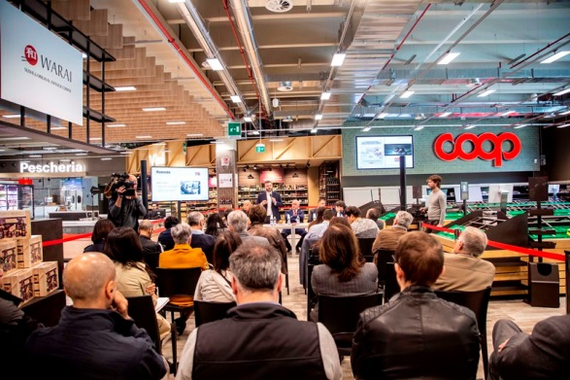
Hosted by
MEP Biljana Borzan
& MEP Angelique Delahaye
working for Zero Hunger
- Bringing Consumers Onboard -
The Facts
European association of consumer co-operatives
Members: national associations & individual consumer co-operative societies
Est. 1957 – oldest European COOP association
The Numbers
20 countries
7,000 local consumer co-operatives
700,000 employees
76,000 points of sale
34 million consumer-members
> € 76 billion annual retail turnover
Co-ops are different: people-first & inherent responsibility
Co-op Principle V: Education, training and information
Brussels, Belgium
European Parliament

Slide 3
Hosted by
MEP Biljana Borzan
& MEP Angelique Delahaye
working for Zero Hunger
- Bringing Consumers Onboard -
Engaging Consumers (our members, our owners)
DK => mobile app “Too Good To Go” = a guide on managing food
IT => “Coop Knowledge” (est. 1979) = educational materials for schools
=> “Coop No Waste Community”
ES => campaign: i) a study; ii) guide to managing food; iii) public lectures
NO => est. country’s 1st food bank
Co-op Retail Practices
SE => campaign “wonky veggies” = change perception of “ugly” veggies
UK => eliminate “last minute” price deals = rather, donate to charity
FI & DK => biogas programs
IT => lobby for new law = allow more donations & food promotions
Brussels, Belgium
European Parliament

Slide 4
working for Zero Hunger
Hosted by
MEP Biljana Borzan
& MEP Angelique Delahaye
European Community of Consumer Co-operatives
WE HAVE A LOT OF WORK TO DO!
THANK YOU FOR YOUR ATTENTION!
TODOR IVANOV
Secretary-General
Brussels, Belgium
European Parliament

