Slide 1
Leading the Race To Zero In The Fisheries Sector
Towards a Carbon Neutral Aquatic Food Production
The sector’s perspective
Jérôme Jourdain
Union des Armateurs à la Pêche de France - UAPF

Slide 2
The maritime sector must reduce its GHG emissions
Where to place EU fisheries sector ?
The Paris Agreement (2015) brings all nations to undertake ambitious efforts to combat climate change and adapt to its effects
Two options :
  Follow the IMO targets: 40% less emissions in 2030 compared to 2008; 50% less in 2050 ;
  Be subject to European or national measures that tend towards neutrality in 2050, with environmental taxation of fuels or fuel consumption reduction targets
  EU Green Deal, « Fit for 55 », etc.

Slide 3
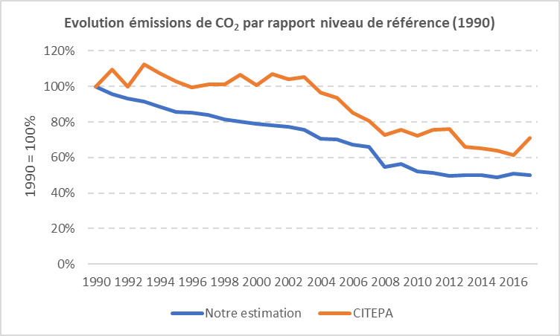
Continuous decline CO2 emissions from EU fleet :
-50% in 2017 compared to 1990
EU Fishing sector has already come a long way to reduce Carbon Aquatic Food Production
EU rules for managing the capacity of the EU fishing fleet : engine power was only 59% of the engine power recorded in 1990
It is undeniable that technological progress has improved the efficiency of EU fishing vessels since 1990

Slide 4
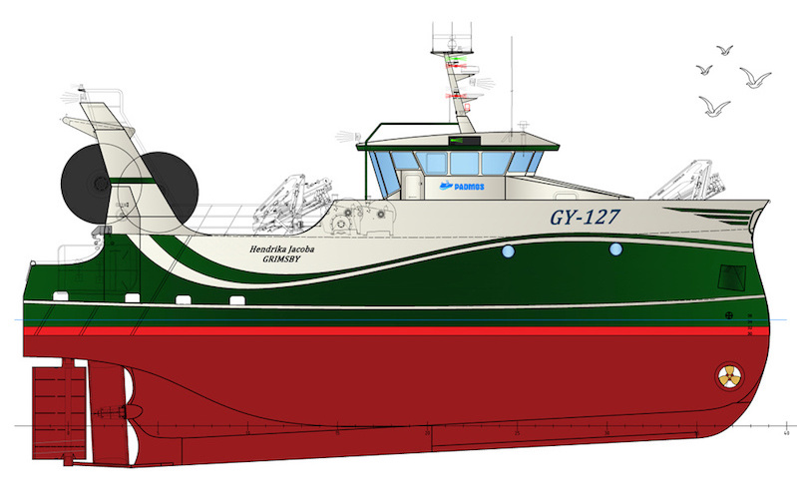
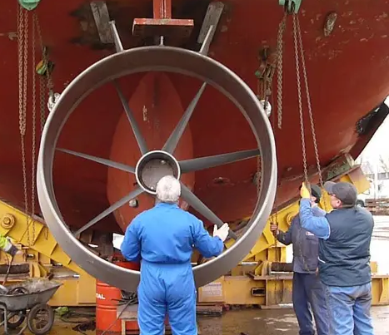
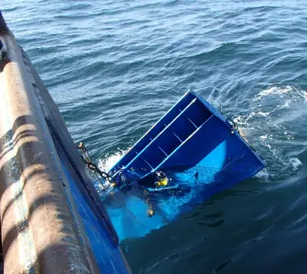
What is being done to reduce individual fishing emissions ?
Current viable options
Equipment : bulbous bow, propeller, rudder, etc.
Exploitation : lube, antifouling new generation, etc.
Fishing gears : new trawl net, reduction of the weight of the panels, with flaps or detached from the bottom, etc.
Vessel construction : interverted bow and new engine technologies (currently limited), like hybrid Diesel-electric.

Slide 5
How « mature » are the technologies for a total Carbon neutral ?
Fishing vessels can make progress in fuel consumption and engines can still be optimised…
… but this is far from a real « break » in engine research & innovation !
New EMFAF (2021-2027) list « energy efficient technologies » that lead to less CO2 emission :
  Liquefied natural gas (LNG)
  Liquefied biogas (LBG)
  Hydrogen
  Fuel cells, Electricity:
  Hybrid (Electricity + combustion)
  Biofuel
Is this the right timeframe to be incentive ?

Slide 6
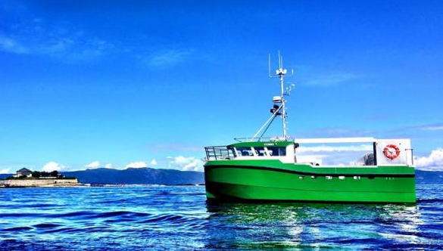
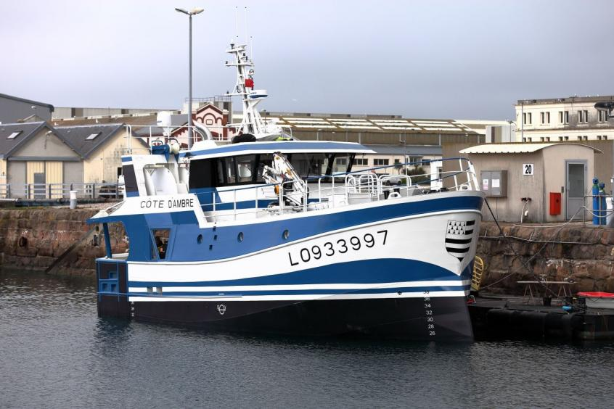
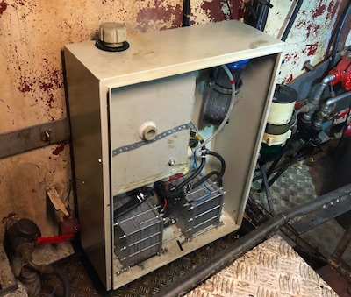
Hydrogen and
Electricity still offers little autonomy
Specialists talk about a storage volume multiplied by 10 or 17 to equal diesel in autonomy
Lack of technology and infrastructure to store on board and on land where needed (i.e. in all ports and fishing landing places)
Technology is not adapted to all fishing types : more expensive, lack of autonomy for trips over 1 day or wider range
Fuel cells not yet adapted to all engine powers, all fleets
Hydrogen production on board? Currently being tested (in France)
Regulatory limitations to be removed
« Karoline » Norway's first electrically powered inshore fishing boat. (Pic : Selfa Arctic)
« Efinor », French ship project (demonstrator) equipped with a 480 kW battery
The hydrogen fuel cell onboard « Cresus » vessel (Pic: CRPMEM NA)

Slide 7
LNG held back by the Gross Tonnage constraint
Mature technology available for vessels.
Limitations :
  Engines are not available for all fishing vessels (space on board and cost)
  Regulation does not allow the storage on board of LNG cylinder
  Need for a specific tank with a security perimeter + a dedicated crew member on board
Safety regulations are not adapted, and given the volume required (2 to 3 times more than diesel), larger boats are needed
The need to increase the tonnage to adopt architectures or technologies that minimize environmental impacts, is in particular not a motivation for which the CFP done right

Slide 8
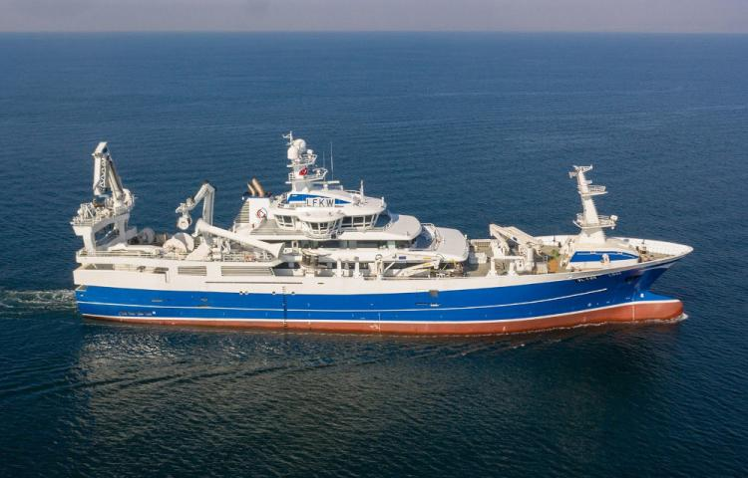
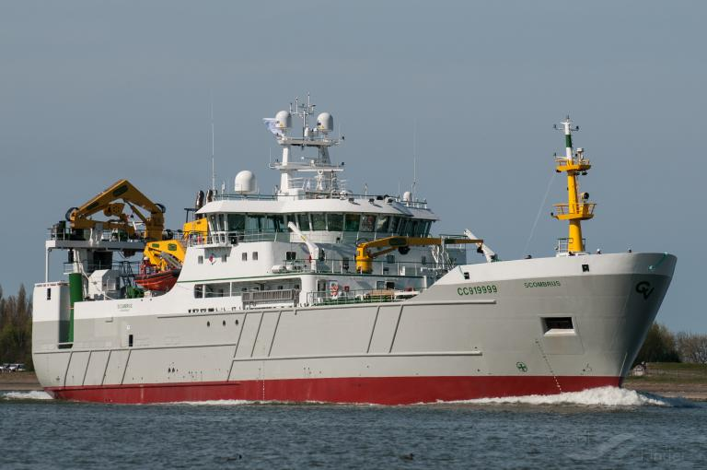
Delivered on March 2021, the Norvegian pelagic LNG vessel « Libas » has started its career in the Barents Sea (Pic : Cemre shipyard)
Delivered on September 2020, the French pelagic vessel « Scombrus » is technically limited to a double hybrid engine diesel-electricity (Pic : France Pélagique)

Slide 9
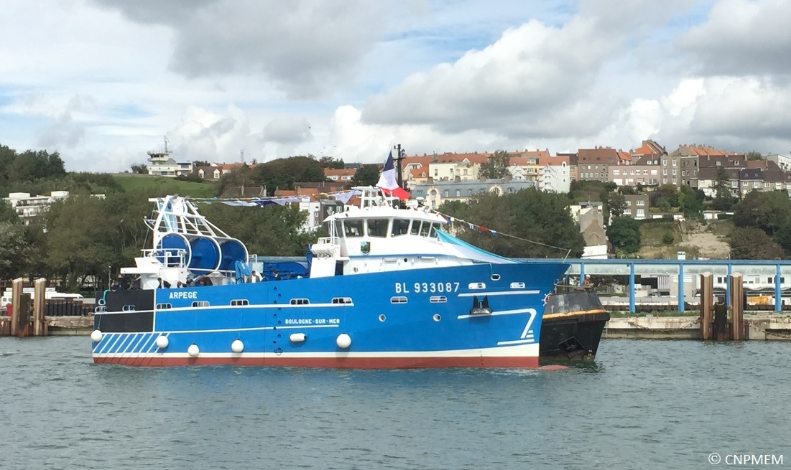
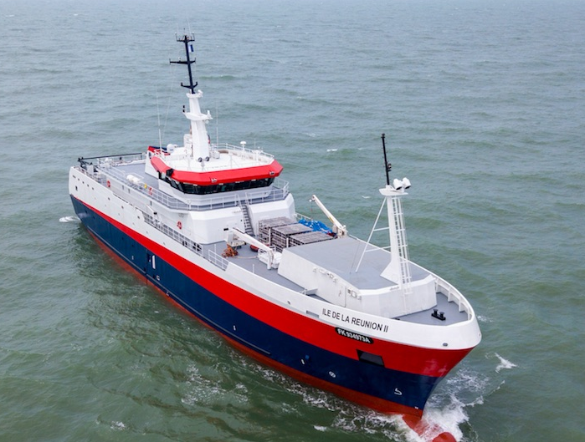
  Hybrid (Electricity + combustion)
More mature technology, the most accessible to date
But hybrid diesel-electricity is still not very successfull :
  Lack of experience
  Larger engine
  Additional construction costs (approx. 20%)
  Useful for highly variable power requirements (pots, seine,etc.)
French trawler « Arpège », 24 meters, delivered in 2015 for a total cost 8.2 millions euros (demonstrator)
French austral longliner « Ile de la Réunion II », 62.8 meters delivered in 2018. Equipped by two 900kW diesel-electric propulsion units

Slide 10
  Review from the fisheries sector’s perspective
Timetables for decarbonising or more drastically limiting the CO2/GHG emissions from activities are accelerating,
Fisheries sector must therefore anticipate future legal or fiscal constraints, whether national, European or international
Lack of mature alternative technologies or those adapted to the size of the fishing vessels : what can be deployed on shiping vessels cannot necessarily be deployed on fishing vessels ;
Some solutions presented for fisheries are not solutions :
  Reduce vessel’s speed, ban and use unique fishing gear, fish closer to the coast, etc.
  Taxing fuel cannot be an incentive without real alternatives, and will only lead to the loss of profitability (and the EU food autonomy) to invest in new vessels (and their capacity to assume their energy transition).

Slide 11
  Review from the fisheries sector’s perspective
Many projects remain at the study stage, in line with some difficulties:
  One of the major difficulties is financing a vessel with new engine technology : the risks are high for shipowners who cannot be first to test and « pay the price » for a new technology ;
  Public funds are mainly directed to research projects (not to cover the risk take from shipowner) ;
  Management capacities of the GT and the engine powers : both were originally designed to regulate the evolution of capacities supposedly reflected the fishing capacities (CFP), and not the emission of GHG, including CO2 ;
  It is not possible to replace a vessel with a larger one with the same hold capacity, which prevents any attempt to move intermediate to other fuels/propulsion engine ;
  What logistics for marketing? How to equip the ports (charging station, LNG storage, maintenance, etc.)
  Crew training adaptation

Slide 12
  Recommendations on how can we progress
How to respond to these limitations and how to progress collectively?
We’ll not be able to encourage shipowners to invest in technologies that are not yet mature
Lack of a real inventory of possible improvements, according to experts, and of the costs/benefits of these solutions, including for yachting and shipping
Improve discussions at EU level between policymakers, engine manifacturerers and representatives from the fisheries (as event organized today)
Need to a real investigation of the degree of maturation of these technologies and their degree of adaptation/limitation = finding solutions to common difficulties

Slide 13
  Union des Armateurs à la Pêche de France
  Jérôme Jourdain jj@uapf.org
Thank you

