Slide 1

A climate-resilient Europe:
Lessons from frontline communities
European Week of Regions and Cities 2025
15 October 2025
In collaboration with WWF-Netherlands

Slide 2



Who are we?
Non-profit research organisation, part of IIED’s family, focusing on Europe as a lever for global change – specific focus on forging climate resilient communities, in Europe and beyond
Independent research organisation that delivers positive change on a global scale, working on solutions to sustainable development challenges for more than half a century
WWF Netherlands is part of the world’s largest network of nature conservation organisations, supporting equitable outcomes for people and nature across the globe.
An alliance of 6 organizations, led by WWF Netherlands and funded by the Dutch Ministry of Foreign Affairs, that has been actively pushing the agenda on locally led adaptation (LLA)

Slide 3
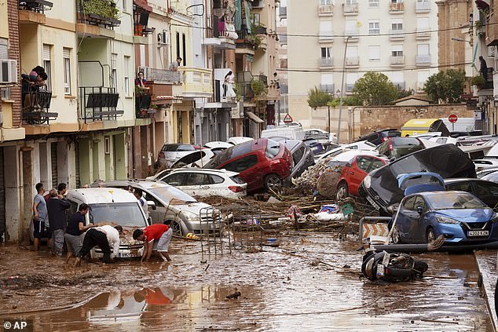
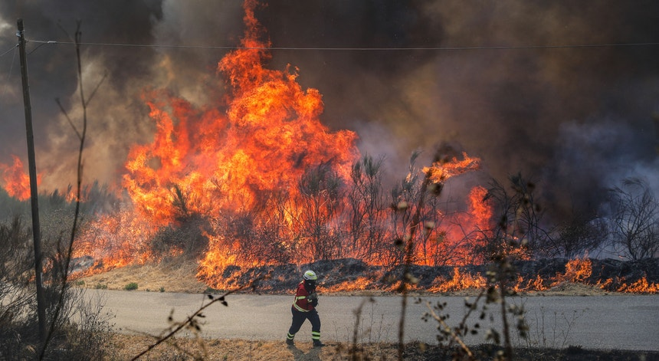
Europe, we have a problem
Europe is the fastest-warming continent in the world (source: EUCRA)
2024 – the hottest year on record (source: Copernicus)
2024 and 2025 marked by a series of extreme weather events in Europe
A heavy toll: Between 1980 and 2024, a total of 441,069 fatalities and 822,624 million EUR in economic losses (EU-27) (source: EEA)
Credit: Paulo Cunha - Lusa

Slide 4
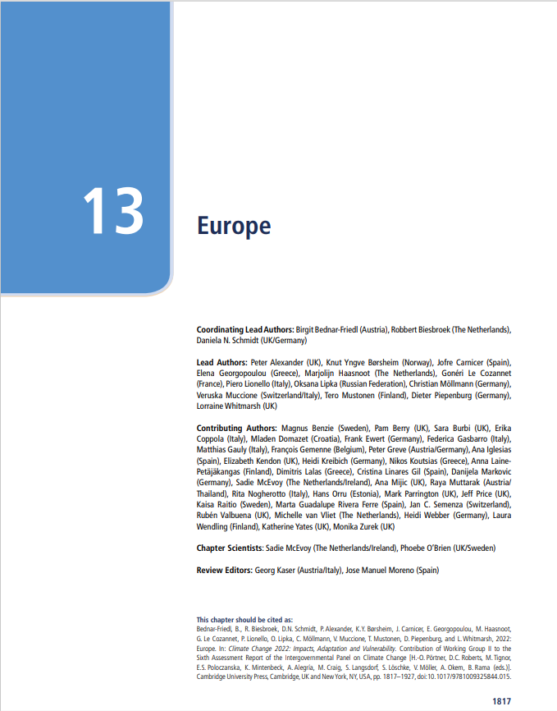
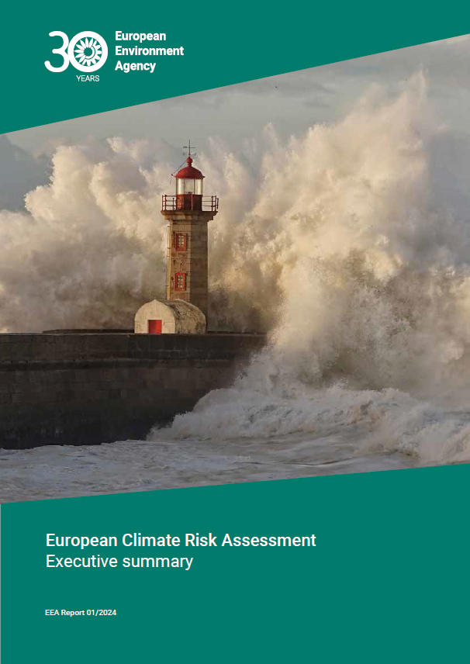
Is Europe prepared?
Most climate change impacts and risks in Europe will become more severe in a warmer world (source: IPCC)
Adaptation is happening, but not implemented at the scale and speed needed (source: IPCC)
Societal preparedness is still low – policy implementation lagging behind increasing risk levels (source: EUCRA)
Credit: IPCC AR6 WGII report

Slide 5
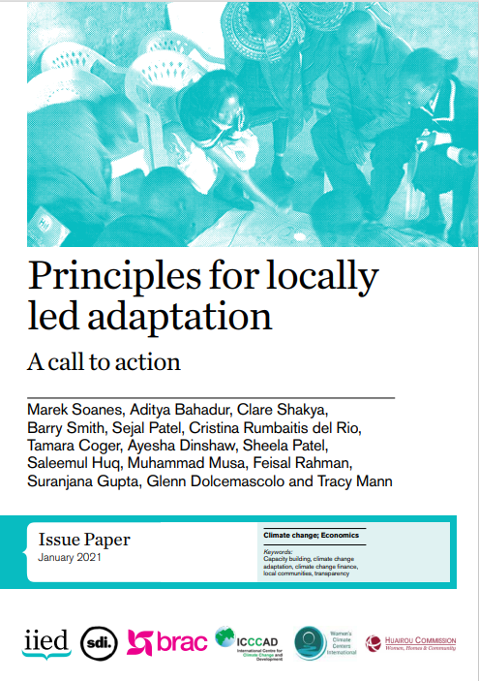
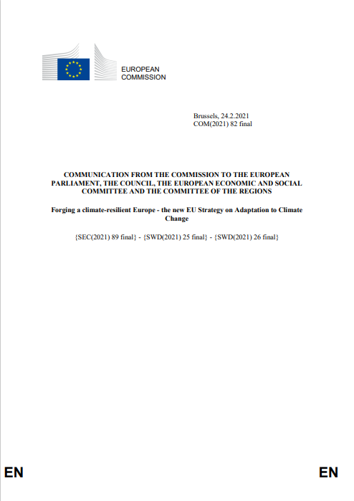
Local leadership in climate adaptation
Leadership and inclusive engagement of local actors is key to the success of adaptation (source: IIED)
Without involvement of local actors – adaptation less effective and risks maladaptive solutions (source: IIED)
EU Adaptation Strategy: local adaptation action as a cross-cutting priority
CoR: key role of local governments in implementing the EU Adaptation Strategy

Slide 6
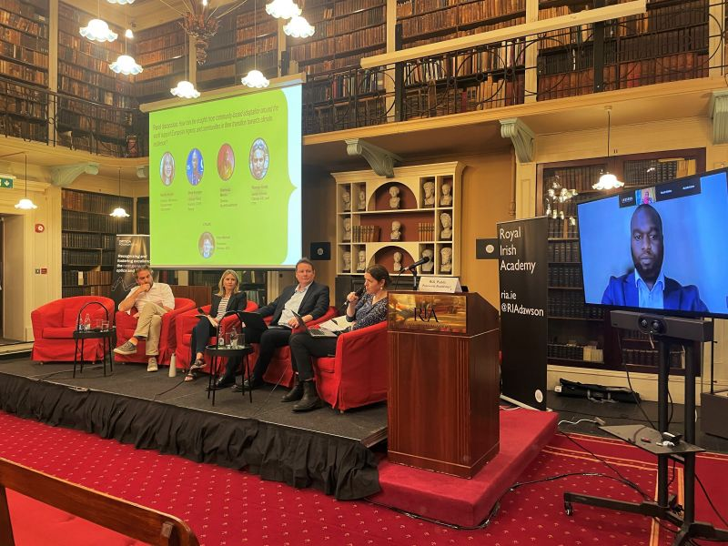
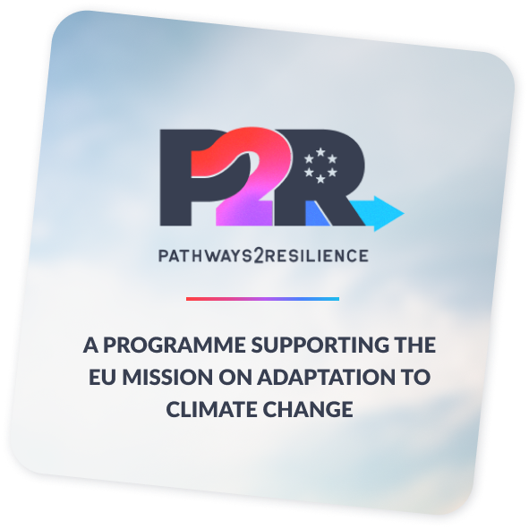
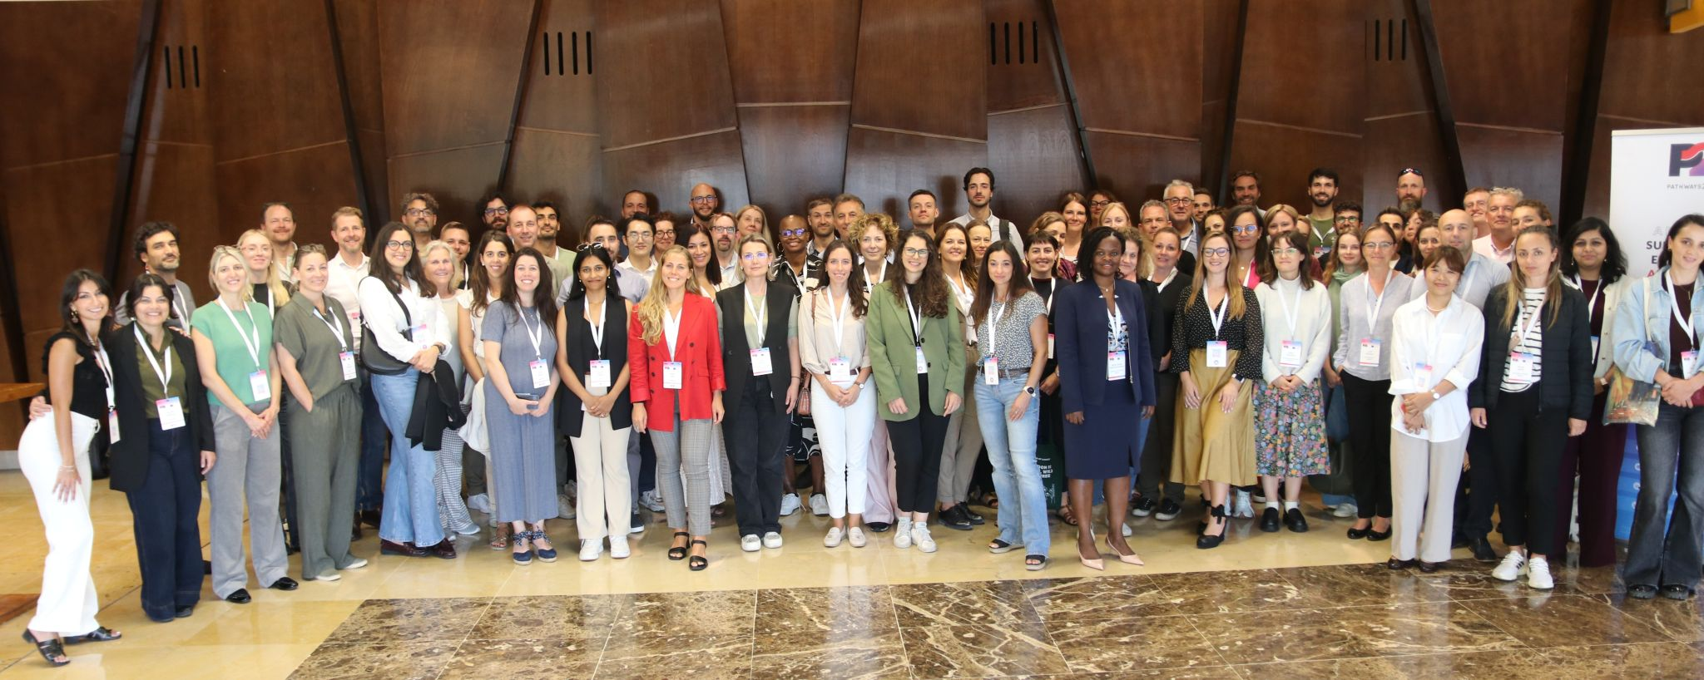
Gaps in regional & local adaptation in Europe
What are we learning from our work with European regions and communities (P2R, ECCA 2023)?
Significant progress, but gaps and challenges identified:
  Need for rapid and accessible finance to local actors
  Strong in climate risk assessment work, but struggling to operationalise just resilience – underrepresentation marginalised groups and vulnerable communities in planning processes
  Enhancing Monitoring, Evaluation and Learning (MEL) approaches – MEL still in its infancy across P2R regions (consistent with EEA findings)
Credit: IIED Europe
Credit: P2R

Slide 7
Learning from our international partners
EU Strategy on Adaptation to Climate Change
“The EU can also learn from others: many of our international partners have long been on the frontlines of climate change and have valuable experience that can help Europe become more climate resilient.”
“The EU is well equipped to conduct structured dialogues to share solutions, and is keen to learn from others”
“There are significant knowledge gaps and innovative approaches where the EU could benefit from existing experience, for instance on community-led and nature-based adaptation”.

Slide 8
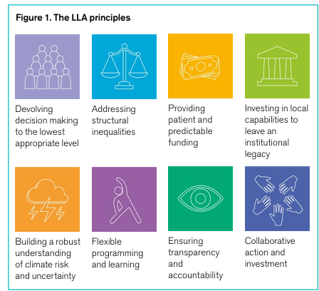
Local communities at the center of adaptation
Locally Led Adaptation (LLA) principles
A framework of 8 principles developed to help ensure that local communities are empowered to lead sustainable and effective adaptation to climate change at the local level
Endorsed by more than 130 governments, global institutions, and local and international NGOs
Moving from endorsement to action – a few examples from the VCA programme

Slide 9
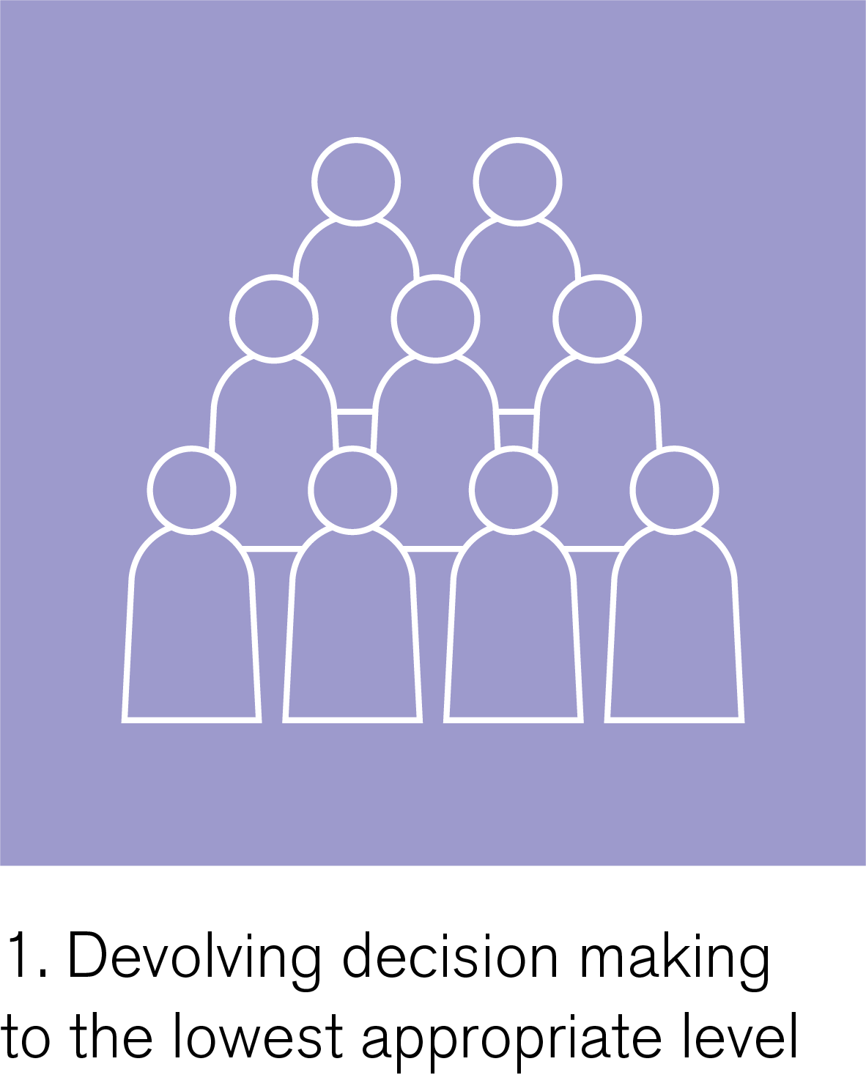
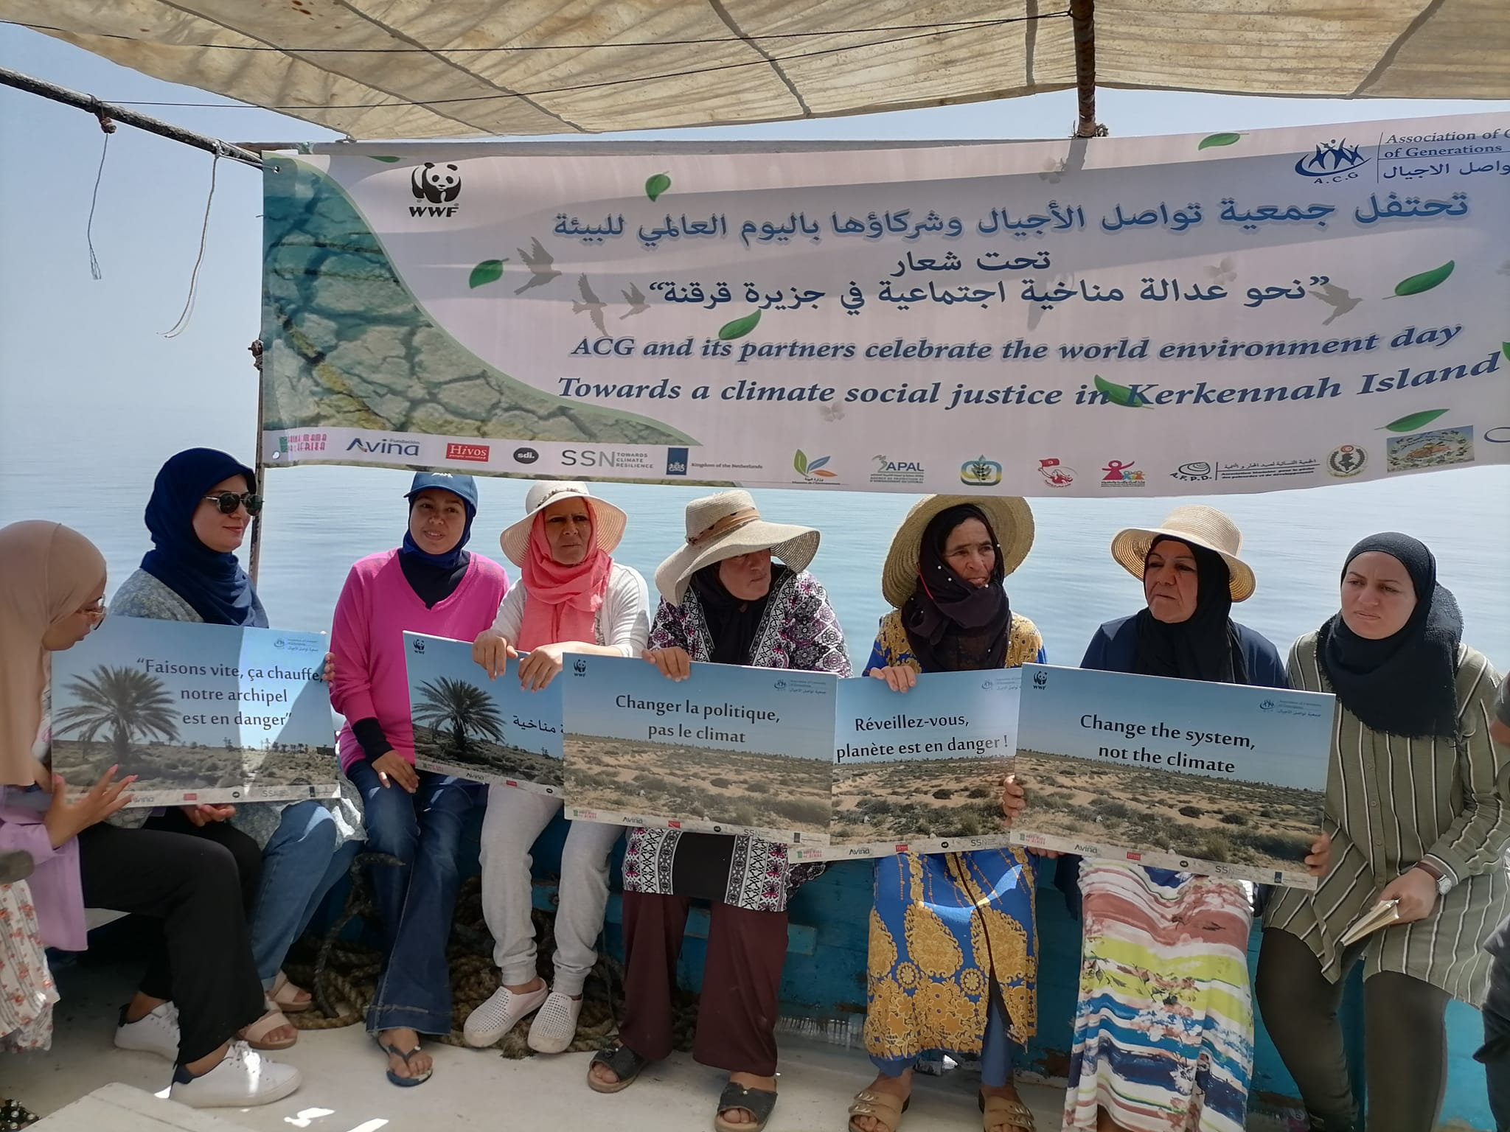
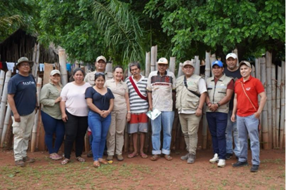

Devolving decision making
The Women’s working group on Fisheries and Agriculture of the Kerkennah islands, Tunisia
Claiming decision-making power and leadership by co-organizing the first women-led group in the archipelago for the Development of Fisheries and Agriculture (GDPA) in 2023
The forest committee of the Ayoreo communities in Bolivia
A stepping stone in providing community members with a seat at the decision-making table over what happens to their territories
Credit: ACG association
Credit: ORE

Slide 10
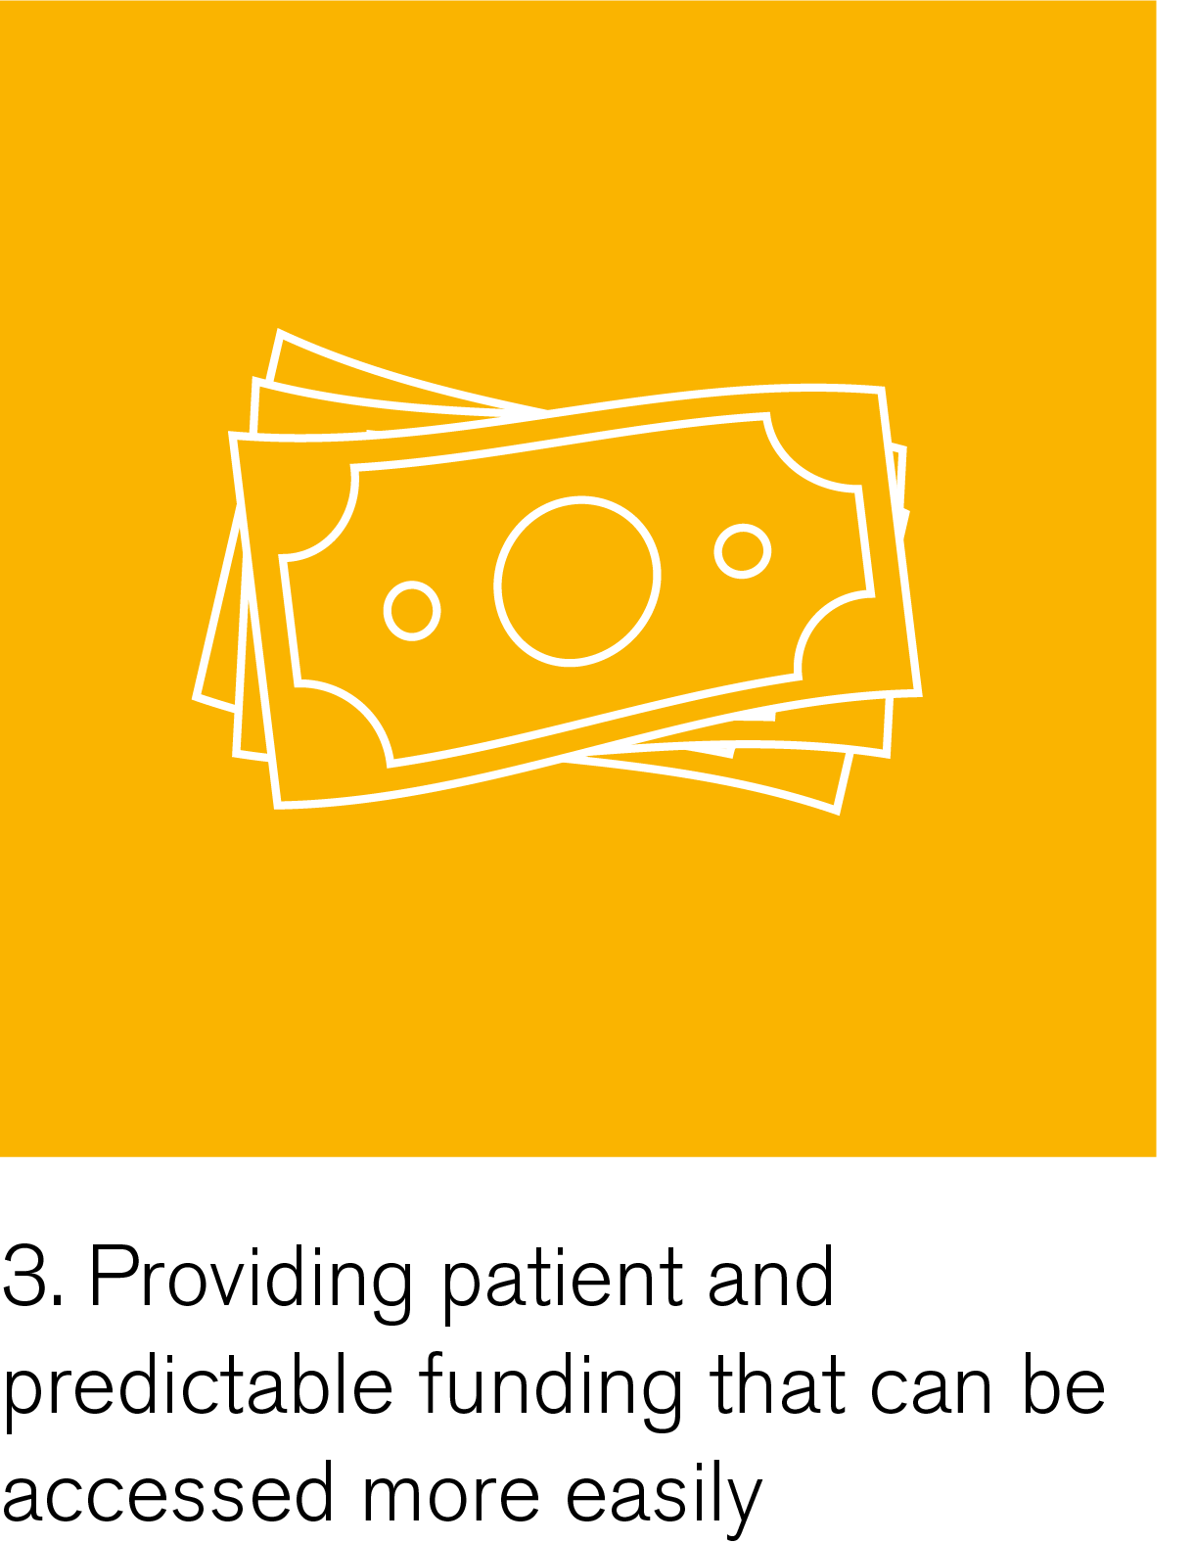
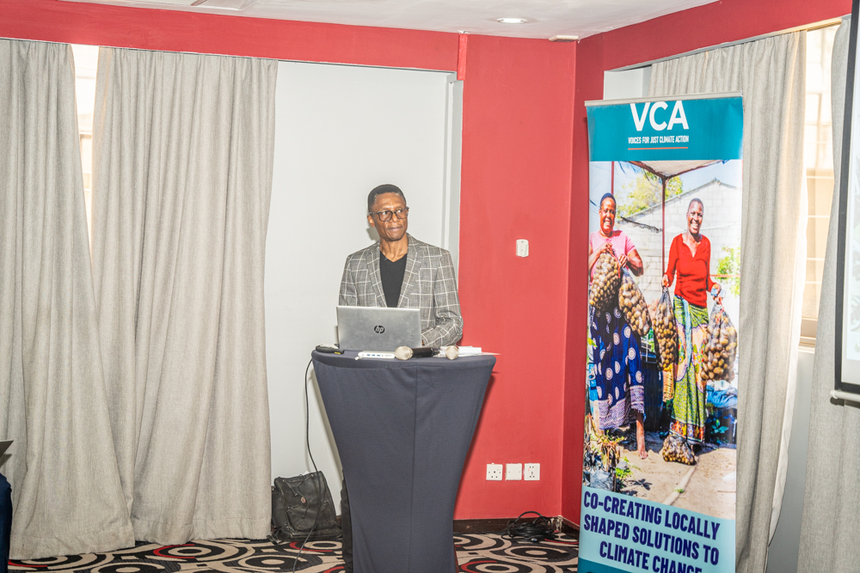
Predictable and accessible funding
The Next Level Grant Facility
An innovative, small grant mechanism to channel finance to marginalized groups and promote community-led decision-making
Credit: PPHPZ

Slide 11

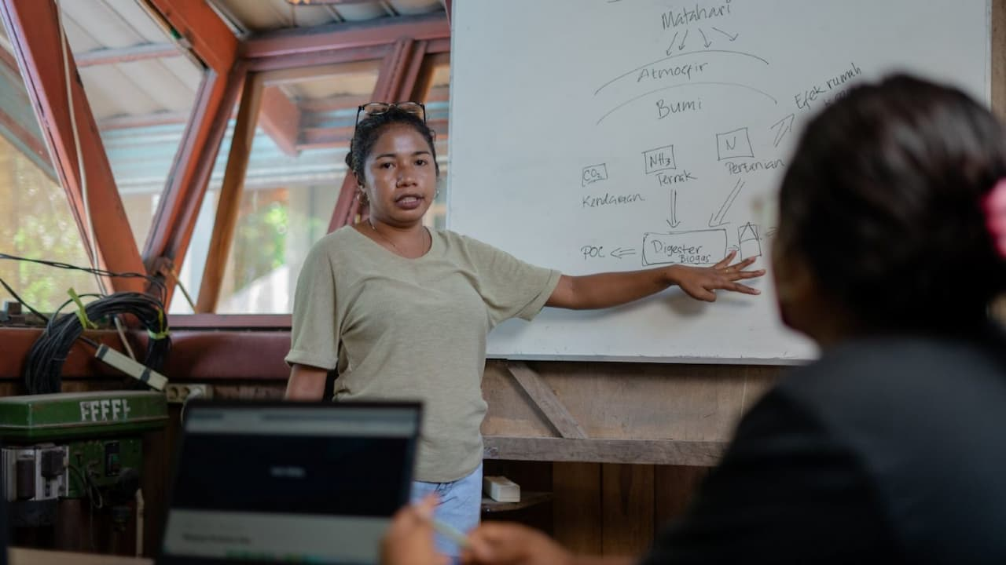
Strengthening local capabilities
Mutual capacity building within the VCA programme
Ensuring that local institutions can understand climate risks, generate solutions, manage adaptation initiatives sustainably, and develop success metrics that matter to them (participatory MEL)
Credit: Mohammad Tsani Pebrian (Hivos)

Slide 12
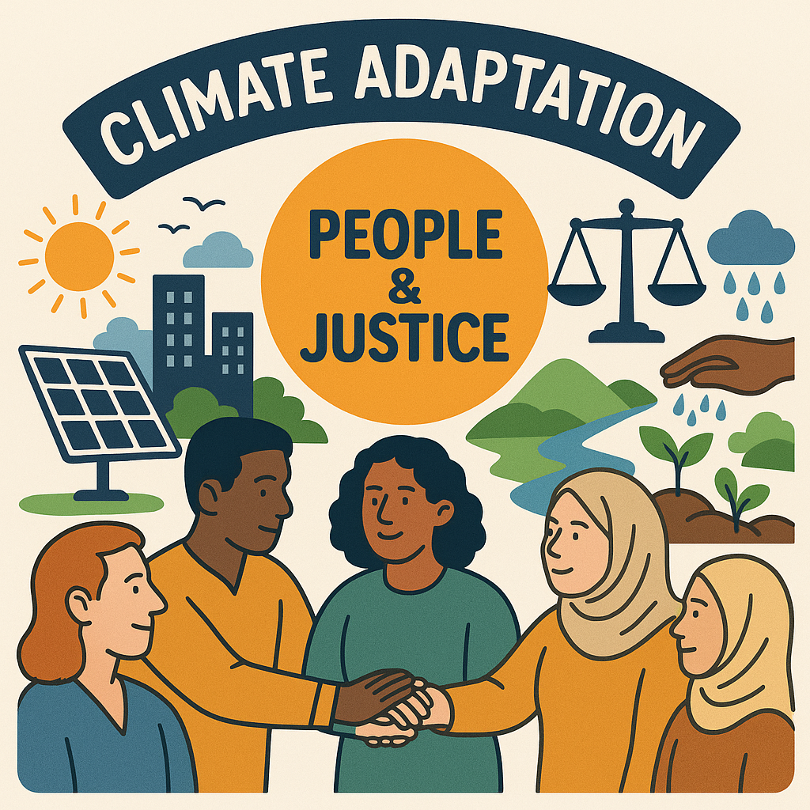
Reframing adaptation through the LLA lens
LLA is more than a set of tools – a transformational governance approach
Going beyond technical solutions – putting people, justice and long-term resilience at the center of adaptation (EU regions and just resilience)
Europe is under pressure and in need of transformative approaches – LLA can provide that approach
EU Adaptation Strategy and EU Mission Adaptation have the potential to support LLA in the European context
Credit: ChatGPT

Slide 13
Thank you

