Slide 1
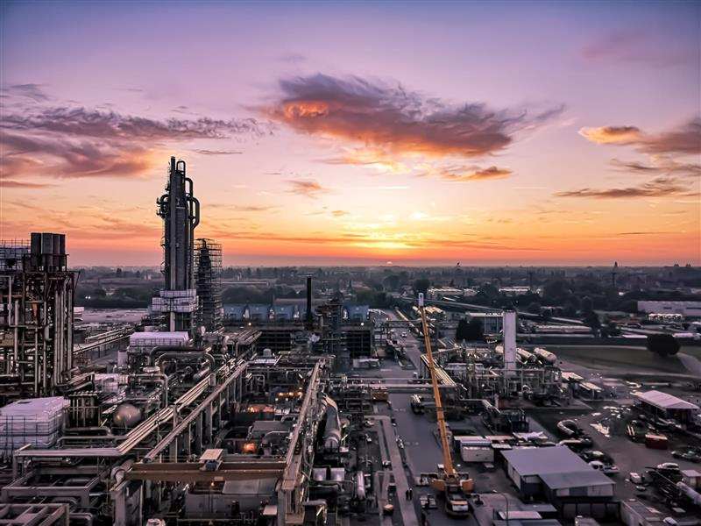


Activating Lead Markets:
A Demand-Side Strategy
for Competitive Low-Carbon Industries
Host MEP Jeannette Baljeu

Slide 2



Opening remarks
Jeannette Baljeu
Host MEP, Renew

Slide 3

Presentation
Ijmert Muilwijk
Programme Manager
Gas Market and Hydrogen, Energie Nederland

Slide 4










Mobilizing consumer demand for sustainable investments
Potential role of demand-side policies to stimulate investments in sustainable products and strengthen European heavy industry
December 2025
Selected research insights

Slide 5
Contents
Why additional demand creation is necessary
What could be a conceptual architecture of demand mandates
How could the mandates be implemented
Report objectives

Slide 6
Challenges in EU heavy industry have led to low adoption of low-carbon emission solutions
Current challenges in EU heavy industry – ILLUSTRATIVE
Emissions from production in EU (Mt CO₂e)
Lower emissions
Strategic autonomy
-91 (-14%)
High energy prices
659
ETS free allowance phase out
569
Production in EU
CBAM not fully working
Objective
Current trend
2014
2022
Carbon offshoring
Strategic dependency
(Possibly) lower emissions
Strategic dependency
Emissions from import to EU (Mt CO₂e)
+45 (+13%)
Import to EU
353
398
Conventional solutions
Low-emission solutions
2014
2022

Slide 7
Strong incentive for import mainly due to the EU's high energy prices and (future) impact of ETS
Cost of EU production vs. import (2024)
Steel (BF-BOF, €/t)
Fertilizers (SMR-NG, €/t of NH₃ equivalent)
Chemicals (naphtha cracker HVC, €/t)
Refining (gasoline, gas-based refining, €/l)
36%
80%
104%
153%
16%
23%
7%
10%
609
670
1,598
0.518
Incl. free allowance 0.495
1,501
0.472
0.493
0.505
1,418
Incl. free allowance 1,433
459
541
1,298
431
Incl. free allowance 451
338
332
Incl. free allowance 354
265
Imported from China
Produced in EU (ETS €75)
Produced in EU (ETS €150)
Imported from Russia
Produced in EU (ETS €75)
Produced in EU (ETS €150)
Imported from US
Produced in EU (ETS €75)
Produced in EU (ETS €150)
Imported from US
Produced in EU (ETS €75)
Produced in EU (ETS €150)
Transport
ETS (excl. free allowances)
ETS (incl. free allowances)
Energy
CAPEX / OPEX
Raw material
xxx
Cost gap to import

Slide 8
Investments in lower-emission solutions are not viable, given significant cost difference leading to a value gap of ~€165B annually
Conventional vs. green alternative costs by sector (2024)
Steel (€/t)
Fertilizers (€/t of ammonia equivalent)
Chemicals (naphtha-based HVC, €/t)
Refining (gasoline, gas-based refining, €/l)
+137%
1,249
+244%
2,212
+66%
+7%
0.554
1,089
1,860
2,488
0.516
0.524
0.541
0.505
0.508
0.527
929
1,508
Import parity
0.472
H₂
1,647
1,589
1,645
1,588
H₂
Import parity
1,298
1,501
503
1,530
1,530
459
444
487
735
470
Import parity
338
657
541
580
Import parity
265
BF-BOF -Coal (ETS €75)
DRI-EAF - Nat. gas (ETS €75)
DRI-EAF - Nat. gas (CCS 55%)
DRI-EAF (Green H₂)
SMR - Nat. gas (ETS €75)
SMR - Nat. gas (CCS 90%)
SMR (Green H₂)
Cracker (ETS €75)
Cracker (CCS 90%)
E-cracker
Cracker (pyr. oil) (ETS €75)
Refining (ETS €75)
Refining (CCS 90%)
Refining (CCS 90% + Green H₂)
Type
CCS (incl. CCS-specific CAPEX / OPEX)
ETS
Energy⁷
CAPEX / OPEX
Raw material
xxx
Value gap
Import parity
Range

Slide 9

Extend current policies tightening CBAM and implementing demand-side mandates
Potential policy instruments to improve EU competitiveness and boost uptake of sustainable products
Supply push
Focus of this report
Demand pull
ETS (and other taxes)
Supply subsidies (incl. tax breaks)
Supply mandates
Demand mandates
EU origin requirements
Value chain enablers
Energy suppliers
Heavy industry producers
Intermediaries
Users of heavy industry products
B2B
Channels
B2C Channels
Consumers
Level playing field
CBAM
CBAM broadening and tightening (e.g., extend to processed goods, exempt export, disallow resource shuffling)

Slide 10
Demand mandates could reverse the shift to imports and boost uptake of sustainable products
Focus of this report
Existing and planned instruments
Potential new instruments
1. Current situation, incomplete CBAM
2. CBAM extension and tightening
3. Demand mandates
4. Demand mandates with EU origin requirements
Subsidies
Subsidies
CBAM
Transport
CBAM
ETS
ETS
Transport
Transport
EU origin (partially) obligated
Import
EU
EU
Import
EU
EU
Import
EU
Import
EU
Conventional
Sustainable
Conventional
Sustainable
Sustainable
Sustainable

Slide 11
Cost of low-carbon production in price of end products is relatively small
Potential price increase of selected products if sustainable materials are used – ILLUSTRATIVE EXAMPLES
 | End-markets | End-products | Example used | Price increase from sustainable solution
 |  |  |  | Current price | Of which input cost | Input cost increase | Price increase (one-off)
Steel | Construction | House (foundation, beams, …) | 185 m² house | €500,000 | €1,601 | +137% BF-BOF (ETS €75) vs. DRI-EAF (Green H₂)
 |  | Wind turbine | 5MW offshore turbine | €3,000,000 | €88,200
 | Automotive | Car (chassis, engine, …) | Toyota Aygo X | €27,500 | €198
 |  | Truck (chassis, engine, …) | MAN TGS 33.480 6x6 | €150,000 | €1,323
 | Groceries | Steel canned tomatoes | Supermarket house brand | €0.69 | €0.03
 | White goods | Fridge | 300l fridge freezer comb. | €700 | €23
Fertilizers | Groceries | Tomatoes (fresh) | 1 kg Roma house brand | €3.67 | €0.01 | +244% SMR (ETS €75) vs. SMR (Green H₂)
 |  | Fries (frozen) | 1 kg house brand | €1.79 | €0.004
 |  | Bread | Entire whole-wheat bread | €1.75 | €0.01
Chemicals | Groceries | Water (plastic bottle) | 330ml house brand | €0.890 | €0.02 | +66% Cracker (ETS €75) vs. Cracker (pyrolysis oil)
 |  | Shampoo (bottle and content) | 300ml bottle | €2.75 | €0.12
 | Automotive | Car (interior, electronics, …) | Toyota Aygo X | €27,500 | €272
 |  | Truck (interior, electronics, …) | MAN TGS 33.480 6x6 | €150,000 | €778
 | Construction | House (PVC, …) | 185 m² house | €500,000 | €6,045
Refining | Transport | Parcel delivery (diesel) | Last-mile delivery | €3 | €0.06 | +7% Refining (ETS €75) vs. Refining (CCS + Green H₂)
 |  | Flight (kerosene) | Direct AMS – JFK | €500 | €89
 |  | Shipping (heavy fuel oil) | 1TEU SHG - RTM | €4,000 | €439
 | Construction | Highway (bitumen) | 1km ZOAB highway | €20,000,000 | €180,000
 |  | House (roofing bitumen) | 185 m² house | €500,000 | €38
References | Average VAT EU
 | Total inflation EU ’15 – ’24 (average annual 2.7%)
0.0%

Slide 12

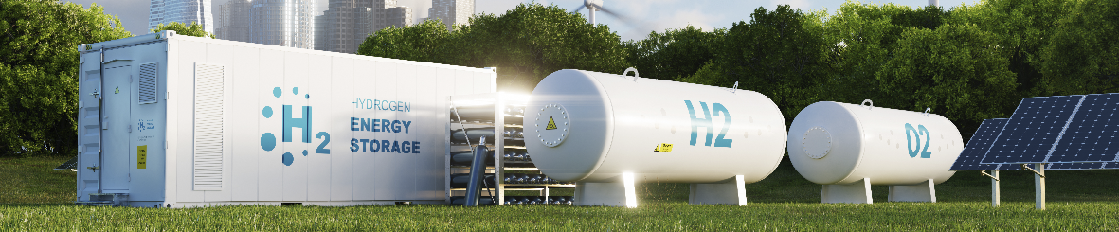
Reality shows that demand-side mandates can stimulate sustainable investments in the EU
Recent demand mandates and resulting EU investments
ReFuelEU Aviation: EU-wide Sustainable Aviation Fuel (SAF) blend mandate
RED III – Green H₂ mandates for transport, enabled through a “refinery route”
SAF – production capacity (Mt p.a.)
Green H₂ for refining – production capacity (MW)
Capacity by FID year (cumulative)
Mandates announced
Mandates adopted
Mandates announced
Mandates adopted
Adoption into local laws
Capacity by FID year (cumulative)
4
1,000
3
Target 2030: 2.8 Mt
2
500
1
Capacity by commissioning year (cumulative)
Capacity by commissioning year (cumulative)
<’20
’20
’21
’22
’23
’24
’25
’26
’27
’28
’29
’30
<’20
’20
’21
’22
’23
’24
’25
’26
’27
’28
’29
’30

Slide 13
Contents
Why additional demand creation is necessary
What could be a conceptual architecture of demand mandates
How could the mandates be implemented
Report objectives

Slide 14
Demand mandates to be designed with clear principles
Proposed principles for demand mandate
Scale | Effectiveness | Feasibility | Competitiveness
Mandate should target a material share of emissions | Mandate should stimulate actionable demand and supply | Mandate should be implemented and enforced at reasonable cost | Mandate should maintain a level playing field for EU producers
Applies to products with significant EU industrial emissions Targets main sources of lifecycle emissions | Applies where consumers cannot bypass the mandate Producers are technically and economically able to scale supply | Adds marginal reporting or tracking costs for companies Targets a manageable number of products and companies | Importers are held to the same standards as EU producers Green premiums paid by EU citizens are used on investments in EU









Slide 15
Five key choices must made to design a demand mandate
Proposed demand mandate design framework (key choices)
Design choices | Choices | Criteria to design a specific demand mandate
MARKETS AND PRODUCTS | Sector-specific (explored later) | Where the consumption (and emissions) is the highest Where products are relatively similar, so mandates do not require many variations Where there are barriers to import (e.g., high transport cost) so EU producers can compete Preference for products where heavy industry inputs account for large share of emissions
MANDATE HOLDERS |  | Companies that are concentrated (small number accounts for large share of volume) Companies that are close to end-users (to avoid circumvention, spread cost)
MANDATED METRICS | Lifecycle emissions Production emissions Production technology Specific feedstock | Metrics that address main sources of lifecycle emissions Emissions and solutions complementary to existing mandates
COMPLIANCE MECHANISMS | Product tracking Mass-balance Book-and-claim | A model that minimizes burden on production, supply chains, and enforcement A model that most directly supports sustainable investments
ACCESS AND ORIGIN REQUIREMENTS Limited focus |  | Stimulate healthy competition, helping supply emerge quickly and at acceptable cost Ensure EU producers and importers have the same basis of competition Is aligned with free trade rules
1.1
1
1.2
1.3
2
2.1
2.2
3
3.1
3.2
4
4.1
4.2
5.1
5
5.2
5.3

Slide 16
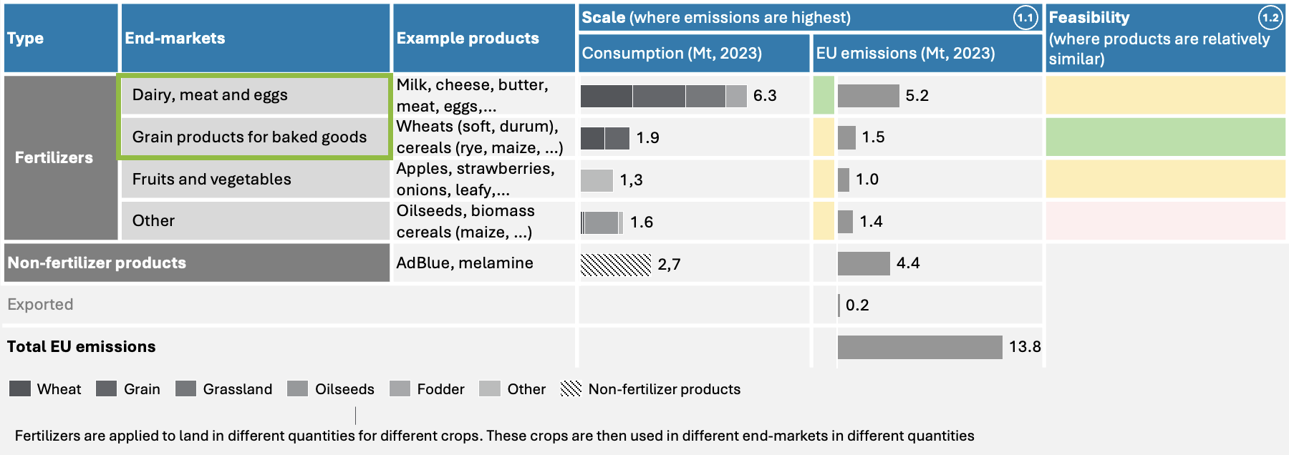
1
MARKETS AND PRODUCTS
Fertilizers
Finished chemicals end-market selection for demand mandate (2023)
>>
 | Favorable |  | Neutral |  | Unfavorable |  | Candidate end-markets for initial demand mandates
Type | End-market | Example products | Scale (where emissions are highest) – EU emissions (Mt) |  | Feasibility (where products are relatively similar) | Competitiveness (where there are barriers to import)
Plastics (56 Mt, 37%) | Packaging | Plastic bottles, food containers,…
 | Construction | Pipes, insulation, window frames,…
 | Automotive | Bumpers, body panels,…
 | Electronics | Casings, cable insulation,…
 | Houseware | Kitchen bowls, furniture,…
 | Agriculture | Greenhouse covers, irrigation pipes,…
 | Other | Medical equipment, textiles,…
Synthetic rubbers |  | Tires, seals, conveyor belts,…
Man-made fibers |  | Protective gear, carpets,…
Specialty chemicals |  | Adhesives, sealants, paints,…
Consumer chemicals |  | Cleaning, personal care,…
Total consumption
Basic chemicals sold to end-markets and used in process
Exported emissions
Total EU emissions
1.1
1.2
1.3

Slide 17
2
MANDATE HOLDERS
Fertilizers: Dairy producers, grocery retailers, and food service are potential mandate holders
EU consumption (2023)
xx
Production
Primary end-users
Distrib.
End-market
End-user
Fertilizer producers
6.3 Mt
Dairy, meat and eggs
Wheat farmers
Livestock farmers
>1000 | ⬅ 4
Dairy producers
< 100 | ⬅ 3
Distributors
100 - 1000 | ⬅ 2
Grain farmers
Egg processors
<100 | ⬅ 3
Grassland farmers
Commodity traders
<100 | ⬅ 4
Animal feed producers
<100 | ⬅ 4
Meat processors and preservers
100 - 1000 | ⬅ 3
CPGs
100 - 1000 | ⬅ 2
Blenders, grinders
Oilseed farmers
Grocery retailers
100 - 1000 | ⬅ 1
Cooperatives
100 - 1000 | ⬅ 4
Animal oils and fat producers
<100 | ⬅ 3
Biofuels
Fodder crops farmers
Permanent crops farmers
1.9 Mt
Grain products for baked goods
Consumer food service
100 - 1000 | ⬅ 1
CPGs
100 - 1000 | ⬅ 3
Fertilizer wholesalers / retailers
Other crop farmers
Grain product producers
<100 | ⬅ 4
Industrial bakeries
100 - 1000 | ⬅ 3
Distributors
100 - 1000 | ⬅ 2
Bakery and coffee shops
>1000 | ⬅ 1
Landscaping and forestry
Brewers and distillers
<100 | ⬅ 3
Industrial users of ammonia
1.3 Mt
Fruit & vegetables
F&V processors and preservers
CPGs
Distributors
Other end-markets (oilseed processors, textile)
Company / organisation type
# Number of parties making up 50% of volume | ⬅ Distance in value chain to end-user
Suitability for mandate holder (positive, neutral negative)
2.1
2.2
Most likely potential mandate holders

Slide 18
3
MANDATED METRICS
Mandated metrics should address main emission sources and complement existing mandates
Main types of mandate metrics – SIMPLIFIED
Emissions focus sectors (2023)
Scope 1
Scope 3
Scope Metric | Production (Scope 1) | Feedstock (Scope 3)
Emissions (solutions-agnostic) | Lifecycle emissions
 | Production emissions | Emissions at use (mainly fuels, out of scope)
Specific solutions | Production technology | Specific feedstock
 | Share Scope 1+3 (% based on typical ranges)
Chemicals (excl. fertilizers)
Steel
Refining
Fertilizers
30%
70%
30%
70%
35%
85%
30%
70%

Slide 19

4
COMPLIANCE MECHANISMS
Compliance mechanism should minimize burden and support sustainable investments
Typical compliance mechanisms for a demand mandate – SIMPLIFIED
High-level assessment of compliance mechanisms
Likely preferred for most products
 | Product tracking | Mass-Balance | Book-and-Claim
Burden | - | +/- | +
Support of investments | +/- |  | +
Intuitive for consumer
Example | Forest Stewardship Council (FSC 100%) | E10 gasoline, EU emission standards for cars and vans, RSPO model for palm oils | Green electricity (PPA), biomethane blending obligation, CORSIA – carbon offsets for aviation
Trading platform
-
+/-
+
4.1
Producer / Importer
Intermediary
Wholesaler
Mandated party
+/-
+
4.2
+
+/-
+/-
Product tracking
Certificate flow: Mass-Balance
Certificate flow: Book-and-Claim

Slide 20

Example: Fertilizer production emissions mandate on dairy producers – Book-and-Claim
Compliance mechanism - ILLUSTRATIVE
Mandate holder perspective
 |  | Value
Milk procured 260 largest dairy producers |  | 116 Mt
Fertilizer used (NH₃e) |  | 658 kt
Mandated volume (NH₃e) |  | 66 kt
CO₂ from fertilizer production (CO₂e) | As-Is | 1.1 Mt
 | Mandate | Minus 10%
 | To-Be | 1.0 Mt
 | Potential reduction | 0.1 Mt
Trading platform
Fertilizer producer Green H₂
~10% green H₂-based fertilizers
Farmer Conventional
Dairy producer
Fertilizer producer SMR-NG
~90% conventional fertilizers
Cost components of 1 liter of milk
Farmer Organic
260 dairy producers procure 116 Mt of milk (~75% of volume)
Holder of an obligation to lower emissions from fertilizers used in milk production by at least 10%
0.6% Fertilizer (6 g per liter) +0.2% if 10% green H₂-based fertilizer is used
17% Rent, machinery,…
37% Labor, contractors,…
Product flow
Certificate flow (Book-and-Claim)
45% Feed, livestock,…
Given concerns about deforestation resulting from production of animal feed, the Book-and-Claim model would likely only be applicable if it was combined with an EU origin requirement

Slide 21

Example: Steel production emissions mandate on car dealers – Product tracking
Compliance mechanism - ILLUSTRATIVE
Mandate holder perspective
 |  | Value
Cars sold by 650 largest car dealers |  | 4.7 M
Required steel |  | 4.3 Mt
CO₂ from steel production (CO₂e) | As-Is | 6.1 Mt
 | Mandate | Minus 20%
 | To-Be | 4.9 Mt
 | Reduction | 1.2 Mt
Low-emission steel cars
Steel producer
Casting manufacturer
Car dealer
Blends in green H₂ into the process
Steel 900 kg per car, incl. 70% virgin and 30% secondary steel. Green H₂ used in virgin steel production
Chassis manufacturer
650 car dealers sold 4.7M cars (70% of volume)
Holder of an obligation to lower emissions from steel used in the cars by at least 20%
Cost components of regular car
Automotive manufacturer
0.9% Steel (900 kg per car) +0.3% if 20% low-emission steel is used (fulfilled via DRI-EAF-H₂)
Regular cars
Conventional product flow
Low-emission steel product and certificate flow

Slide 22




Panel discussion
Jeannette Baljeu
Luc Haustermans
Hans Grünfeld
Irene Domínguez
Host MEP, Renew
VP Corporate Affairs & Industry Relations,
Yara International
Chair,
IFIEC Europe
Policy Manager Embodied Carbon & Lead Markets,
Bellona

Slide 23
Q&A
Ask your questions
to the speakers!

Slide 24
Closing remarks
Jeannette Baljeu
Host MEP, Renew

Slide 25
Thank you!
Let’s continue
the conversation

