Slide 1
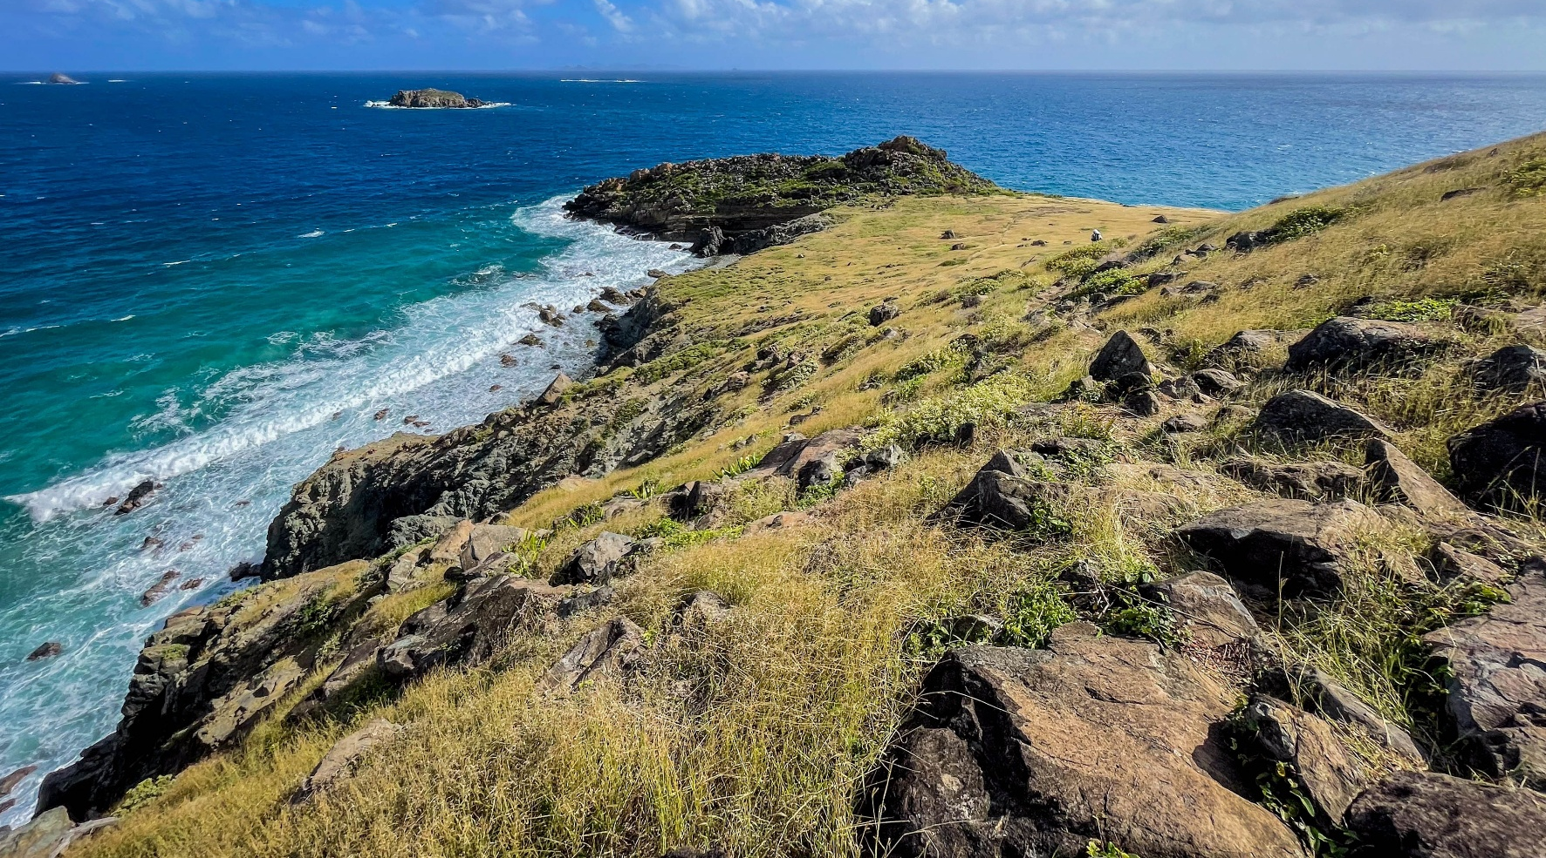
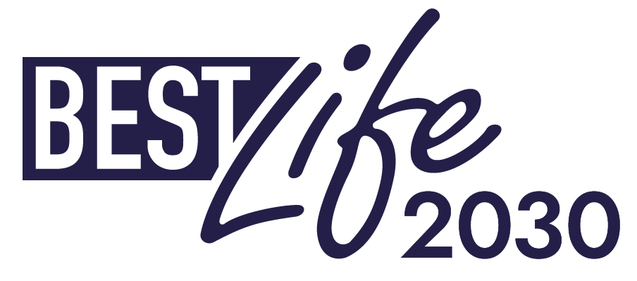
Voices from the territories
Locally led biodiversity action in practice
1 July 2026
Notes:
SABRINE
Honorable Members, distinguished representatives, dear partners -- thank you very much for the opportunity to present to you today. My name is Sabrine Brismeur, and I have the great honor of leading the "Voices from the Territories" presentation today.
Across the globe, the EU’s outermost regions and Overseas Countries and Territories harbour a disproportionately high level of biodiversity compared to their metropolitan states and are estimated to account for more than 70% of Europe's biodiversity. Their diverse flora and fauna, much of it unique to these regions, form incredible ecosystems that directly and intimately support the livelihoods and wellbeing of local economies and cultures.
But this biodiversity is under severe threat. At the frontlines of this crisis are local conservationists, who are working to turn the tide on globally declining environmental conditions, often with the support of EU-funded programmes like BESTLIFE2030.
Together, our experiences demonstrate how locally led conservation is contributing to the implementation of the EU Biodiversity Strategy for 2030 and the Kunming–Montreal Global Biodiversity Framework, while highlighting why continued investment will be essential under the next Multiannual Financial Framework.
Today, a few of these impacted environmental practitioners are pleased to share our experiences with you, from our work in the Caribbean, Macaronesia, and the Indian Ocean.

Slide 2
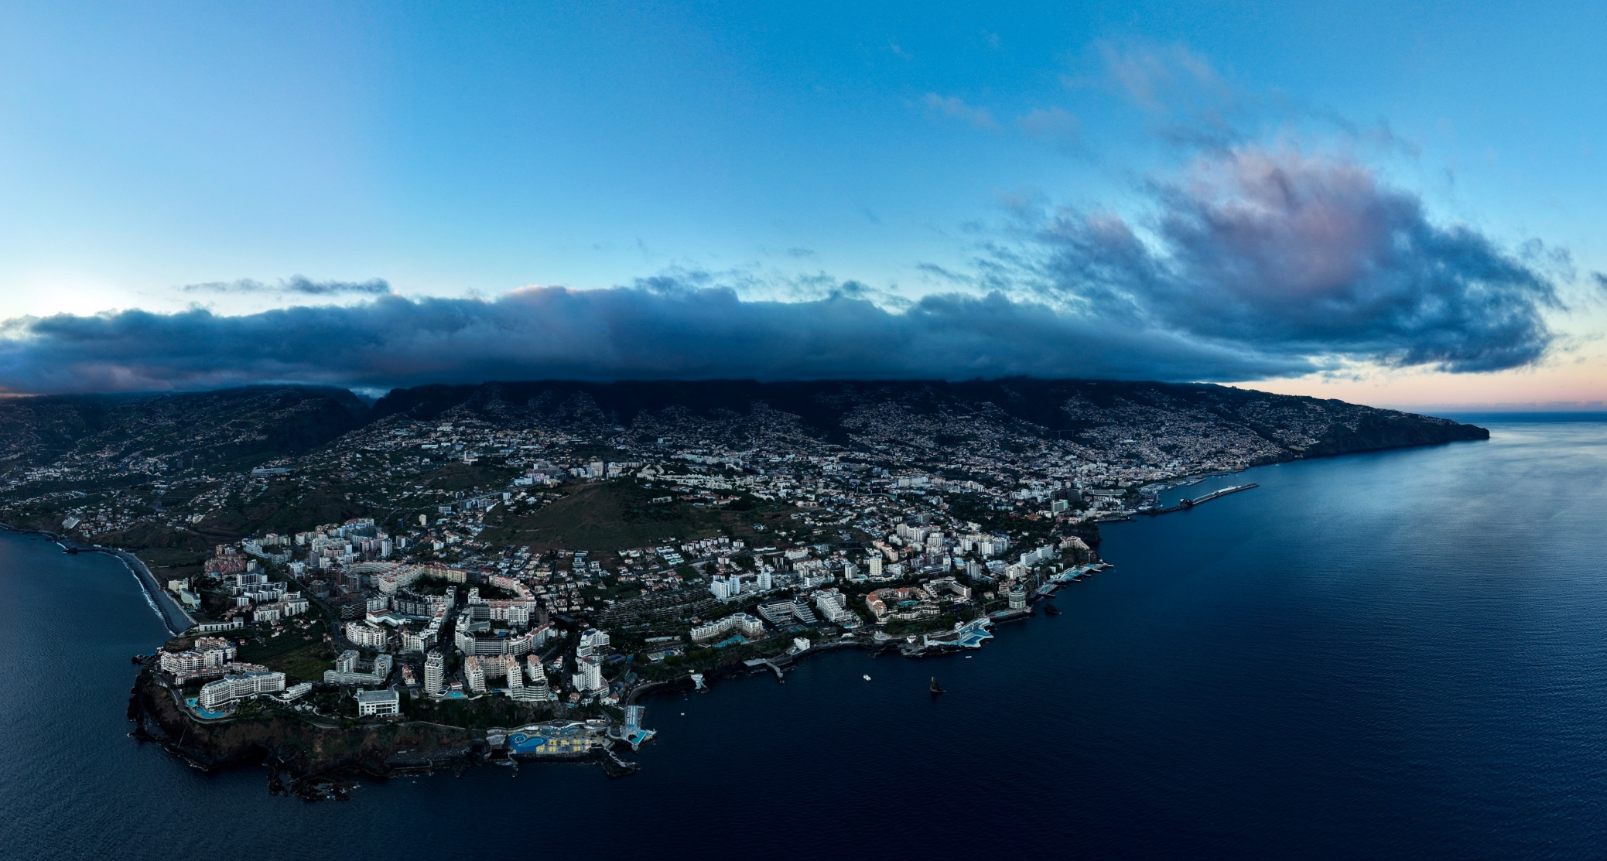

1. Context
© Ricardo Lourenço
Notes:
SABRINE
First, for a bit of context regarding what we do and what challenges we face in doing this work…

Slide 3
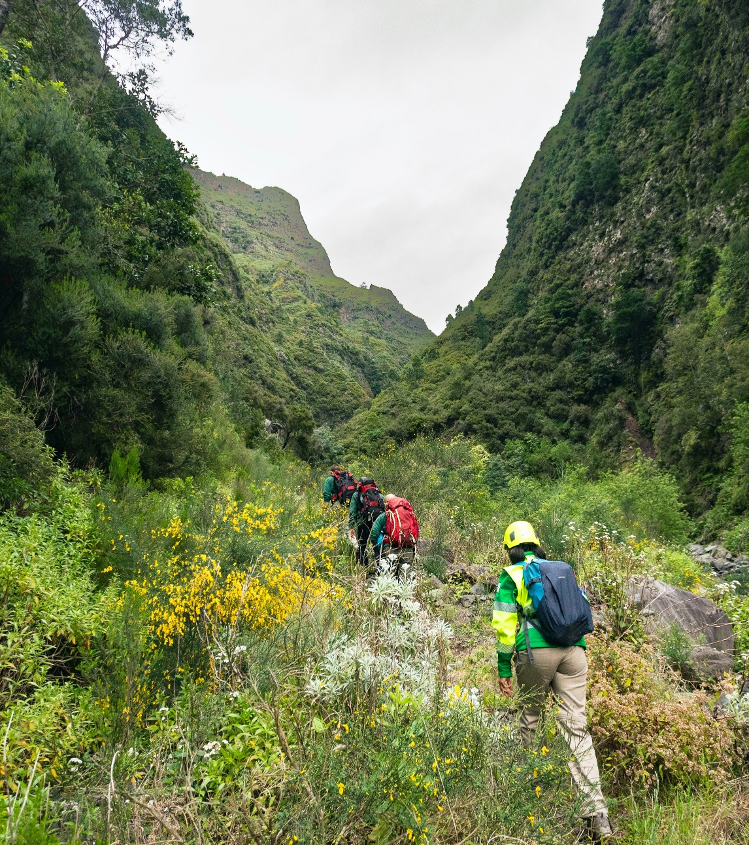

What we do
© Ricardo Lourenço
As conservation practitioners on these islands, we work to protect biodiversity by:
Building locally-relevant projects for critical issues
Linking them to economic and cultural empowerment
Working with, not against, local stakeholders
We represent local non-profits, consulting agencies, and governmental bodies.
Notes:
SABRINE
The three speakers today represent local non-profits, consulting agencies, and governmental bodies working to protect biodiversity on our islands.
Conservation practitioners like ourselves do this by:
Building locally-relevant projects for critical issues
Linking them to economic and cultural empowerment
And working with, not against, local stakeholders

Slide 4
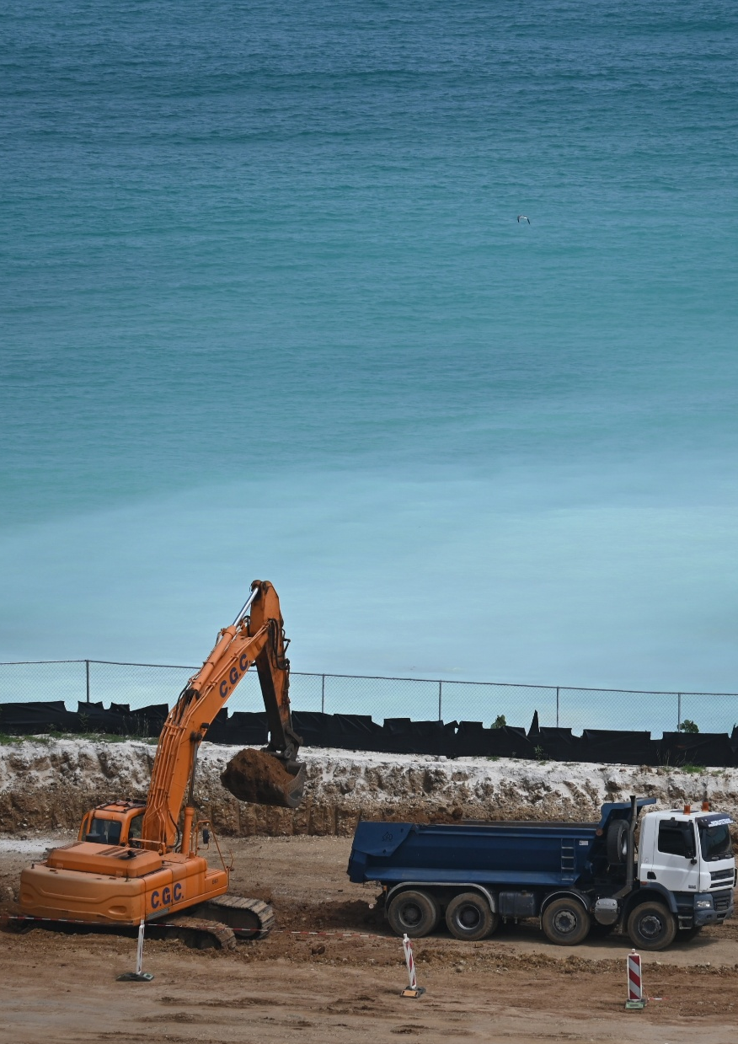
Environmental challenges
Ecosystem destruction, largely linked to supporting tourism-oriented economies
Real or suspected species overexploitation, particularly for marine species
Climate change-induced impacts, which we have no mitigative control over
Invasive species and grazing pressures on already-degraded habitats
Notes:
SABRINE
Our institutions are faced with a variety of complex, interlinked, and evolving environmental challenges shared by countries all over the world.
These include:
Ecosystem destruction, largely linked to supporting tourism-oriented economies. For example, on Sint Maarten, fewer than 22 hectares of mangroves remain, with two of the four species approaching local extinction. Most of these sensitive wetlands have been built over or dredged out for marinas, hotels, and other infrastructure.
In addition, real or suspected species overexploitation, particularly for marine species, is an ongoing threat.
As well as climate change-induced impacts, which our small territories have no mitigative control over;
And invasive species and grazing pressures on already-degraded habitats form another significant challenge for our work.

Slide 5
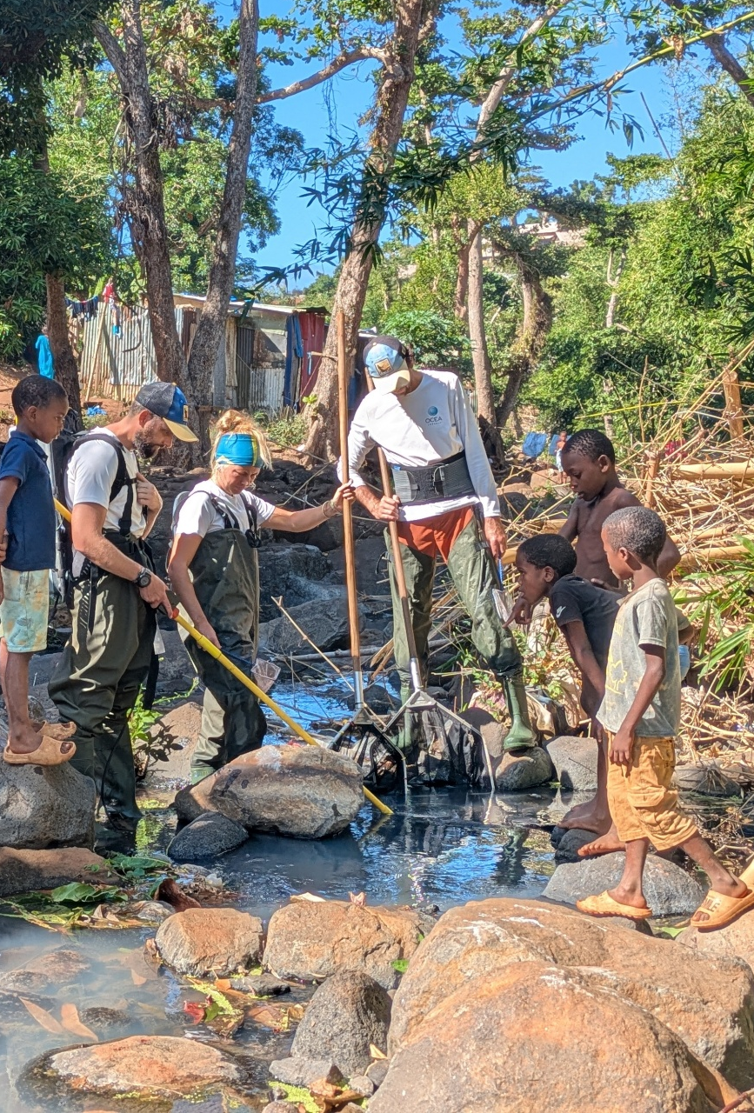
Sociopolitical challenges
Biodiversity initiatives can be difficult to advance alongside immediate policy pressures
Competing demands on limited land and marine resources require careful balancing
Linkages between environmental health and community wellbeing are not apparent
Policy frameworks and enforcement capacity must evolve, with scope to strengthen implementation at the national level
Notes:
SABRINE
Unsurprisingly, sociopolitical challenges have significant implications for the scope, timeline, budget, and success of our projects and the conservation field as a whole.
Biodiversity initiatives can be difficult to advance alongside immediate policy pressures. For example, in Mayotte, one-third of the population lacks access to running water, and those who do have access face water outages half the time. Two-thirds lack access to sanitation facilities. So, while the issue of aquatic biodiversity -- particularly in freshwater -- is urgent, it can sometimes be harder to justify and is often overlooked in favor of other critical issues at hand.
In addition, competing demands on limited land and marine resources require careful balancing
Linkages between environmental health and community wellbeing are not always apparent;
And policy frameworks and enforcement capacity must evolve, with scope to strengthen implementation at the national level

Slide 6
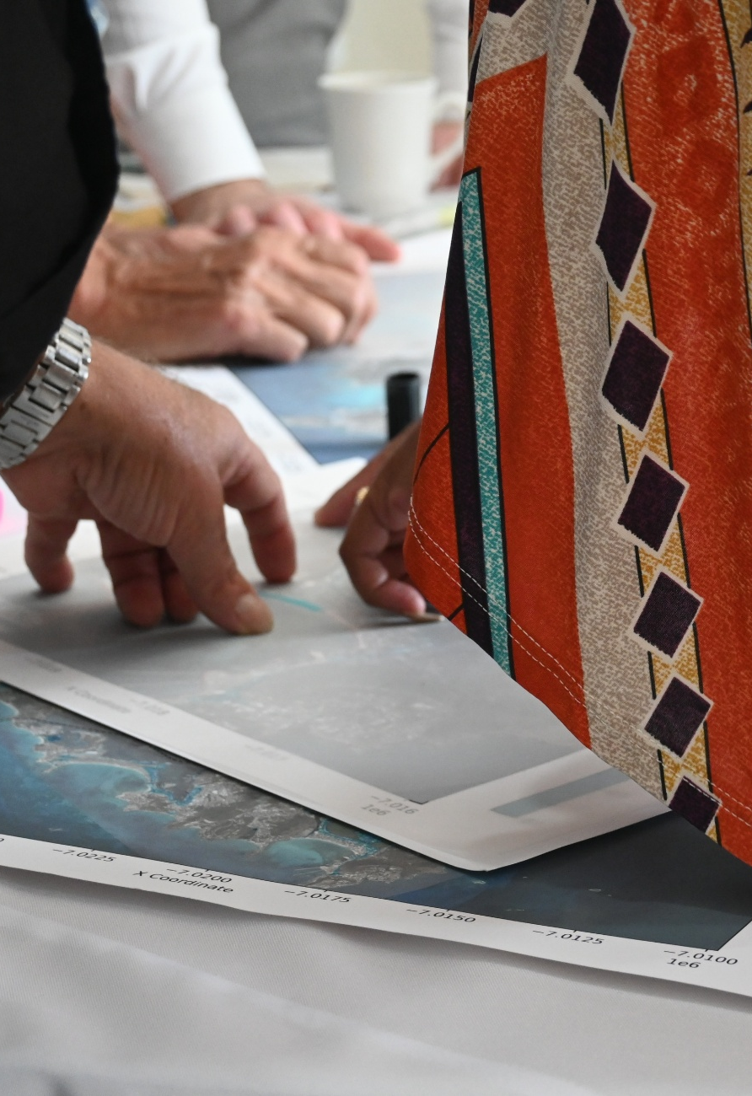
Institutional challenges
Bureaucratic complexities create challenges in coordination, funding access, policy implementation
Data must be strengthened in ecosystem and species monitoring programmes
Activities may be constrained or limited by reliance on donor or project-based funding
Capacity constraints and workforce retention remain ongoing challenges in small island contexts
Notes:
SABRINE
And finally, the institutional challenges we collectively face:
Bureaucratic complexities create challenges in coordination, funding access, and policy implementation.
Data must be strengthened in ecosystem and species monitoring programmes. For example, in Madeira and the Canary Islands, limited information on breeding colonies and the species' distribution at sea initially made it difficult to identify priority conservation areas and effectively plan future monitoring and management actions.
Frequently, activities may be constrained or limited by reliance on donor or project-based funding.
And finally, capacity constraints and workforce retention remain ongoing challenges in small island contexts.

Slide 7
Programmes like BESTLIFE2030 can’t solve all our problems...
Relying solely on project-based funding is unsustainable. Outermost regions and Overseas Countries and Territories need structural and open funding to support long-term conservation initiatives that respond to local needs.
... but they are essential to helping us reach our goals.
BESTLIFE2030 plays a key role in protecting biodiversity globally. Its focuses, inclusion, and flexibility allow us to conduct valuable work when financial instruments can’t be provided sustainably, projects are deemed too ambitious for solely local support, or institutions are already juggling too many tasks.
Notes:
SABRINE
We know that:
Programmes like BESTLIFE2030 can’t solve all our problems...
Relying solely on project-based funding is unsustainable. Outermost regions and Overseas Countries and Territories need structural and open funding to support long-term conservation initiatives that respond to local needs.
... but they are essential to helping us reach our goals.
BESTLIFE2030 plays a key role in protecting biodiversity globally. Its focuses, inclusion, and flexibility allow us to conduct valuable work when financial instruments can’t be provided sustainably, projects are deemed too ambitious for solely local support, or institutions are already juggling too many tasks.

Slide 8
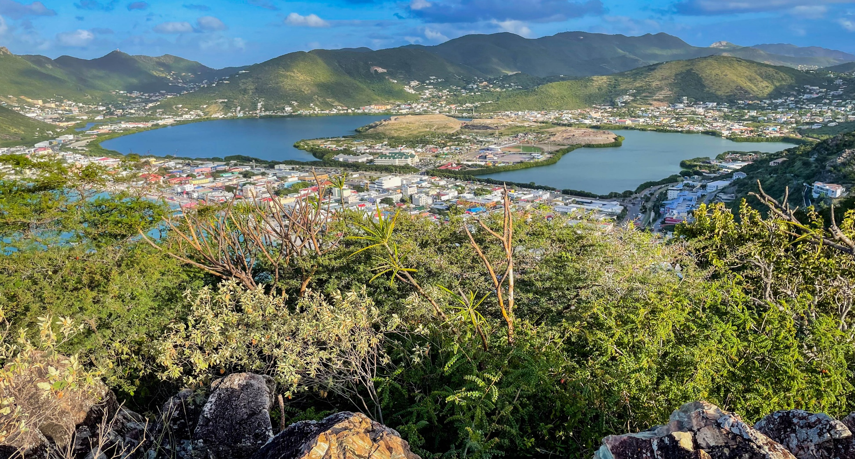
2. Stories
Notes:
SABRINE
With some understanding about the significant challenges we face in mind, we are excited to share a little bit about our projects with you now.
These three projects are just a small selection from more than 50 locally led conservation initiatives supported currently through the BESTLIFE programme across Europe's overseas regions and territories.
From habitat restoration to scientific monitoring and community engagement, these projects allow for nimble, innovative, and targeted focuses. They encourage us to explore unknown and long-overdue sectors of our work and develop creative and collaborative solutions in a local context, with scientifically sound and deeply personal results.

Slide 9
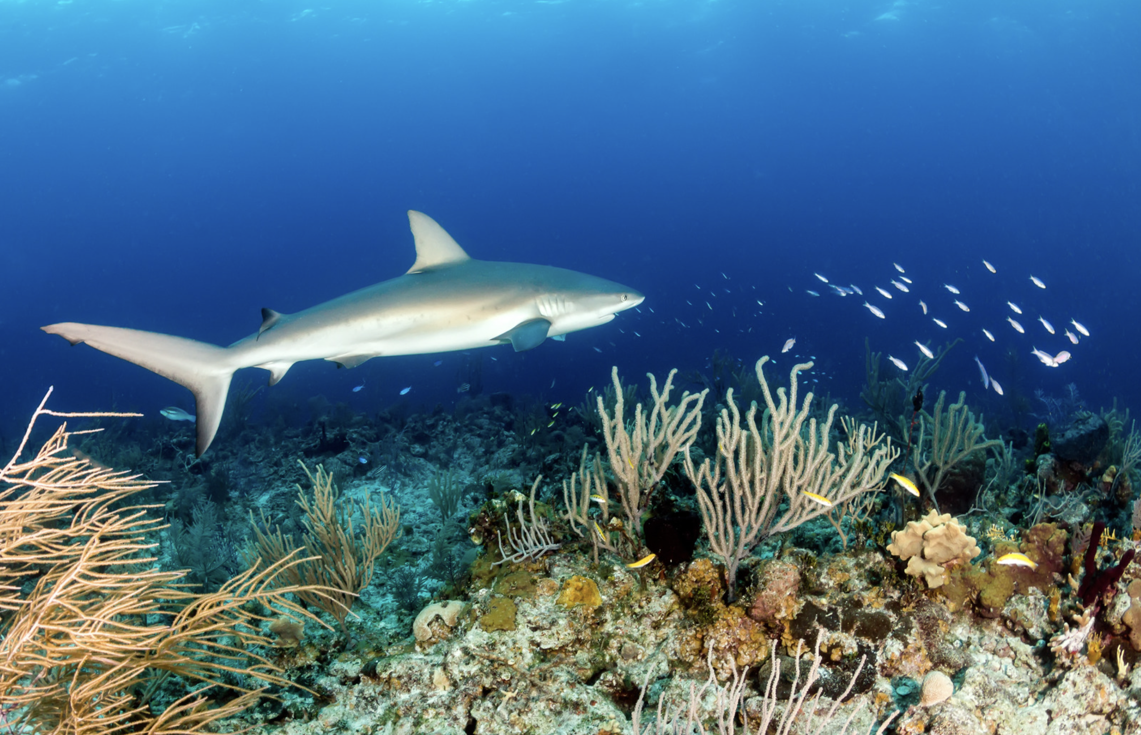
Sabrine Brismeur
Sint Maarten
Marine Elasmobranch Nursery Area Advocacy (MENAA)
Implemented by Nature Foundation Sint Maarten
Notes:
SABRINE
My name is Sabrine Brismeur. On the island of Sint Maarten in the Caribbean, I lead a project dedicated to establishing a foundation for conservation success in our marine and coastal areas — particularly for our local sharks and rays.
Despite being critical to a balanced marine ecosystem, these species are globally under threat from overfishing and habitat degradation. Sint Maarten's waters are no exception.
Through our BESTLIFE2030 project, MENAA, we developed an initiative that collects essential data on our understudied artisanal fishery and works closely with fishers to improve conservation outcomes for sensitive shark and ray species.
This is the kind of long-term partnership needed to strengthen the effective management of marine biodiversity and enable locals deliver the EU's biodiversity objectives.

Slide 10
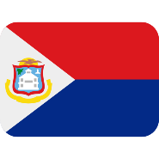
Sint Maarten: Healing critical stakeholder relationships
Issue
Action
Impact
Our local fishery is completely unstudied, and key stakeholders lack trust. Sharks, rays, and other marine species are at risk in ways not understood.
Compensation-based initiatives connected to educational workshops, fishery monitoring, qualitative interviews, and stakeholder engagement.
Fishers are supported, informed, and heard. Critical information on the fishery sector and species threats is obtained. Tools are customised for local public knowledge.
Notes:
SABRINE
I come from a family on French Saint-Martin that has been prominent in the maritime sector for decades. As a child, I often accompanied my father on recreational fishing trips for snapper, tuna, or lobster.
But the artisanal fishery was never something I knew much about — and neither did my organisation, the Nature Foundation — despite our role as a leading marine conservation institution on the island.
Conservation and fisheries are often seen as being at odds with one another, and relationships can be particularly tense in Caribbean island contexts — where some conservation efforts can leave people feeling like nature is being protected from them, rather than for them.
When I joined the NGO in 2023, we didn't necessarily have a bad relationship with fishers — but we didn't have a relationship with them at all. For years, local fishers had been engaged repeatedly by agents from governments, consultancies, and private companies, with no tangible benefits for them. This has understandably eroded their trust and willingness to cooperate with decision-makers, especially in a politically sensitive sector like conservation.
This is an enormous disadvantage for both parties. On an island as small as ours, individual negative actions can quickly accumulate into significant impacts — whether that means a shark taken from a protected reef, or a fisher who walks away feeling dismissed.
So, through our BESTLIFE2030 project, my team and I set out to change the status quo and build a real relationship — for the benefit of everyone involved. The centerpiece of our project was a programme linking collaborative educational workshops with direct livelihood support for artisanal fishers.
In exchange for helping us develop our programme and participating in workshops on marine conservation and sustainable fisheries, fishers received up to USD 1,500 in essential goods and services.
We helped one fisher find and install a boat winch to place his fish traps in deeper waters — allowing him to target varied species and move away from the overexploited shallow reefs where parrotfish are regularly harvested. Another chose a replacement pump for his boat, whose failing equipment was directly threatening his income and livelihood.
During these workshops, fishers received locally customised, 3D-printed measurement gauges for lobster and conch, fish identification resources, and descending devices to release undersized catch — tools we have since seen them using in the field. We worked together to understand what a sustainable fishery could look like for Sint Maarten. We found common ground on difficult and sometimes divisive topics, and we found a way to communicate with one another — even when we disagreed.
In the coming weeks, our project will roll out a second round of workshops for more fishers, tied to fishery monitoring that will generate the critical baseline data we need for effective conservation and management going forward.

Slide 11
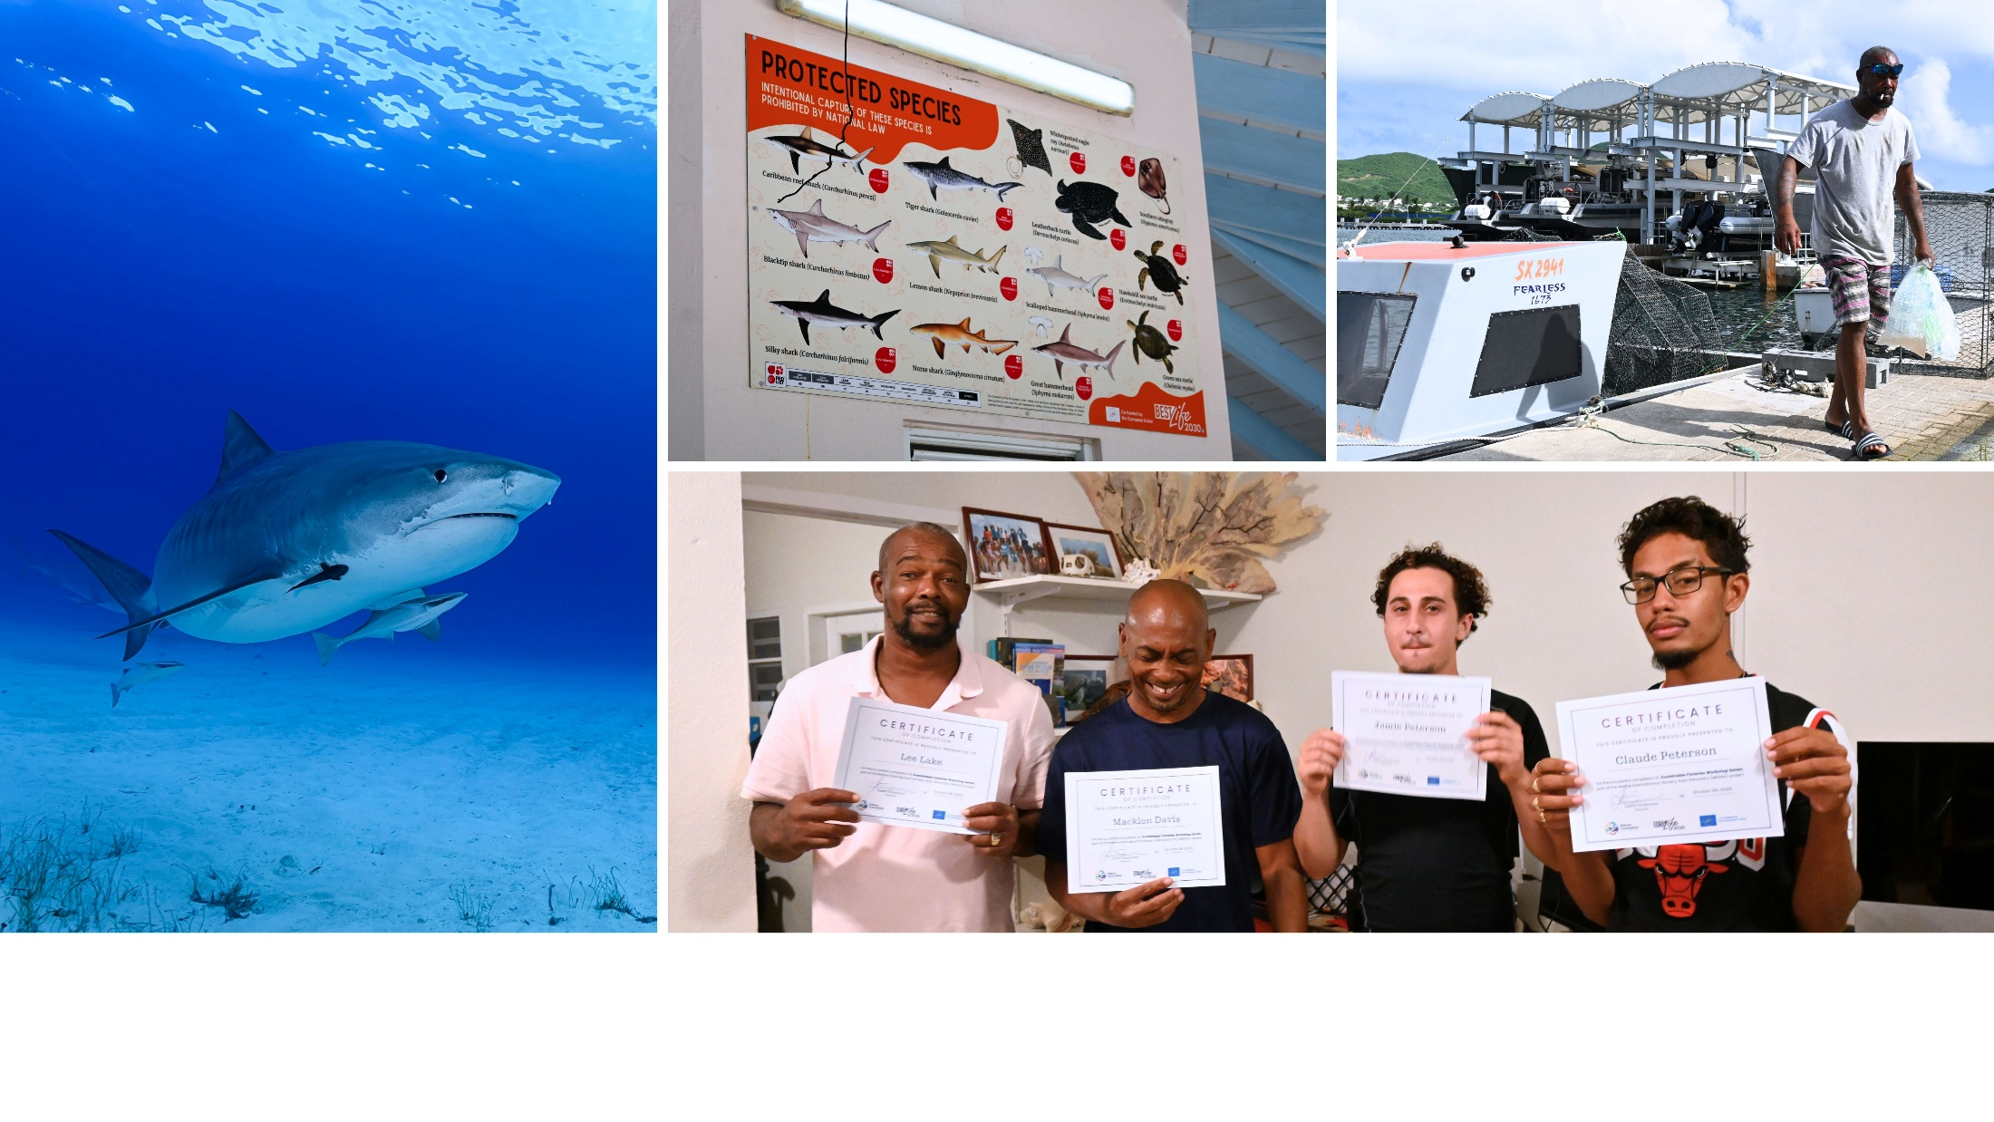
On St. Maarten, strengthening legislative frameworks and enforcement capacity is important for addressing biodiversity pressures. BESTLIFE2030 allows us to make community-focused interventions that support local livelihoods and involve key stakeholders in conservation efforts.
Notes:
SABRINE
This group of fishers now knows that we are serious about supporting them and their livelihoods. They know that we have immense respect for what it takes to fish, and for the knowledge they carry. They know that though we will not always agree, we ultimately want the same outcomes: abundant marine life in a healthy sea. And now, we can begin working toward that together — through marine park management, fisheries legislation, and public education.
This kind of work takes an extraordinary amount of time, trust, and transparency. Mindset shifts do not immediately translate to behavioral change — but we must start somewhere, and this is it. BESTLIFE2030 gave us the means to begin building this critically important relationship, with what we anticipate will be real and lasting benefits for marine biodiversity down the line.
Thank you!

Slide 12
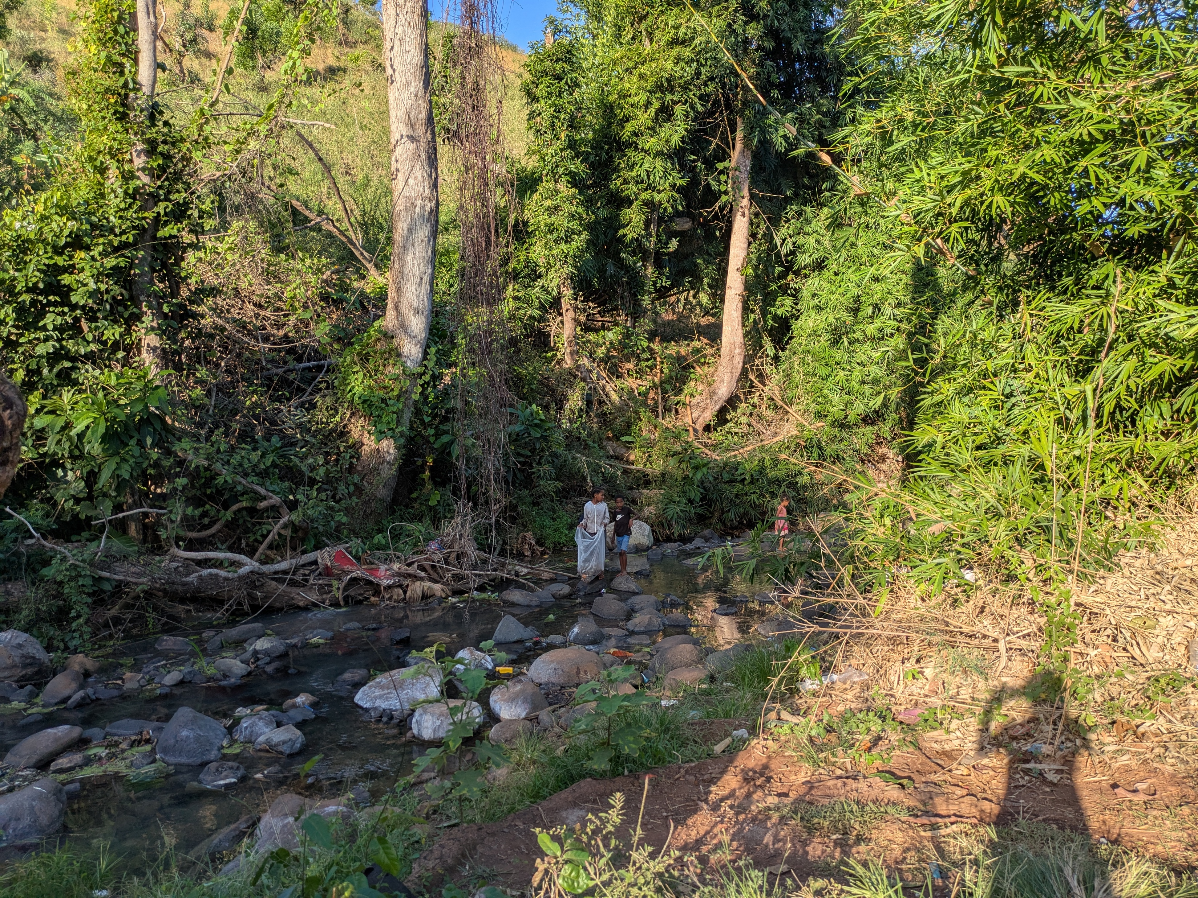
Laëtitia Faivre
Mayotte
RESTOCOR: Restoration of the Habitat and Populations of Cotylopus rubripinnis in the Rivers of Mayotte
Implemented by OCEA Consult’ & Mayotte Nature Environnement
Notes:
LAETITIA
My name is Laëtitia Faivre, and I work on the island of Mayotte, where I lead the RESTOCOR project — a restoration initiative focused on the freshwater rivers that are home to Cotylopus rubripinnis, a fish species found nowhere else on Earth outside the Comoros Archipelago.
Mayotte's rivers are under serious pressure. More than 330 barriers interrupt their natural flow. Domestic uses continuously degrade water quality and widespread illegal water extraction leaves stretches of river too shallow and sluggish to sustain aquatic life at all.

Slide 13
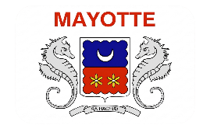
Mayotte: Involving communities in riverway restoration
Issue
Action
Impact
Mayotte's waterways are under serious threat, with native fishes and crustaceans becoming increasingly vulnerable.
Restoration of habitat quality, education of community members, and assessment of ecological benefits.
Maintenance of 3 watersheds, training for 5 NGOs, public awareness campaigns; indicators of changes in habitats and wildlife populations
Notes:
LAETITIA
The RESTOCOR project works on two fronts at the same time:
The first is restoring habitat quality across three watersheds through river cleanups carried out in partnership with social reintegration NGOs, awareness campaigns reaching local communities, elected officials and schoolchildren, training local organisations in biodiversity and habitat monitoring, and targeted action against illegal water extraction.
The second is measuring whether it is working, by tracking populations of Cotylopus rubripinnis and other native fish and crustaceans as well as monitoring how their spawning grounds respond over time.
The real challenge of this project was bringing together local organisations from the social sector, community members, local authorities, and scientific expertise — all toward the common goal of long-term biodiversity conservation.
But during my last field visit in June, on the Gouloué River, I realised that challenge had been partially met.
Ali, 20, participated in a work-study programme with our partner NGO, Mayotte Nature Environnement. He was responsible for waste and log jam cleanup sessions, and that day, Ali was diligently measuring the river's flow rate with a current meter — assessing whether the removals his team had carried out were yet improving water circulation.
Marcellina, 11, lived in the banga — the informal settlement — just beside the river. She was examining larvae caught in plankton nets under a magnifying glass. She hasn't missed a single one of our four monitoring sessions. She told me that if the river is cleaner today, it's partly because of her — and the 80 other eco-delegates from her middle school who have been coming to clean it every month, ever since she went back and told her teacher what we were doing.
We have risen to the challenge — thanks to a young volunteer who found us after seeing our work on television, thanks to local organisations independently raising funds to continue what we started, and thanks to their ongoing support for environmental monitoring on other rivers in Mayotte.
RESTOCOR is making visible progress, but our work is not finished. It is still too early to say whether these actions have truly led to the recovery of Cotylopus rubripinnis populations. They remain highly vulnerable — along with the broader biodiversity and the rivers we all depend on.

Slide 14
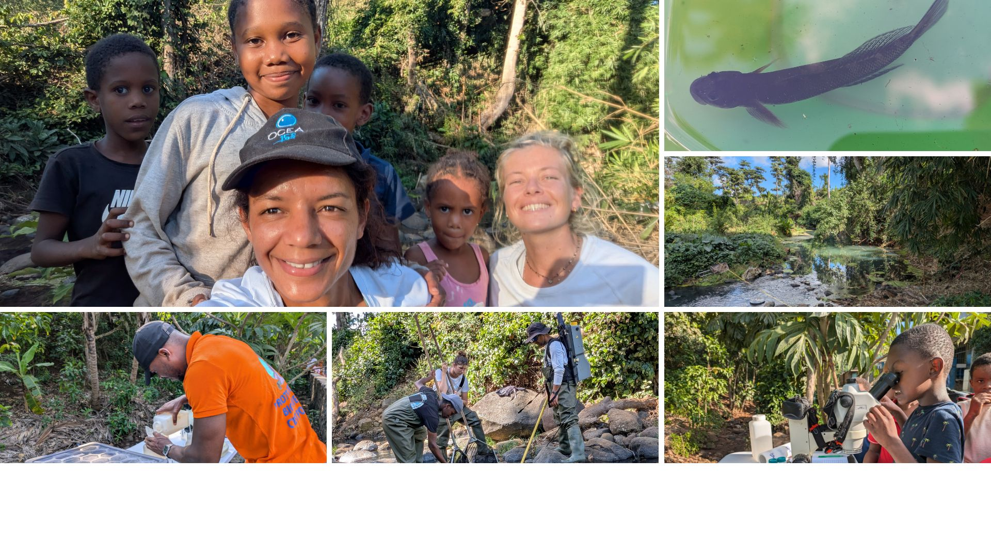
In Mayotte, coordinating the efforts of socio-environmental stakeholders is essential for the long-term preservation of biodiversity and water resources. BESTLIFE2030 allows us to bring together the efforts of social NGOs, local populations, managers, local authorities, and scientists.
Notes:
LAETITIA
Restoring freshwater ecosystems takes time. Flexible, long-term investment is therefore essential if Europe is to meet its restoration ambitions.
These joint efforts in restoration, awareness-raising, and scientific monitoring must be sustained. The condition of our waterways continues to deteriorate in the face of growing pressures on the territory. The impact of habitat restoration and awareness-raising can only be measured over the medium to long term — 5 to 10 years. That is the true nature of ecological recovery.
Biodiversity and water resource protection must become genuine priorities for the region, backed by the financial, human, and technical resources needed to see them succeed.
Initiatives like RESTOCOR deserve greater support from local governments and authorities, and programmes like BESTLIF2030 are essential in helping us showcase the value of these conservation projects to our regional decision-makers.
Thank you.

Slide 15
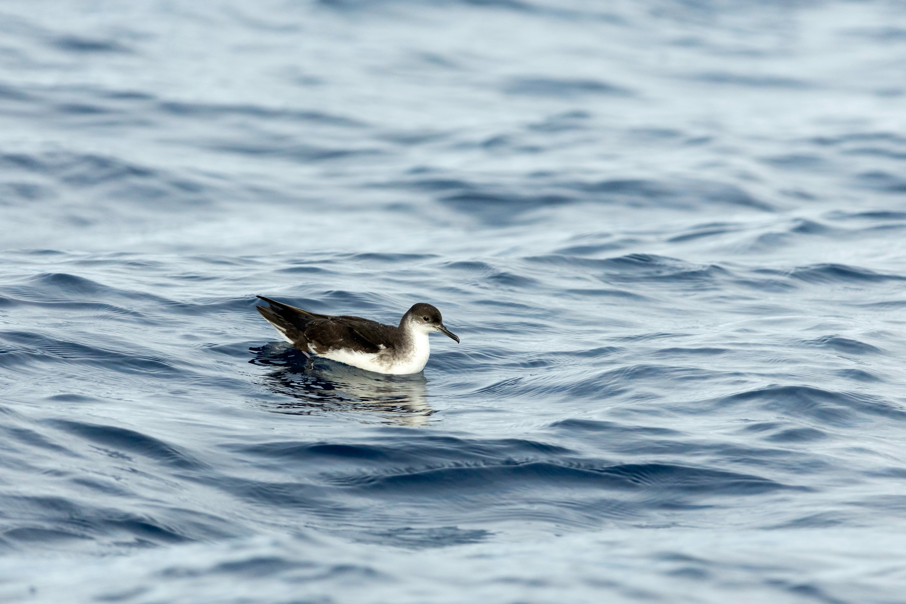
João
Nunes
Madeira and the Canary Islands
MAC Puffinus: Conservation of the Manx Shearwater in Madeira and the Canary Islands
Implemented by Funchal City Council, Ecological Park of Funchal, ARDITI, MARE-Madeira, and the University of Barcelona - Seabird Ecology Lab
© Ricardo Lourenço
Notes:
JOAO
My name is João Nunes, and I coordinate the Mac Puffinus project at the Ecological Park of Funchal on Madeira Island, managed by the Funchal City Council. Our project focuses on the conservation of the Manx Shearwater — a seabird that breeds in Madeira and the Canary Islands and remains one of the least-known seabirds in our region.

Slide 16

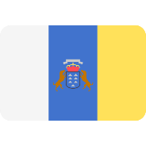
Madeira and the Canary Islands: Holistic interventions for species
Issue
Action
Impact
A poorly understood seabird faces mounting threats from invasive predators, habitat loss, and human disturbance, with insufficient data to guide protection.
GPS tracking, acoustic monitoring, nest prospecting, predator control, and cross-island stakeholder collaboration generate the data needed for conservation.
First GPS data collected, active nests identified, and a transnational conservation network established to secure the species' long-term survival.
Notes:
JOAO
When we started this project, one of our biggest challenges was surprisingly simple: we did not know enough. Important breeding areas remained undiscovered, and the threats these birds face were poorly understood. Without this knowledge, it is difficult to protect a species effectively.
BESTLIFE2030 gave us the opportunity to change that.
Over the last few months, teams in Madeira and the Canary Islands have worked together to better understand this species. In Madeira, we monitored remote valleys and searched for breeding areas in difficult terrain. In the Canary Islands, our partners identified several new potential breeding areas and began mapping how these birds move across the region. By sharing methods, experience, and knowledge across islands, we have been able to achieve much more than any of us could have achieved alone.
What we discovered exceeded our expectations, and what we found is already informing management decisions and laying the foundation for the long-term conservation of this species in Macaronesia.
But what I value most about this project is not a specific result. It is the collaboration that made those results possible.
We brought people and institutions together, filled critical knowledge gaps, and created foundations for long-term conservation. Public authorities, NGOs, schools, volunteers, private companies, and local stakeholders all contributed to a common goal. This is what locally led conservation looks like in practice.
Projects like Mac Puffinus demonstrate that targeted investment creates lasting impact when it supports local expertise, cooperation, and commitment. We are delivering meaningful outcomes for biodiversity, strengthening cooperation across territories, and creating benefits for both nature and society.
At the same time, our experience has made one thing clear: conservation is not a one-time effort. Without continued support, the knowledge gaps we have begun to close would remain unresolved, important breeding areas could remain unprotected, and the momentum built through this collaboration could be lost. Long-term conservation requires long-term commitment — and long-term funding.

Slide 17
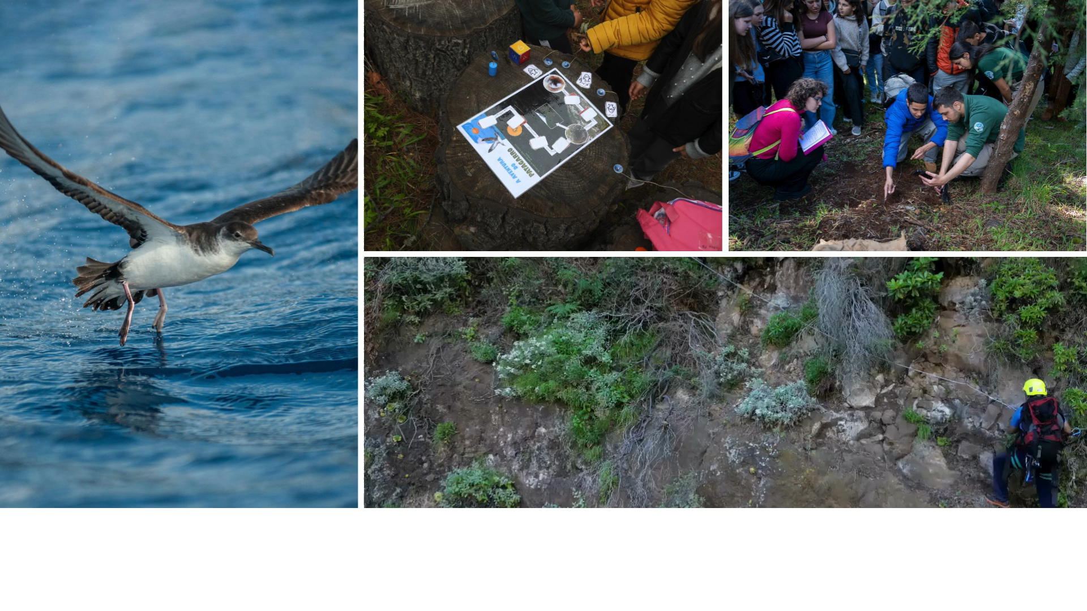
© Rene Pop
On Madeira and the Canary Islands, successful scientific monitoring and management efforts for species-specific preservation requires institutional cooperation. BESTLIFE2030 brings together stakeholders from all groups to collect ecological data and improve species outcomes.
Notes:
JOAO
If I had the opportunity to share one message with EU decision-makers, it would be simple: don't forget the islands. Island regions may be small and remote, but they are home to extraordinary biodiversity and unique ecosystems that form an irreplaceable part of Europe's natural heritage. Island regions safeguard biodiversity of global importance.
Continued EU investment through programmes such as BESTLIFE2030 enables local organisations to generate the knowledge, partnerships, and long-term stewardship needed to protect these ecosystems for future generations.
Continued investment in biodiversity action in island regions through programmes like BESTLIFE2030 is not only an investment in nature; it is an investment in people, cooperation, resilience, and the future of our natural heritage.
Thank you.

Slide 18
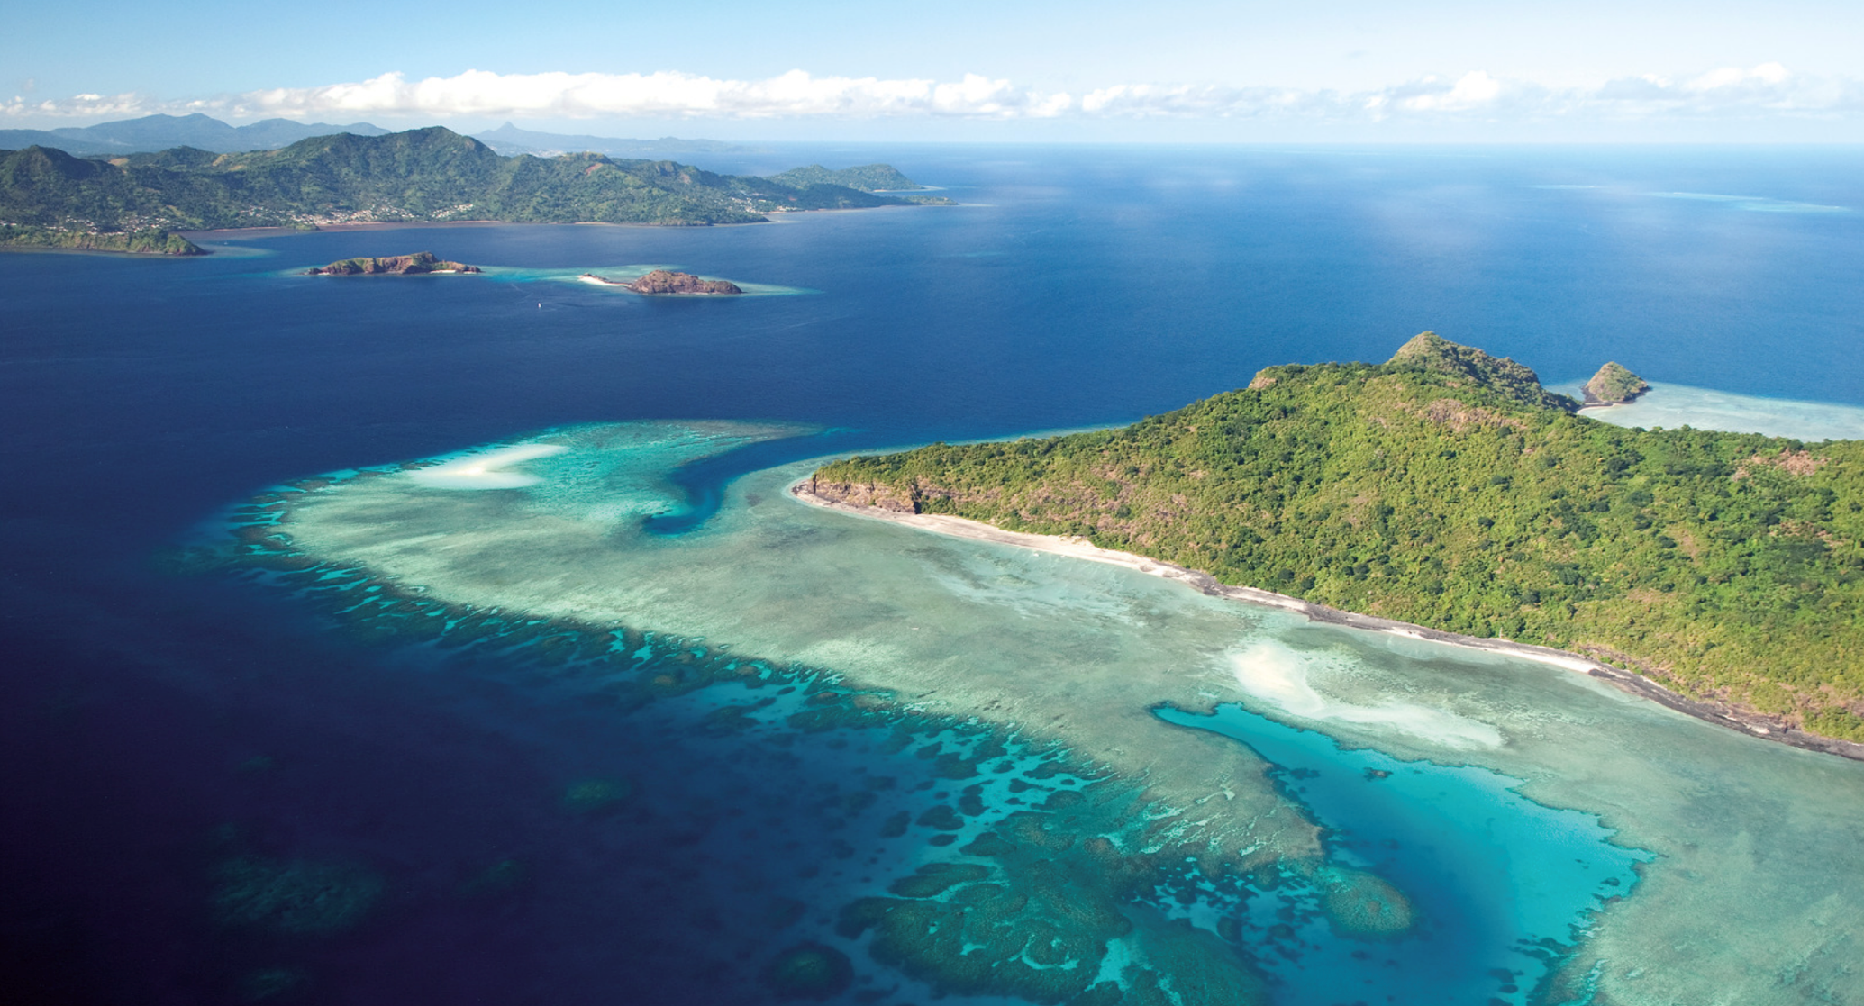
3. Closing
Notes:
SABRINE
In closing…

Slide 19

Flexible, long-term programmes are needed more than ever to support our work’s sustainability and help meet biodiversity commitments and targets, such as the EU Biodiversity Strategy for 2030 and the Kunming-Montreal Global Biodiversity Framework.
Global biodiversity faces significant pressures, but local actors continue to deliver meaningful results on the ground.
Notes:
SABRINE
It is no secret that global biodiversity faces significant pressures, but we hope that the handful of examples of BESTLIFEL2030 projects discussed today helps showcase that local actors continue to deliver meaningful, involved, and foundational results on the ground. We represent what effective, locally-led conservation really looks like, not as a concept, but as a proven practice which has been and will continue to deliver results for Europe's biodiversity commitments in the long-term.
As we’ve emphasised today, conservation initiatives like ours take time and relationships to develop, implement, monitor, and produce results. The sorts of outcomes we are working for may function in the timespan of years, decades, or even longer. Earth takes time to heal, even with assistance.
But this vital work cannot begin without immediate funding and long-term backing. We cannot deliver tomorrow's results without today's support. Our natural world depends on it.

Slide 20
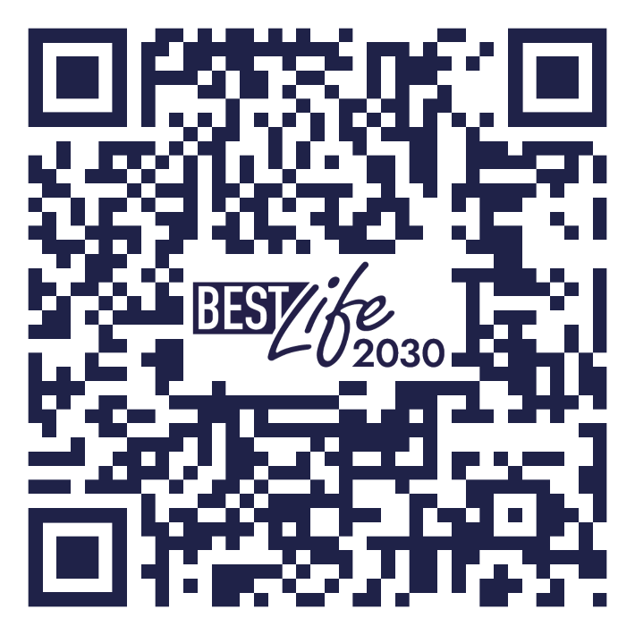
Sabrine Brismeur
Nature Foundation Sint Maarten
sabrine@naturefoundationsxm.org
João Nunes
Funchal City Council
miguel.nunes@funchal.pt
Laëtitia Faivre
OCEA Consult’
laetitia.faivre@ocea.re
IUCN BESTLIFE2030 team:
Admin/comms: bestlife2030@iucn.org
Finance: financebestlife2030@iucn.org
SIGN UP TO OUR NEWSLETTER
Notes:
SABRINE
Thank you very much for your time and attention. We remain open to any questions or comments you may have through our institutional emails.

