Slide 1
Progress towards GBF Target 9
Dr. Dilys Roe,
IIED & IUCN SULi

Slide 2
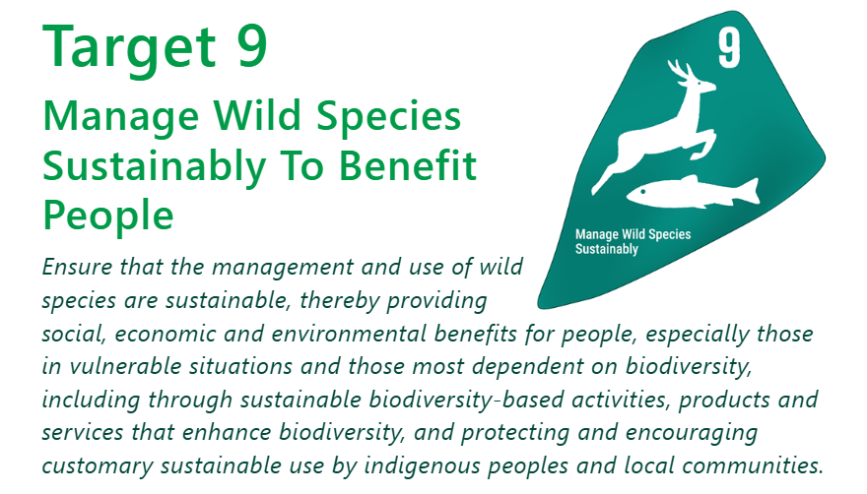

Slide 3
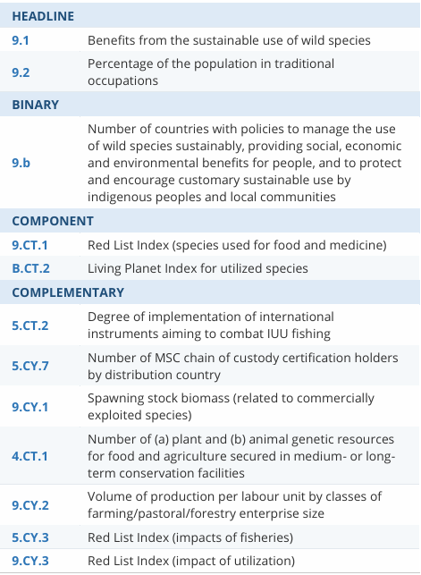

Slide 4
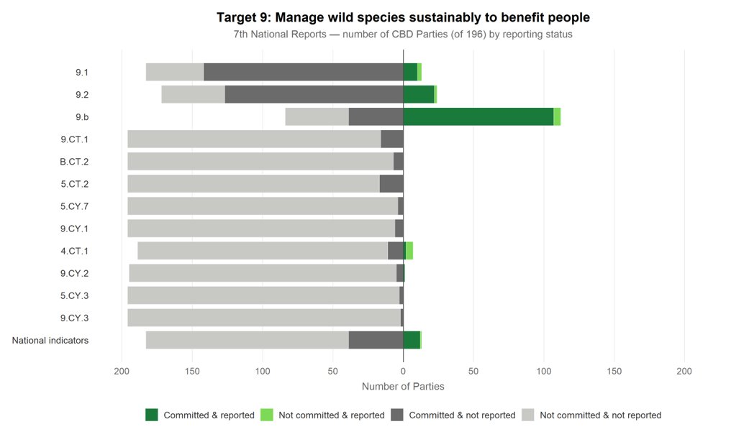

Slide 5
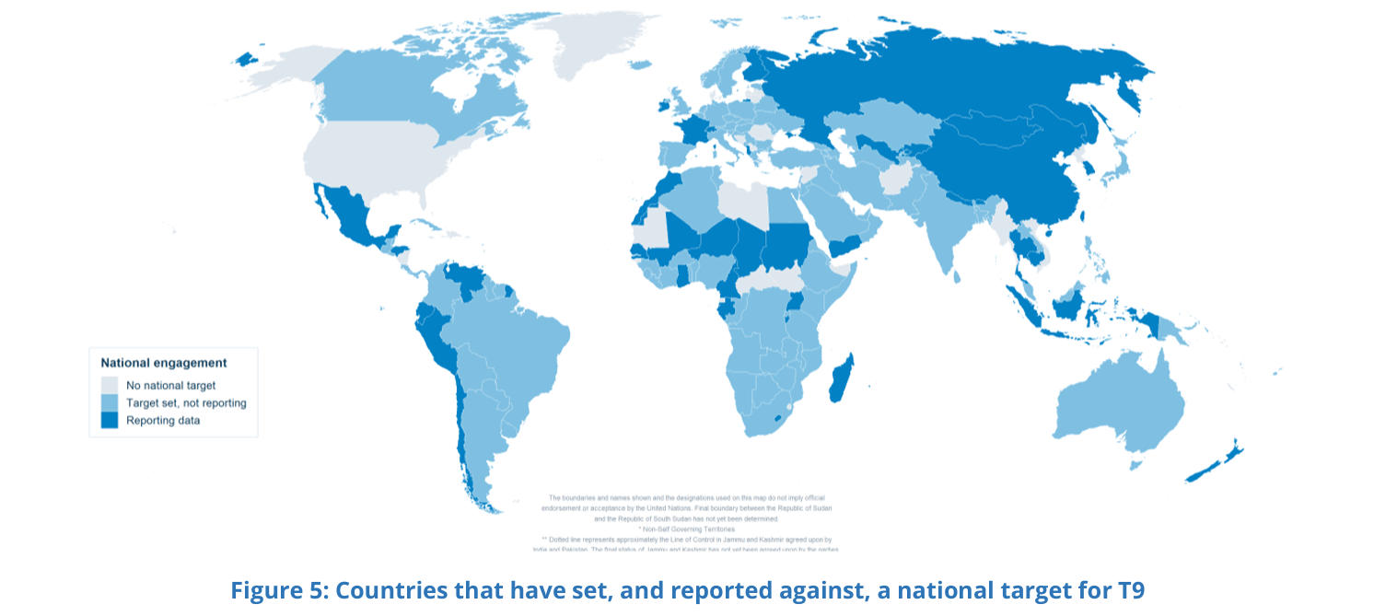

Slide 6
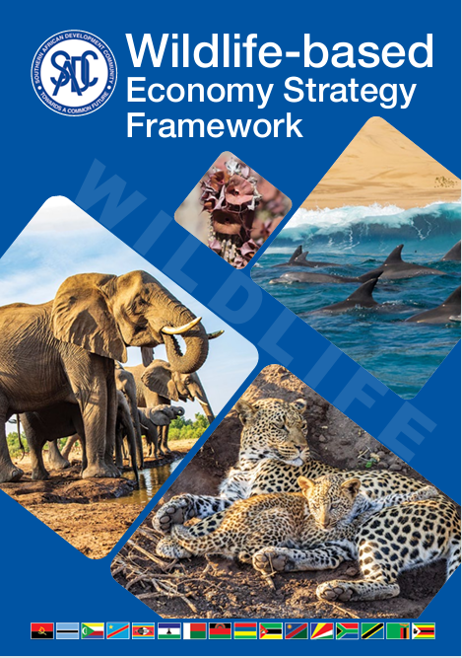
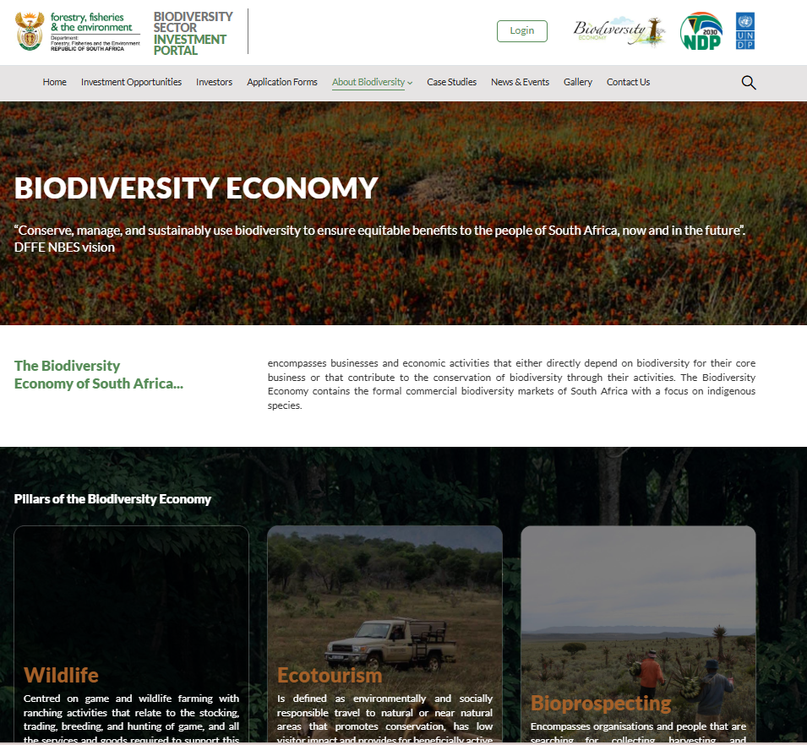
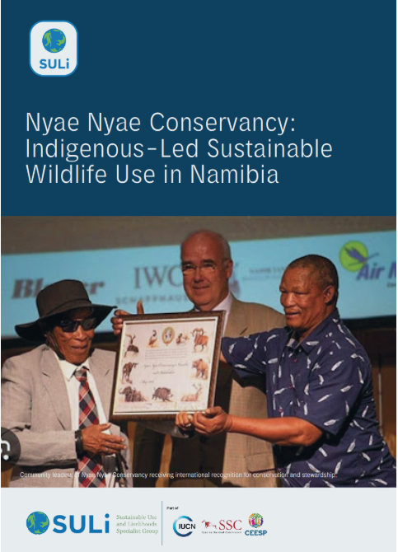
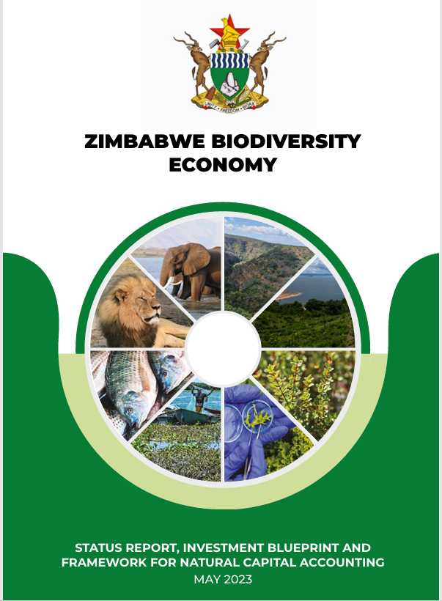
Wildlife economy in Southern Africa

Slide 7
Challenges and opportunities in the region
Successful and effective CBNRM networks and associations across the region
Unique natural capital representing a significant development opportunity
BUT
Resource constraints to develop and implement biodiversity based activities, products and services
External policy environment against wildlife utilization (eg trophy import bans)
Methodological and data challenges in monitoring benefits from sustainable use

Slide 8
How the EU can help
Support efforts to raise profile of, and increase support for, sustainable use (eg within CBD: Brazil proposal for a new PoW, adoption of SWM guidance)
Increase efforts to recognize and strengthen rights of local communities (eg within CBD and CITES support and strengthen efforts to include local communities in CITES decision-making
Promote inclusive, equitable, biodiversity-positive approaches to bioeconomy (eg through G20 continuation of bioeconomy initiative and high level principles)
Avoid unilateral measures that inadvertently undermine progress towards T9 (eg domestic measures to curtail hunting even if evidence available on sustainability)

Slide 9
Thank You dilys.roe@iied.org

