Slide 1
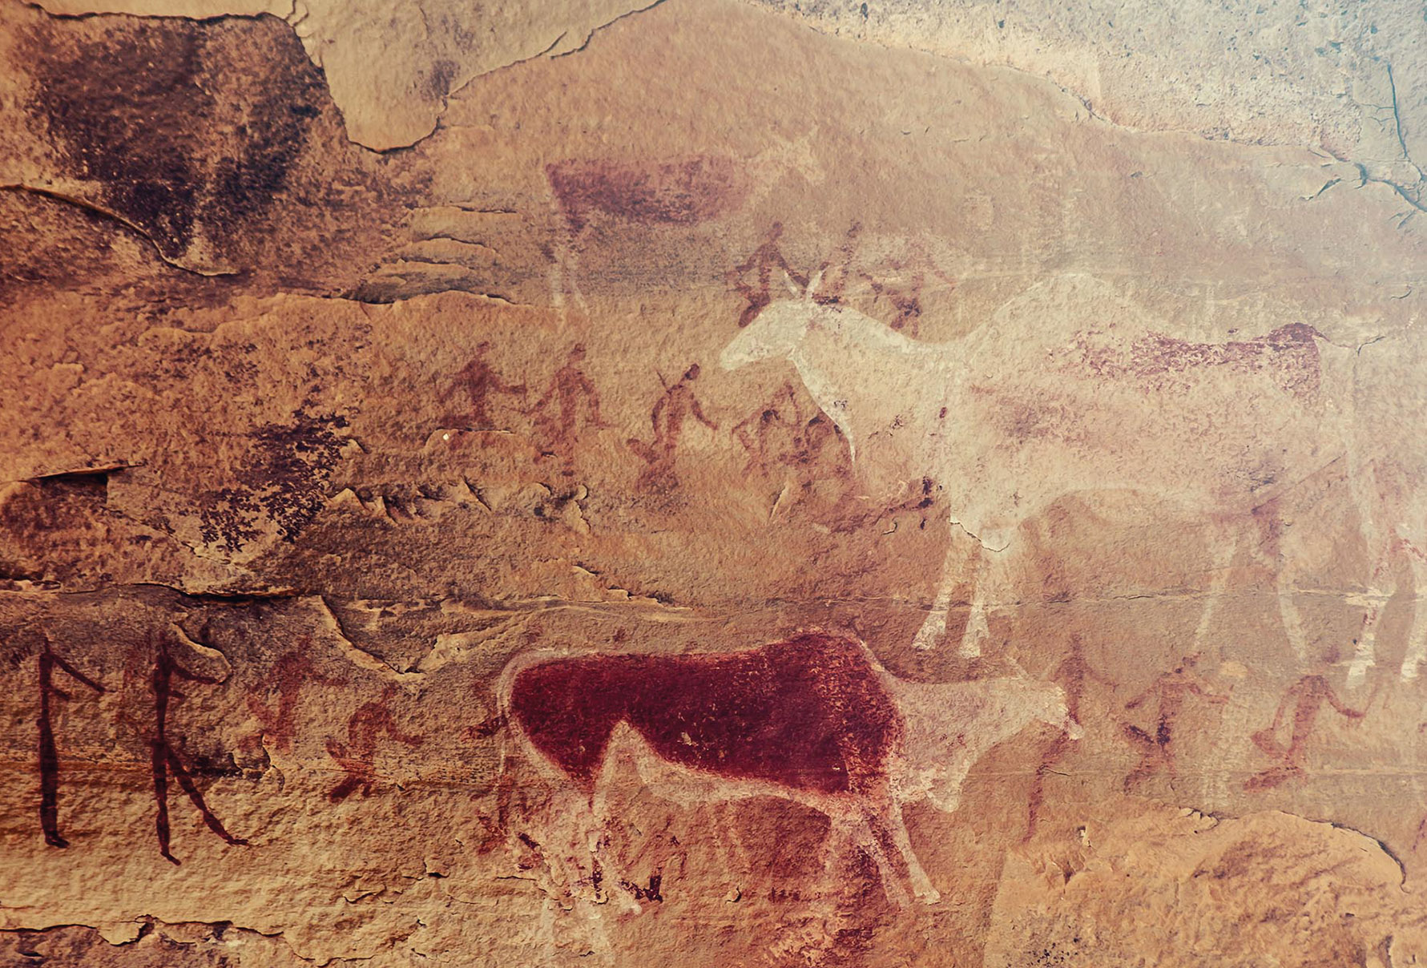


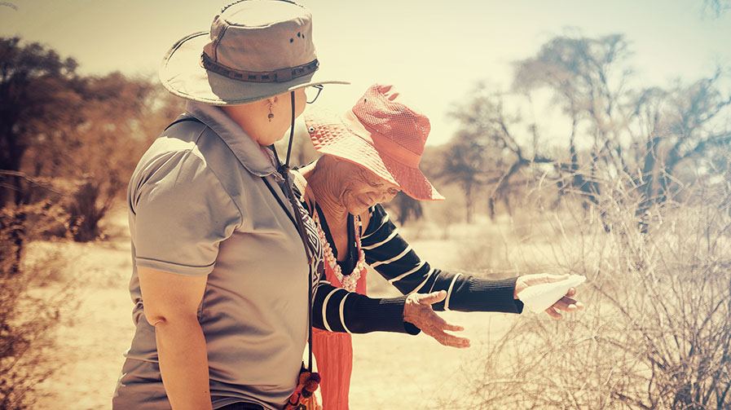
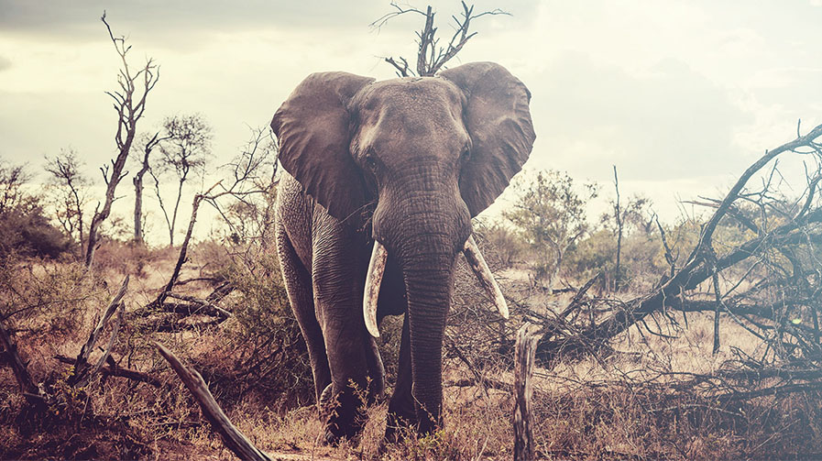
EST 2024
SOUTHERN AFRICA
CBD COP 17
Global Biodiversity Framework
Lesle Jansen
Achieving Climate Justice through the Biocultural Rights of Indigenous Peoples and Local Communities

Slide 2
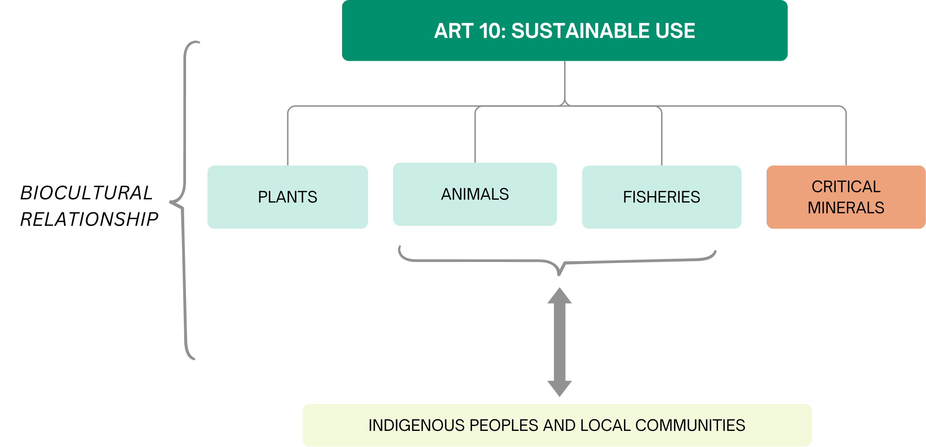
HUMAN CENTERED CONSERVATION APPROACH
Small scale farmers/women
Achieving Climate Justice through the Biocultural Rights of Indigenous Peoples and Local Communities
2

Slide 3
GLOBAL BIODIVERSITY FRAMEWORK (CBD)
TARGET 9: Manage Wild Species Sustainably To Benefit People
Ensure that the management and use of wild species are sustainable, thereby providing social, economic and environmental benefits for people, especially those in vulnerable situations and those most dependent on biodiversity, including through sustainable biodiversity-based activities, products and services that enhance biodiversity, and protecting and encouraging customary sustainable use by indigenous peoples and local communities.
TARGET 5: Ensure Sustainable, Safe and Legal Harvesting and Trade of Wild Species
Ensure that the use, harvesting and trade of wild species is sustainable, safe and legal, preventing overexploitation, minimizing impacts on non-target species and ecosystems, and reducing the risk of pathogen spillover, applying the ecosystem approach, while respecting and protecting customary sustainable use by indigenous peoples and local communities.
Target 3
Conserve 30% of Land, Waters and Seas
Ensure and enable that by 2030 at least 30 per cent of terrestrial, inland water, and of coastal and marine areas, especially areas of particular importance for biodiversity and ecosystem functions and services, are effectively conserved and managed through ecologically representative, well-connected and equitably governed systems of protected areas and other effective area-based conservation measures, recognizing indigenous and traditional territories where applicable, and integrated into wider landscapes, seascapes and the ocean, while ensuring that any sustainable use, where appropriate in such areas, is fully consistent with conservation outcomes, recognizing and respecting the rights of indigenous peoples and local communities, including over their traditional territories.
IPBES

Slide 4
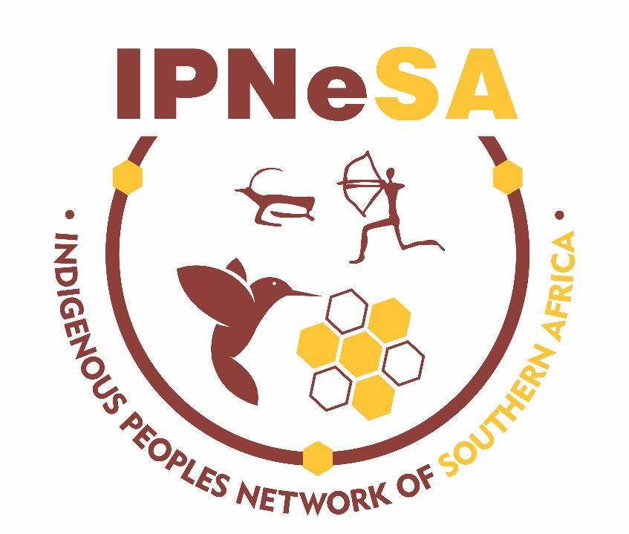
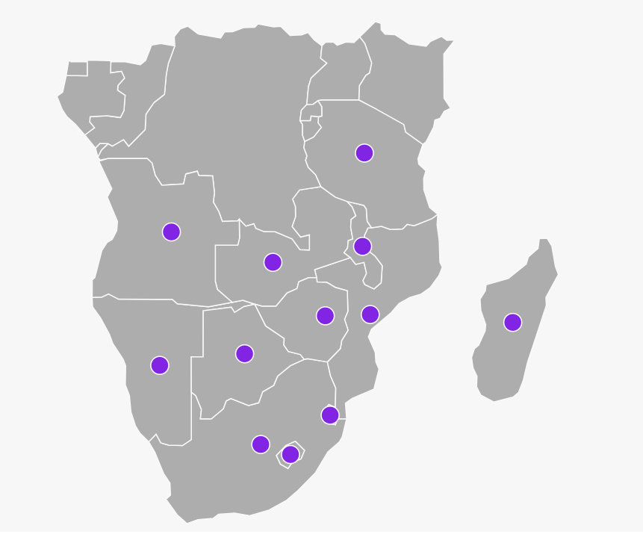
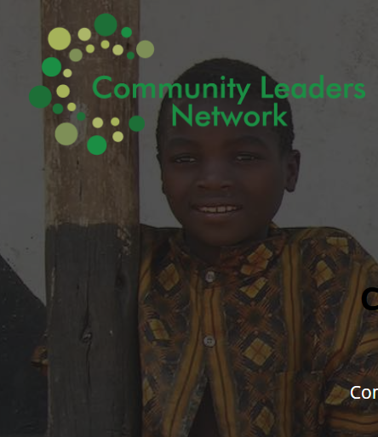

Notes:
Main network
Geographical areas (SA, Namibia, Botswana)

Slide 5
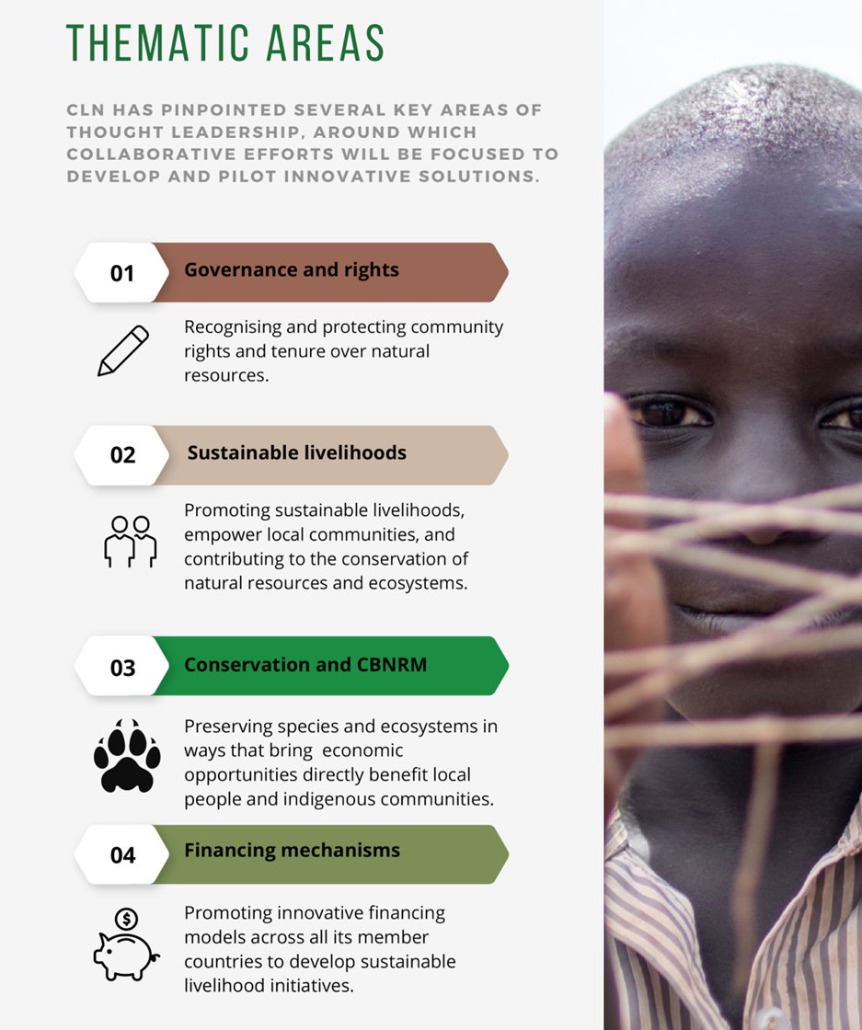
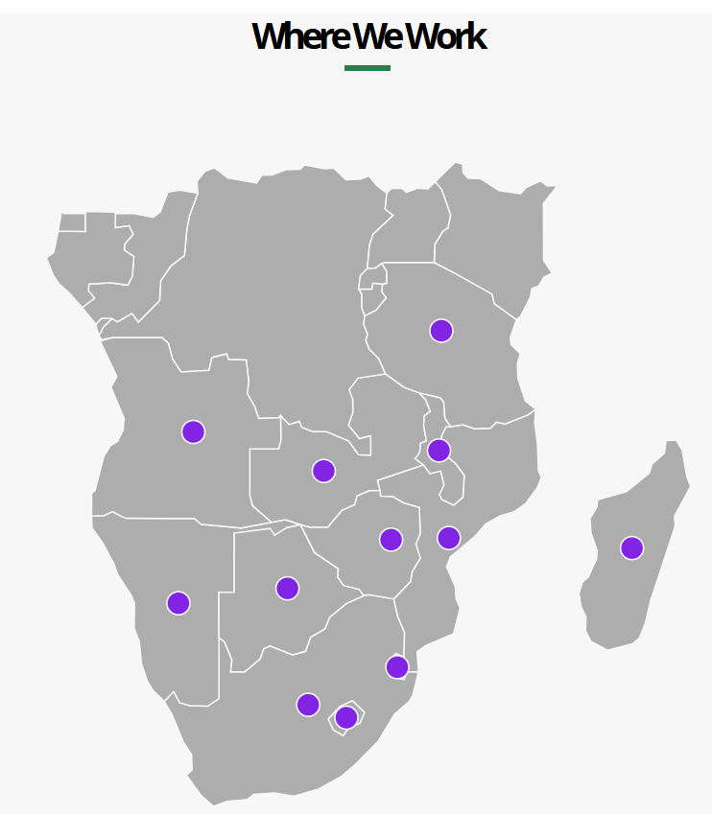

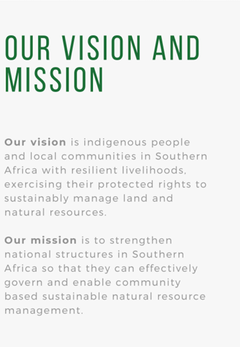
SUBHEADER
Achieving Climate Justice through the Biocultural Rights of Indigenous Peoples and Local Communities
5

Slide 6
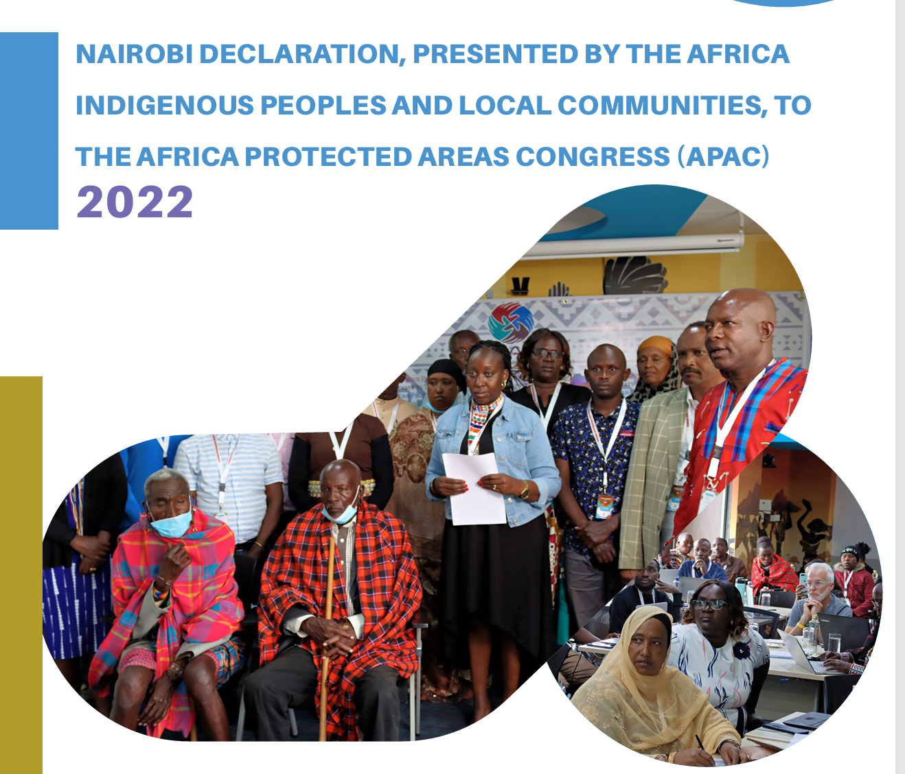
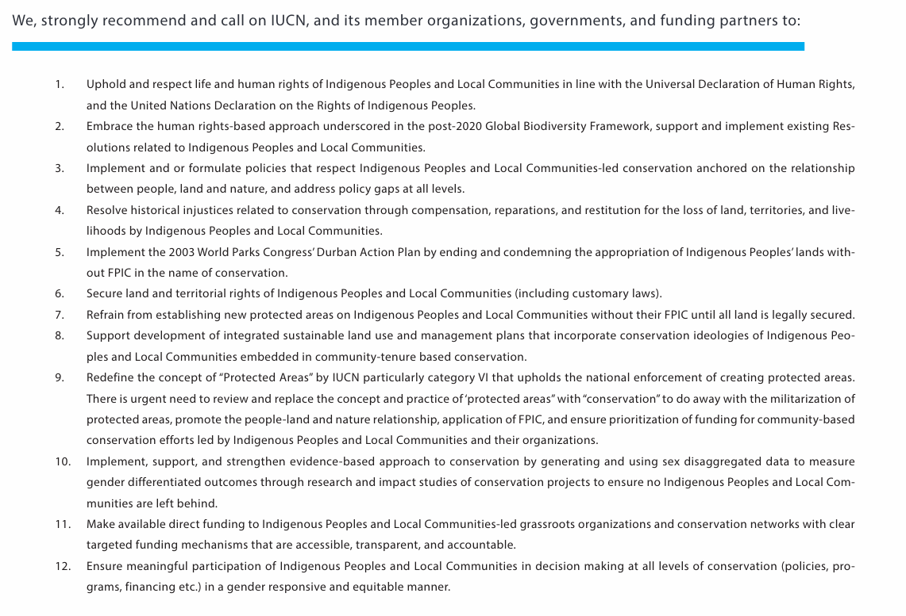
AFRICA: INDIGENOUS PEOPLES
SUBHEADER
Achieving Climate Justice through the Biocultural Rights of Indigenous Peoples and Local Communities
6

Slide 7
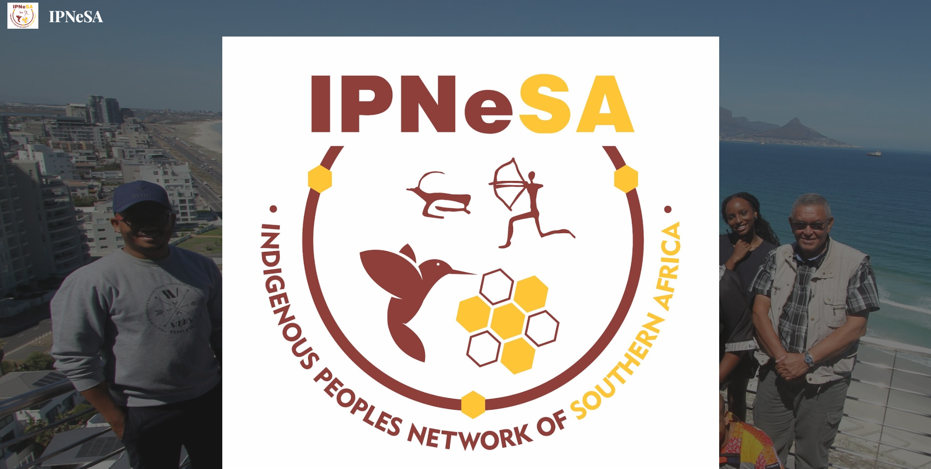
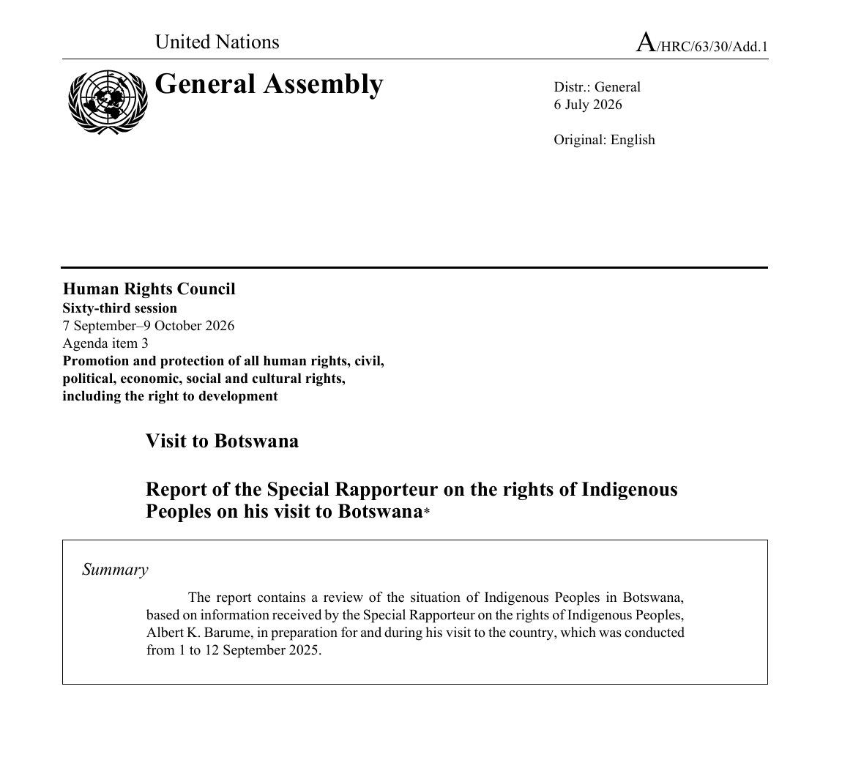
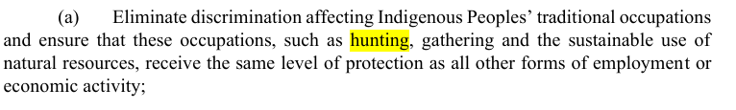
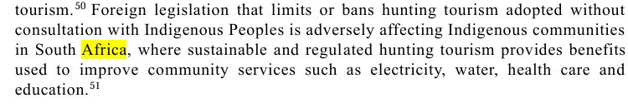
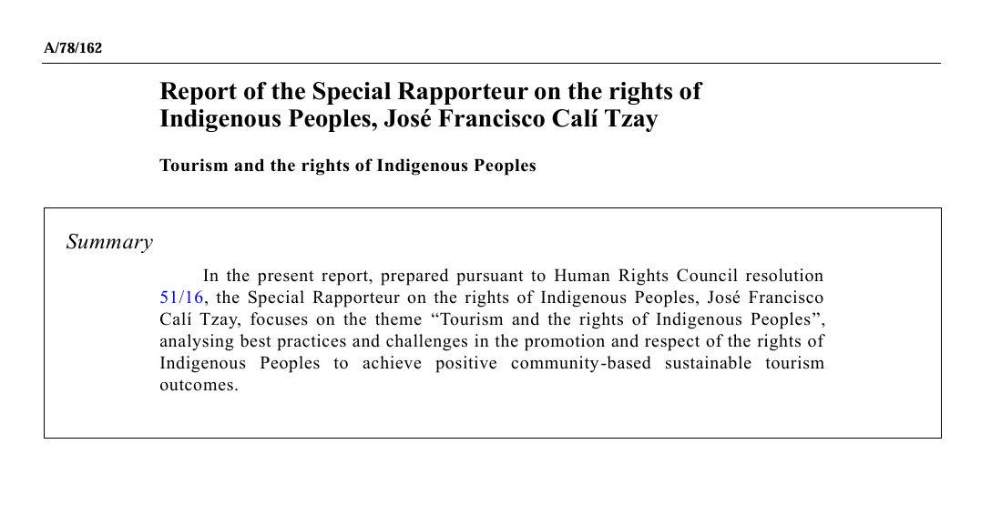
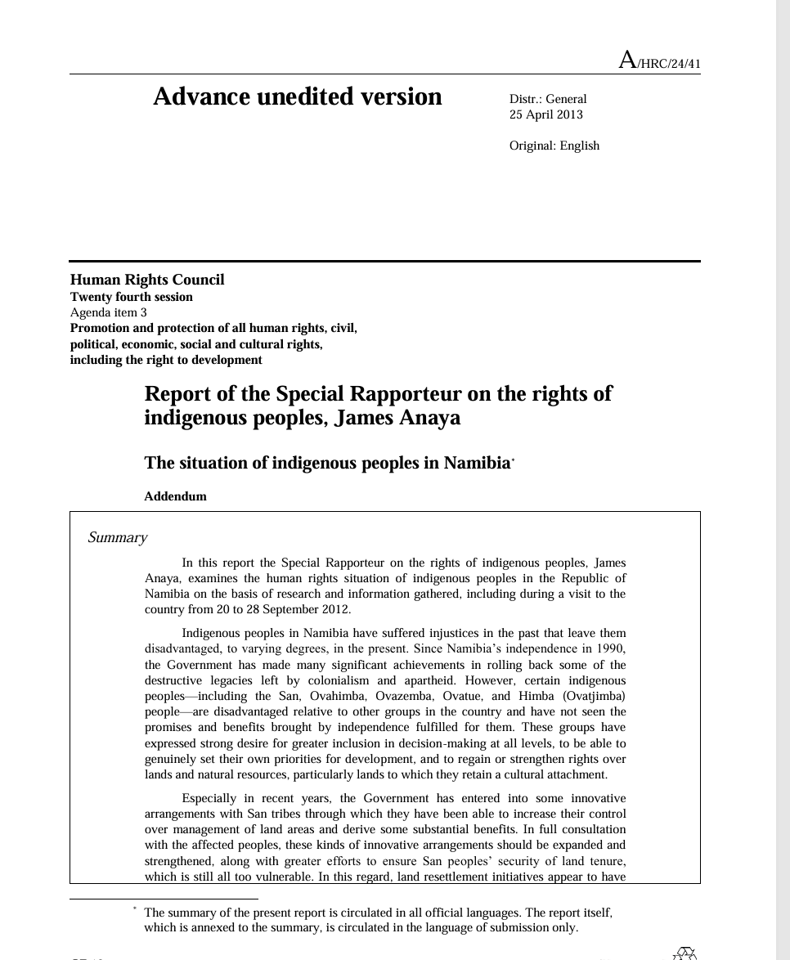
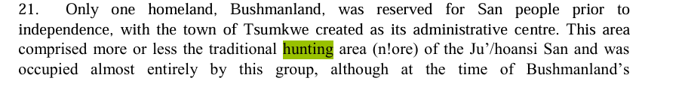
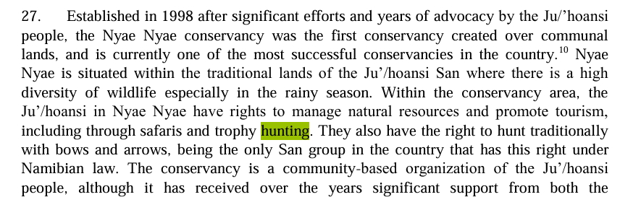
Achieving Climate Justice through the Biocultural Rights of Indigenous Peoples and Local Communities
7

Slide 8
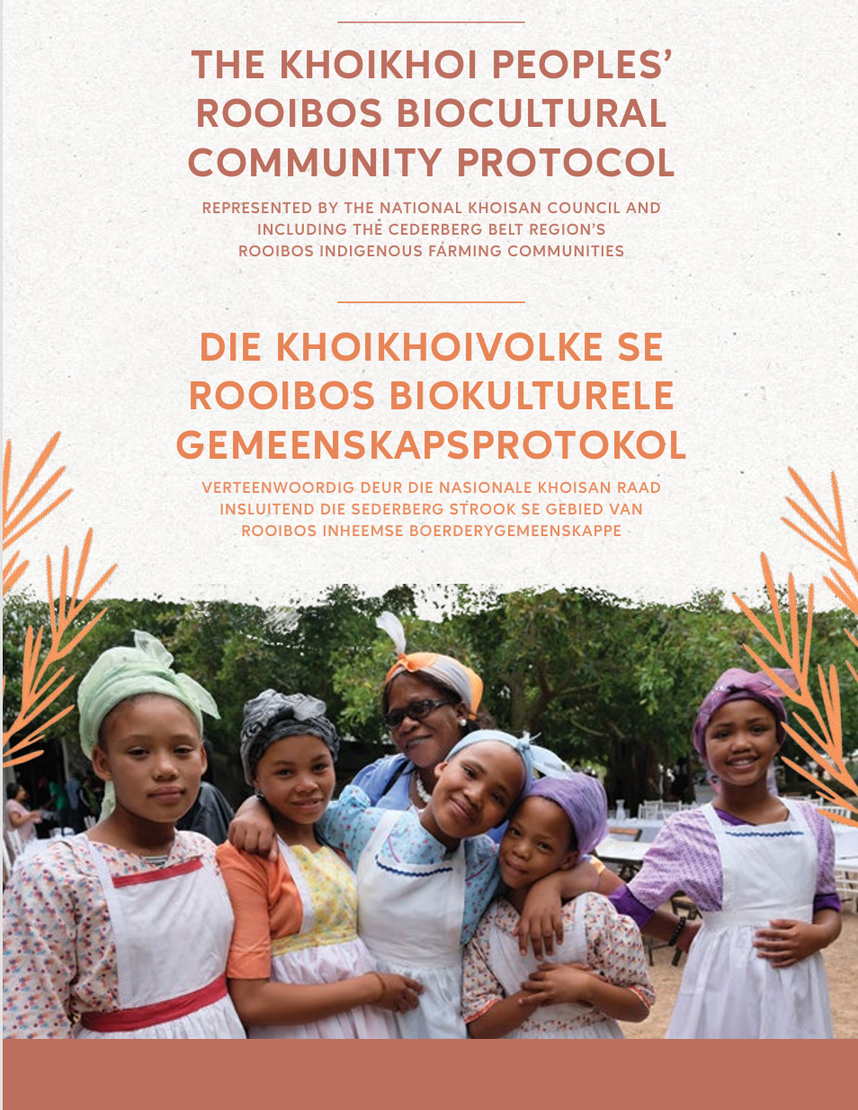
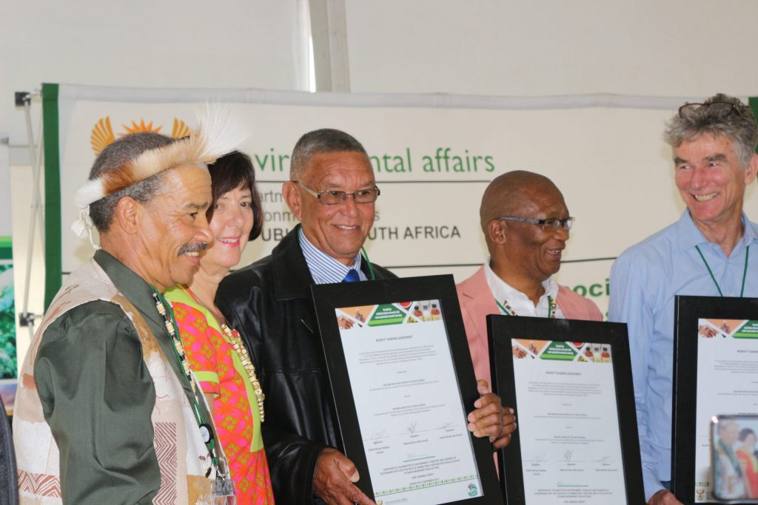
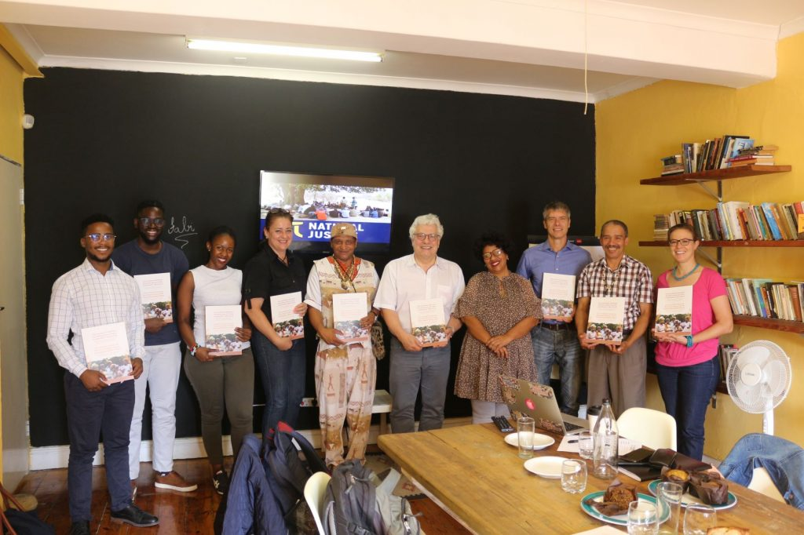
GLOBAL COOPERATION EXAMPLE:
GIZ, ABS Initiative & IPs
ROOIBOS INDUSTRY & INDIGENUS PEOPLES:
SOUTH AFRICA
Achieving Climate Justice through the Biocultural Rights of Indigenous Peoples and Local Communities
8

Slide 9

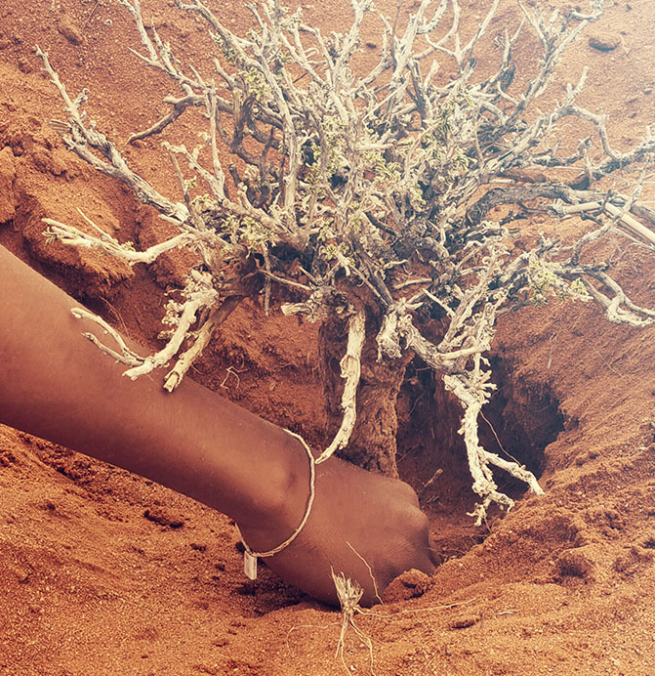
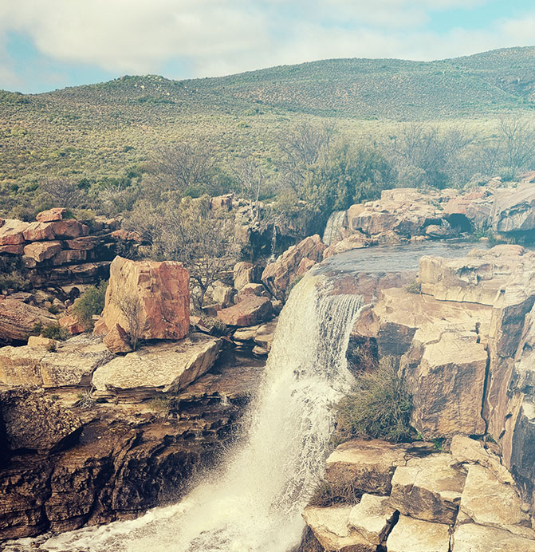

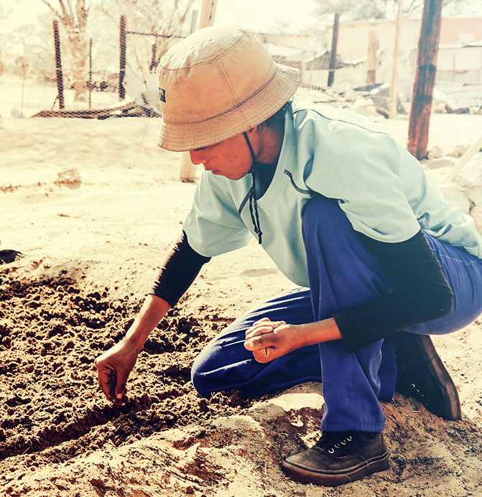
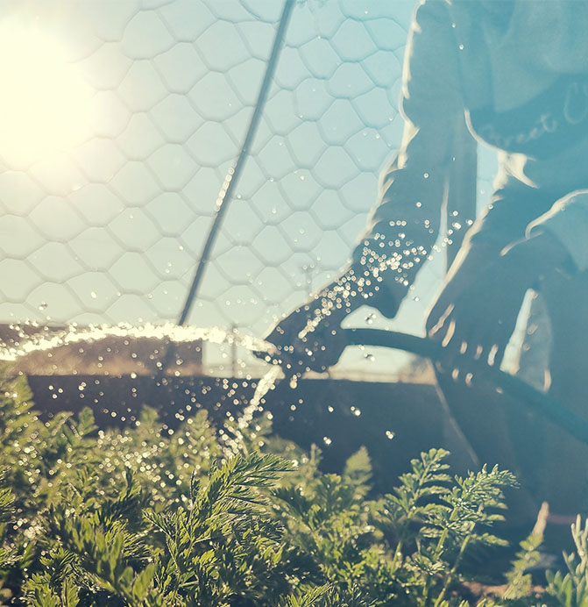
WAY FORWARD:
-Collaboration model
-Resource Mobilisation
-Human rights based approach
Article 8J Programme of Work
NBSAPs
Achieving Climate Justice through the Biocultural Rights of Indigenous Peoples and Local Communities

Slide 10
