Slide 1
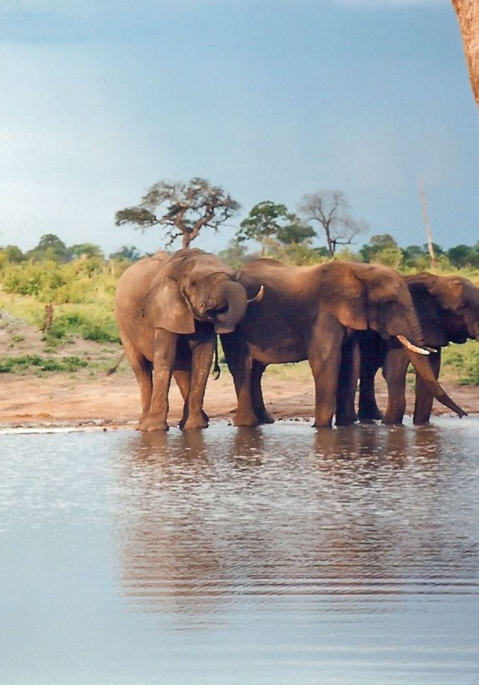
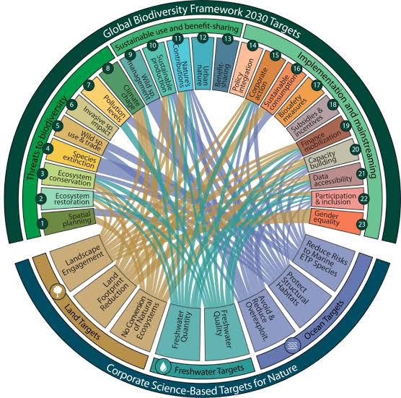

Zimbabwe Parks and Wildlife Management Authority
Implementing the Kunming-Montreal Global Biodiversity Framework and the lessons that can be drawn from Zimbabwe: Southern Africa
13 October 2026
EU-Southern Africa Biodiversity Dialogue
Parliament Building, Brussels, Belgium
Prof. Patience Gandiwa
Director International Conservation Affairs

Slide 2
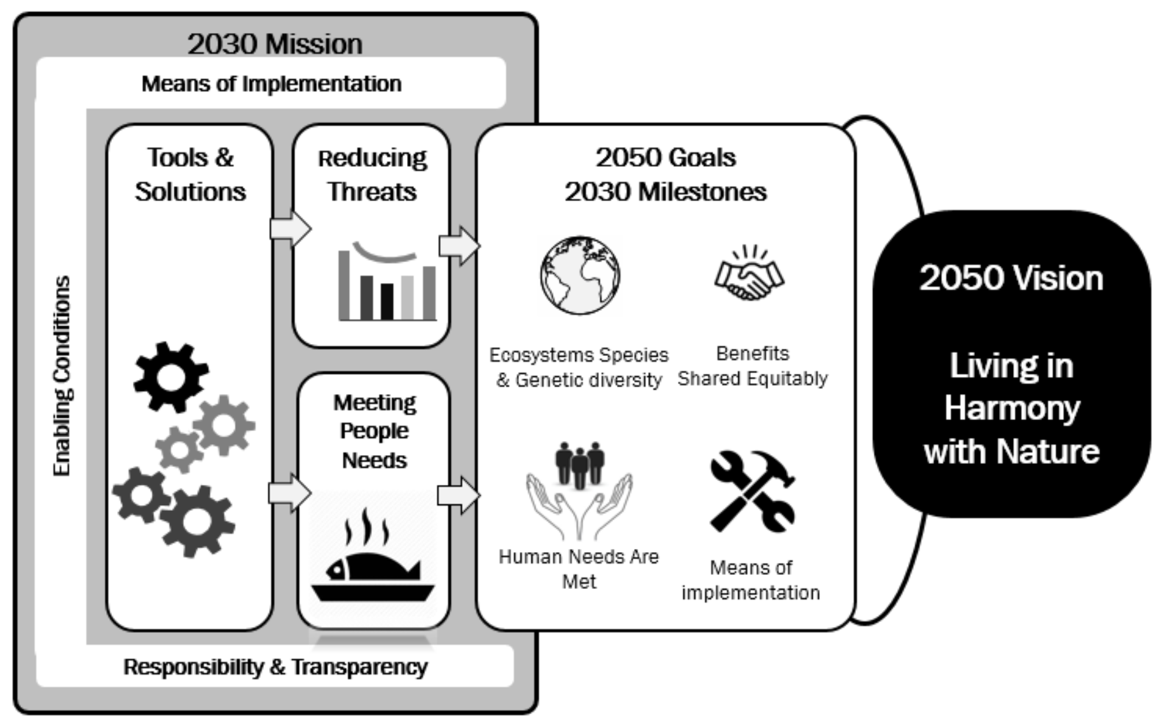
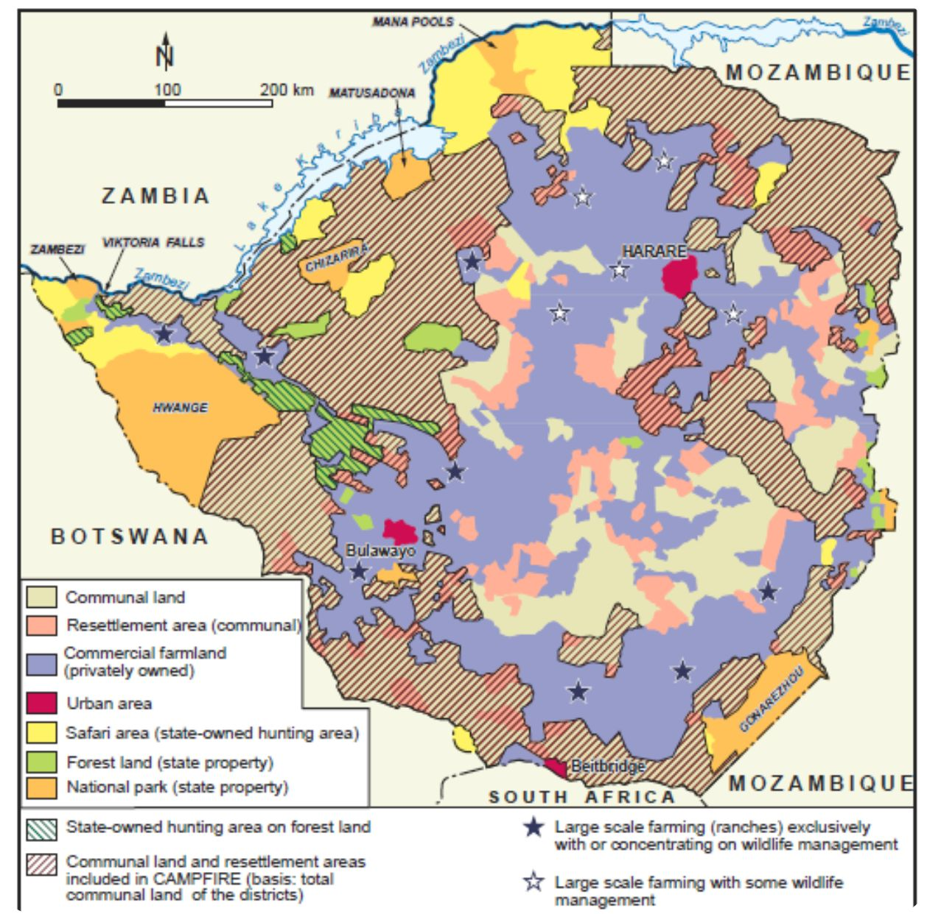
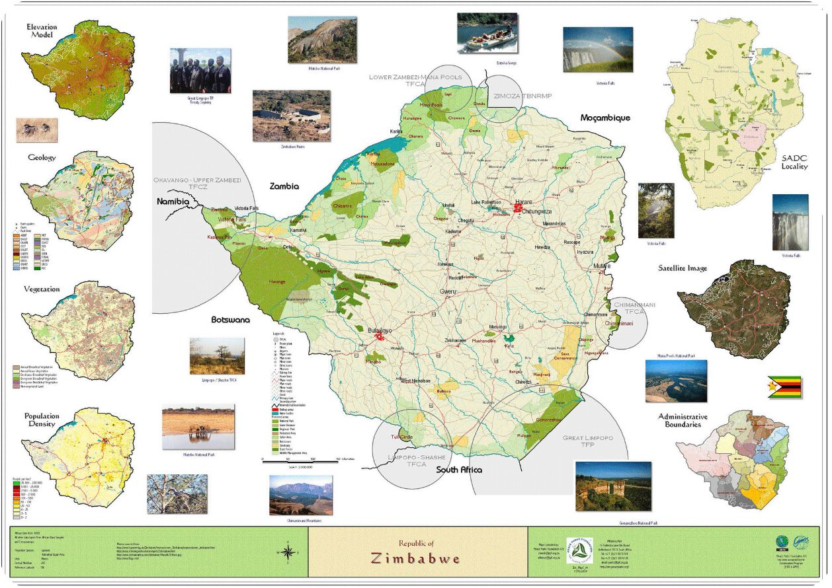
Conservation Beyond Protected Area Boundaries
CAMPFIRE Programme Areas
Transfrontier Conservation Areas (TFCAs)
Zimbabwe participates in six TFCAs, securing space for wildlife to roam across international boundaries and enabling compatible land use options that benefit local communities:
Lower Zambezi–Mana Pools
ZIMOZA TFCA
KAZA TFCA
Chimanimani TFCA
Greater Mapungubwe TFCA
Great Limpopo TFCA
The Communal Areas Management Programme for Indigenous Resources (CAMPFIRE) covers 55,000 km² (11% of Zimbabwe), expanding habitat — particularly for elephants — well beyond the formal protected area network. It supports community-based conservation and development in rural communal areas.

Slide 3




Guiding Policy & Legal Framework
ZimParks operates within a multi-scale, multi-faceted policy and legal framework spanning local, regional, and global levels, ensuring its conservation work is both legally compliant and internationally aligned.
International Obligations
CBD, CITES, CMS, SADC Protocols and Strategies, Guidelines and Resolutions; Integrated Development Plans in TFCAs such as KAZA and the Greater Mapungubwe TFCA.
National Policy Framework
National Wildlife Policy; 5-Year Strategic Plan (2026–2030) aligned to the Ministry's Strategic Plan, NBSAP and NDS2; Research Strategy.
Operational Plans
Area-specific Protected Area Management Plans, Fire Management Plans, Annual Operation Plans, Workplans, and Performance Contracts in line with the PECOG Act.
Species-Specific Plans
National plans for Elephant, Rhino, Lion, Cheetah, Wild Dog, Vulture, and management strategies for invasive exotic species requiring elimination.

Slide 4
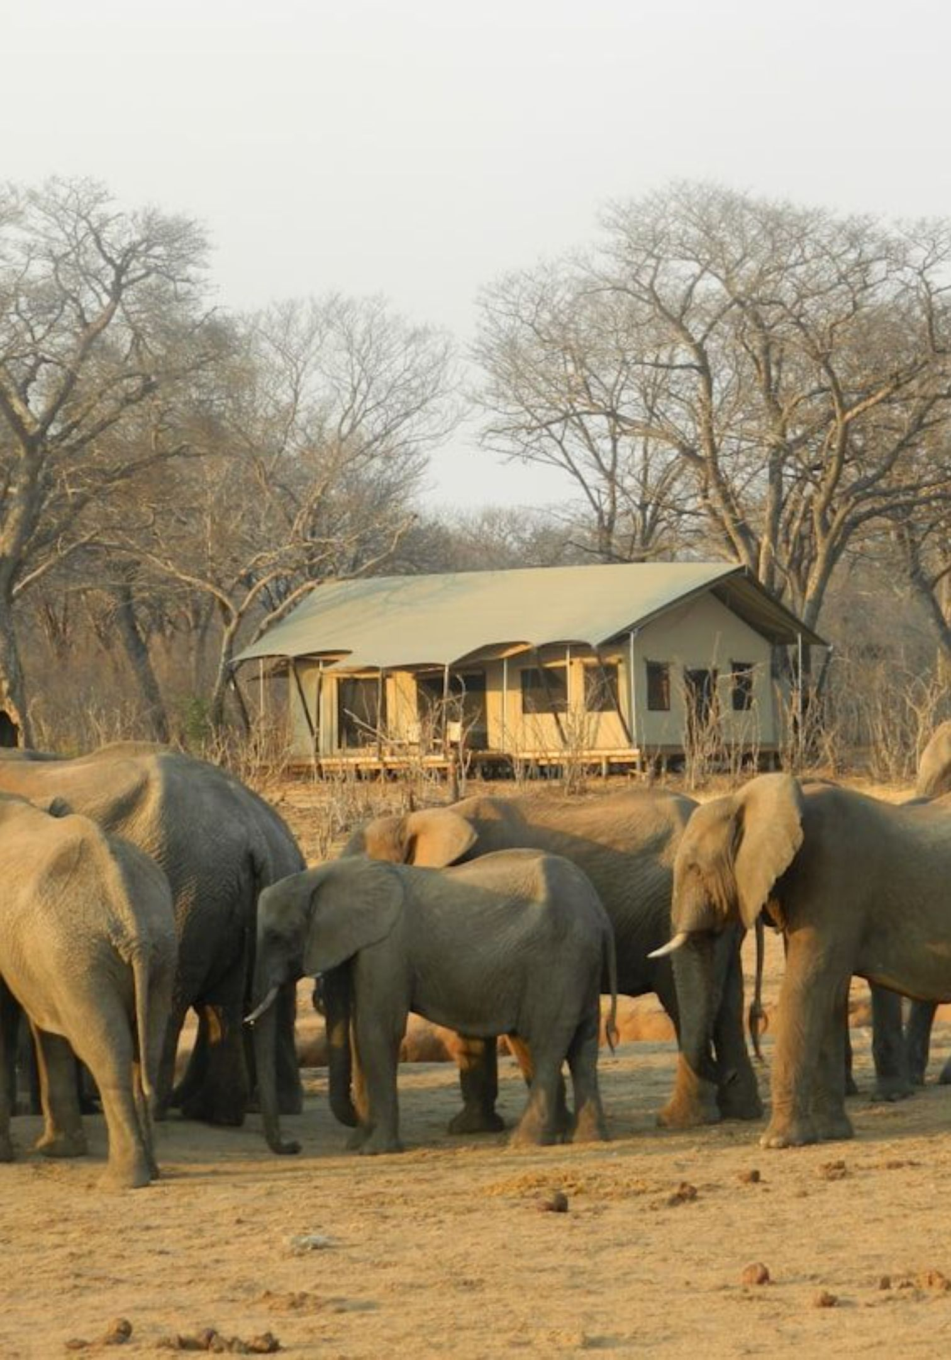
Zimbabwe's Extraordinary Wildlife Heritage
The country supports over 5,930 vascular plant species (214 endemic), 670+ bird species, 270+ mammal species, 256+ reptile species, 120 amphibian species, and approximately 151 fish species.
2nd
4th
Elephant Population
Rhino Population
Zimbabwe holds the world's 2nd largest elephant population, estimated at approx. 100,000 individuals.
Zimbabwe hosts the world's 4th largest rhino population, with both Black and White rhino sub-species represented.
1st
KAZA Carnivores
The KAZA landscape, anchored in Zimbabwe, supports the largest carnivore population in Africa — including lion, leopard, and wild dog.

Slide 5
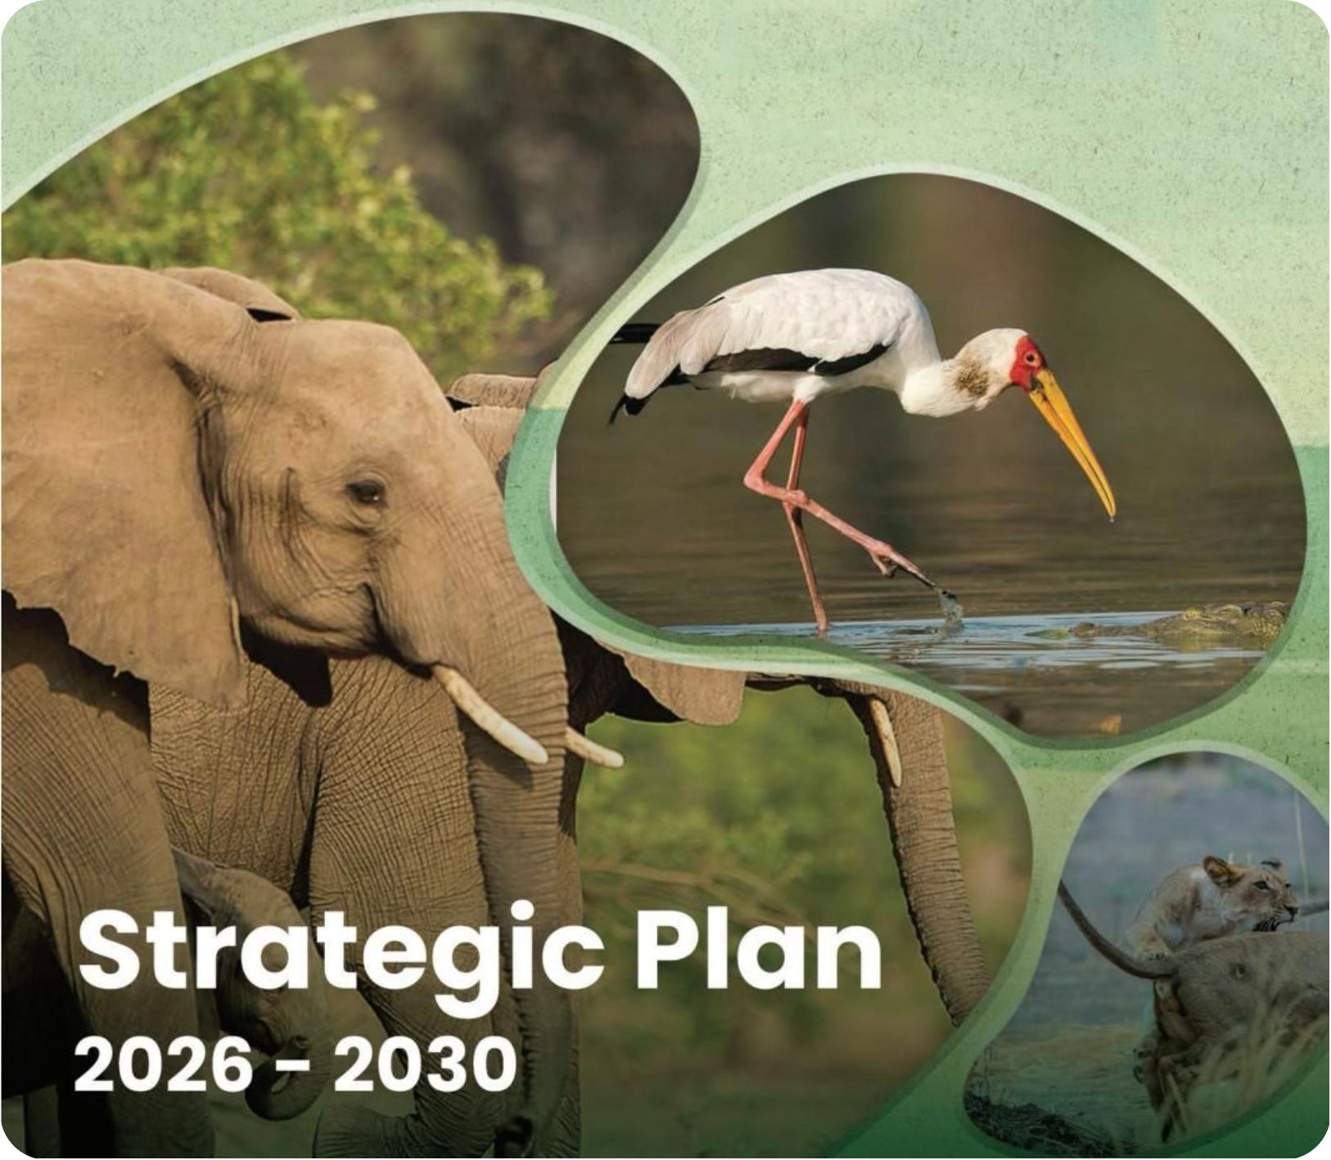
Our Success Formula: What has worked?
Defined in the Parks and Wildlife Amendment Act, No. 4 of 2025 and a clear mandate
Implementation of Blue-Prints
Whole-of Government and Whole-of-Society approach
Wildlife & Habitat Management
Sustainable Utilisation
Managing and protecting wildlife populations and their natural habitats across the entire Parks and Wildlife Estate.
Enabling the responsible use of wildlife resources, including photographic tourism, hunting, and fishing, within sustainable limits, informed/guided by science
Innovative & Adaptive Conservation Model
Partnerships and Resource Mobilisation
Developing and implementing innovative conservation initiatives that addresses emerging threats and opportunities at species, population, and ecosystem levels.
Judiciously balancing the conservation mandate with the need for financial self-sufficiency, including commercial activities to mobilise resources for conservation.
Recognition and Empowerment of People Living in Biodiversity Rich Areas
Growing the wildlife economy and promoting stewardship together with the frontline stewards: Stakeholders, Stockholders & Stickholders in a multifaceted, multi-level approach

Slide 6
What has worked at grassroots level in Zim
Conservation Operations
Research, Monitoring & Scientific Services
On-the-ground management of PCAs, anti-poaching patrols, law enforcement, and day-to-day activities in line with approved plans.
Wildlife research, ecological monitoring, species management plans, and science/evidence-based conservation policy guidance & management. Value-Driven Protection (GBF Targets 5 & 9)
Ecotourism & Commercial Services
Finance, ICT Application & Administration
Revenue generation through tourism, concessions, safari hunting, and other commercial activities that fund conservation in PCAs. Role of Private sector and Community-based stewardship
Innovative and effective financial management, meeting human resources needs, administration, and procurement
International Conservation Affairs
Legal & Corporate Affairs
Managing international obligations, transfrontier conservation areas/TFCAs, and bilateral conservation partnerships-Joint Commissions & BNCs. LEAP strategy
Legal compliance at all levels, corporate governance, and regulatory oversight within and beyond PAs.
Collaborations & Partnerships that support local communities in a meaningful way
Hwange, Matetsi, Matusadona, Gonarezhou, Chipinge, Greater Mana Pools, Chewore, Tuli Circle….

Slide 7
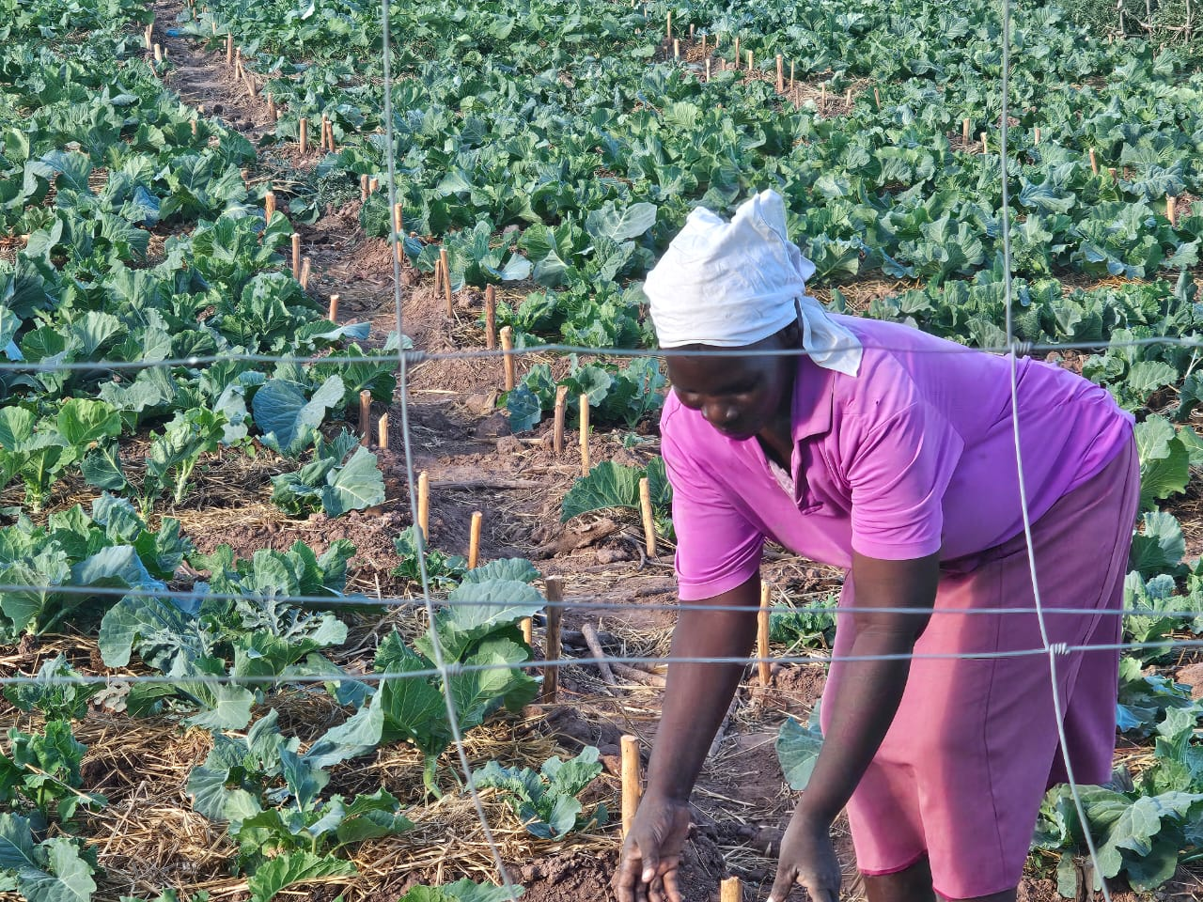
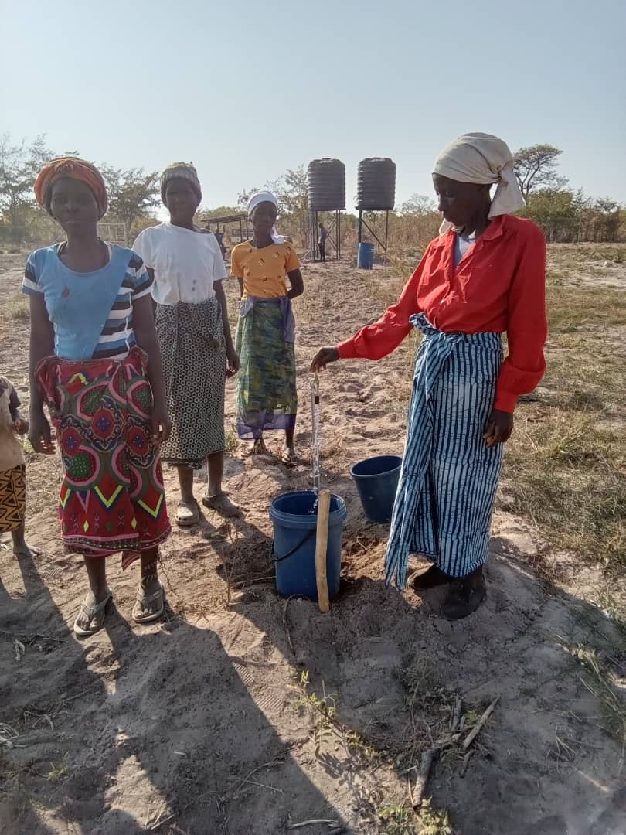
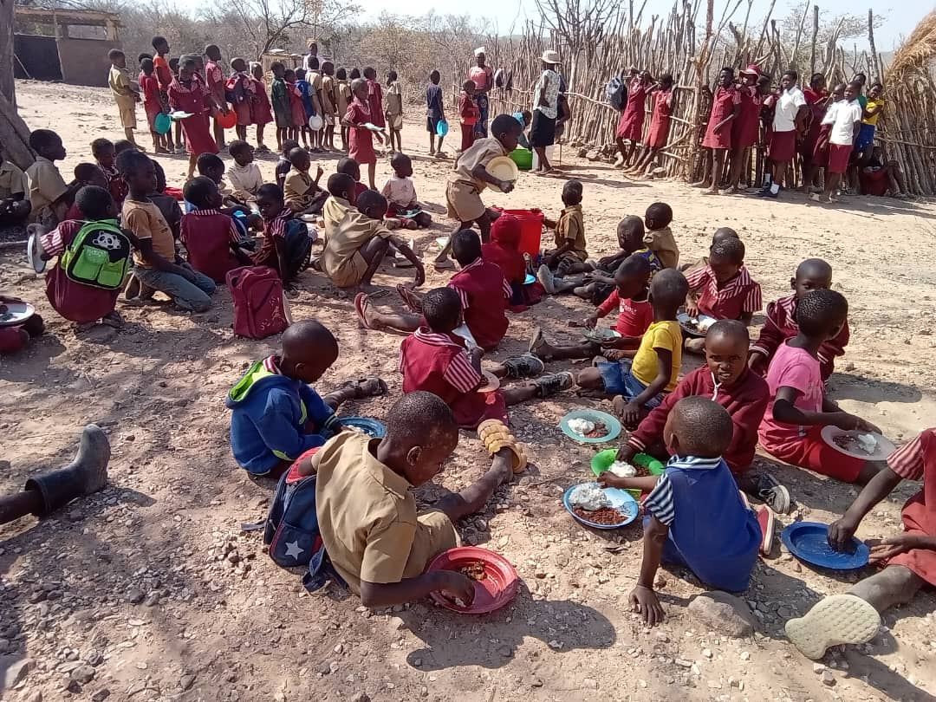
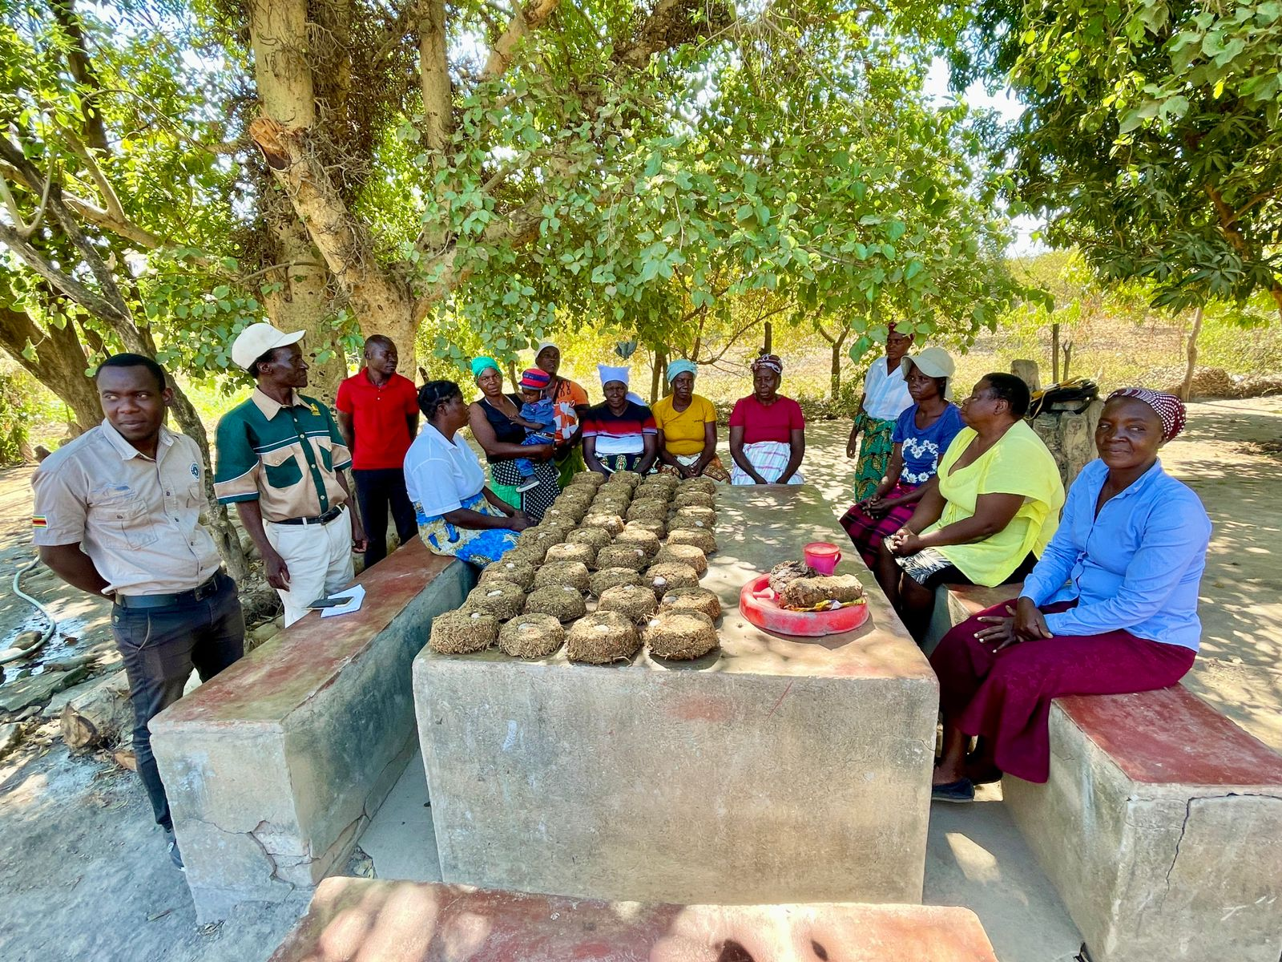
Matusadona Conservation Trust
Community Livelihoods Support Initiatives
Nutrition gardens
Portable water supply
Human wildlife conflict mitigation initiatives
School feeding program

Slide 8
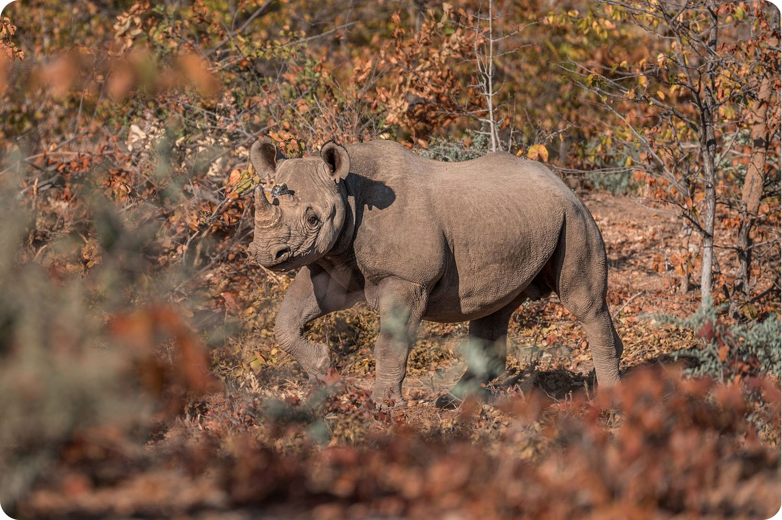
Target Trekking-Monitoring & Evaluation: Example: Q3 2026 Outcome 2 — Biodiversity Conservation
Wildlife Conservation: Poaching & Rhino Range
Elephant Poaching
4 elephants poached in Q3 2026, down from 10 key species in 2025. Rate: 0.02% vs. 0.01% target on a national population of Approx 100,000 individuals
Rhino Poaching
No rhinos were poached in Q3 2026. National rhino population stands at 1,406.
Rhino Range Expansion
-Black rhinos reintroduced at Matusadona NP (100% of plan).
-
White rhinos reintroduced at Nakavango, Stanley & Livingstone Reserve near Victoria Falls — 100% achievement vs. 50% quarterly target.

Slide 9
What we need to deliver more
# | Issue | Intervention Required
1 | Revamp, Refurbish & Repair infrastructure in protected and conserved areas | Some key infrastructure like road and bridges continue to be destroyed by climate change induced extreme weather events
2 | Community voice in MEA negotiations Access & Benefit Sharing MLM that delivers | Having a permanent forum on Art.8J is one thing, making it work for communities is another Capacitation and Facilitation to have stronger community voice MEA negotiations beyond the CBD
3 | Sustainable Trade in wildlife products | Sustainable and Legal trade should remain in our toolbox of options. Blanket trade bans may yield opposite results and dis-incentivise strong conservation models in SADC if not carefully considered.
4 | Wildlife Economy & Resource Mobilisation | There are opportunities for partnerships and investment for nature & people to unlock SADC Wildlife Economy potential
5 | Robust and innovative policy | Continuous reviews – OECM Framework, EMS for TFCA initiatives, Human Wildlife Coexistence Strategy
6 | Competing claims on natural resources (e.g., encroachments, rehabilitation, restoration, quelea) | Cross-sectorial engagements and supporting cooperation across MEAs. Promoting synergies at all levels
7 | Role of Wildlife in Climate Action | Support the declaration (and subsequent efforts) to recognize the role of wildlife in climate action at COP31
8 | Africa’s voice on wildlife matters | Africa needs Unity not division, support for AMCEN & AUC

Slide 10




Taking Action for Nature @ COP17
IT CANNOT BE BUSINESS AS USUAL
7th national reports: the world is falling short on 22 of the 23 Kunming-Montreal Global Biodiversity Framework (KMGBF) targets set for 2030. Guidelines for implementation of GBF Targets 2 and 3
Evidence Base: Effective Implementation of National Strategies and Action Plans (NBSAPs) requires resources
Inadequate and Uneven Progress: collective ambition falls short of what is required to halt and reverse biodiversity loss by 2030. Progress remains uneven across regions.
Resource Gap: Resource mobilisation and the financial mechanism (including operationalising the Cali Fund for digital sequence information benefit-sharing) remain critical. Target19
Local Authorities and Community-Led Conservation: Support for cities, local governments, and rural or Indigenous/local communities to craft localized action plans, recognizing that local stewardship is essential for managing land, wildlife, and inland water/freshwater ecosystems
ACKNOWLEDGEMENTS
https://sciencebasedtargetsnetwork.org/news/blog/what-the-global-biodiversity-framework-means-for-your-business-and-how-to-take-action/

